Slide 1
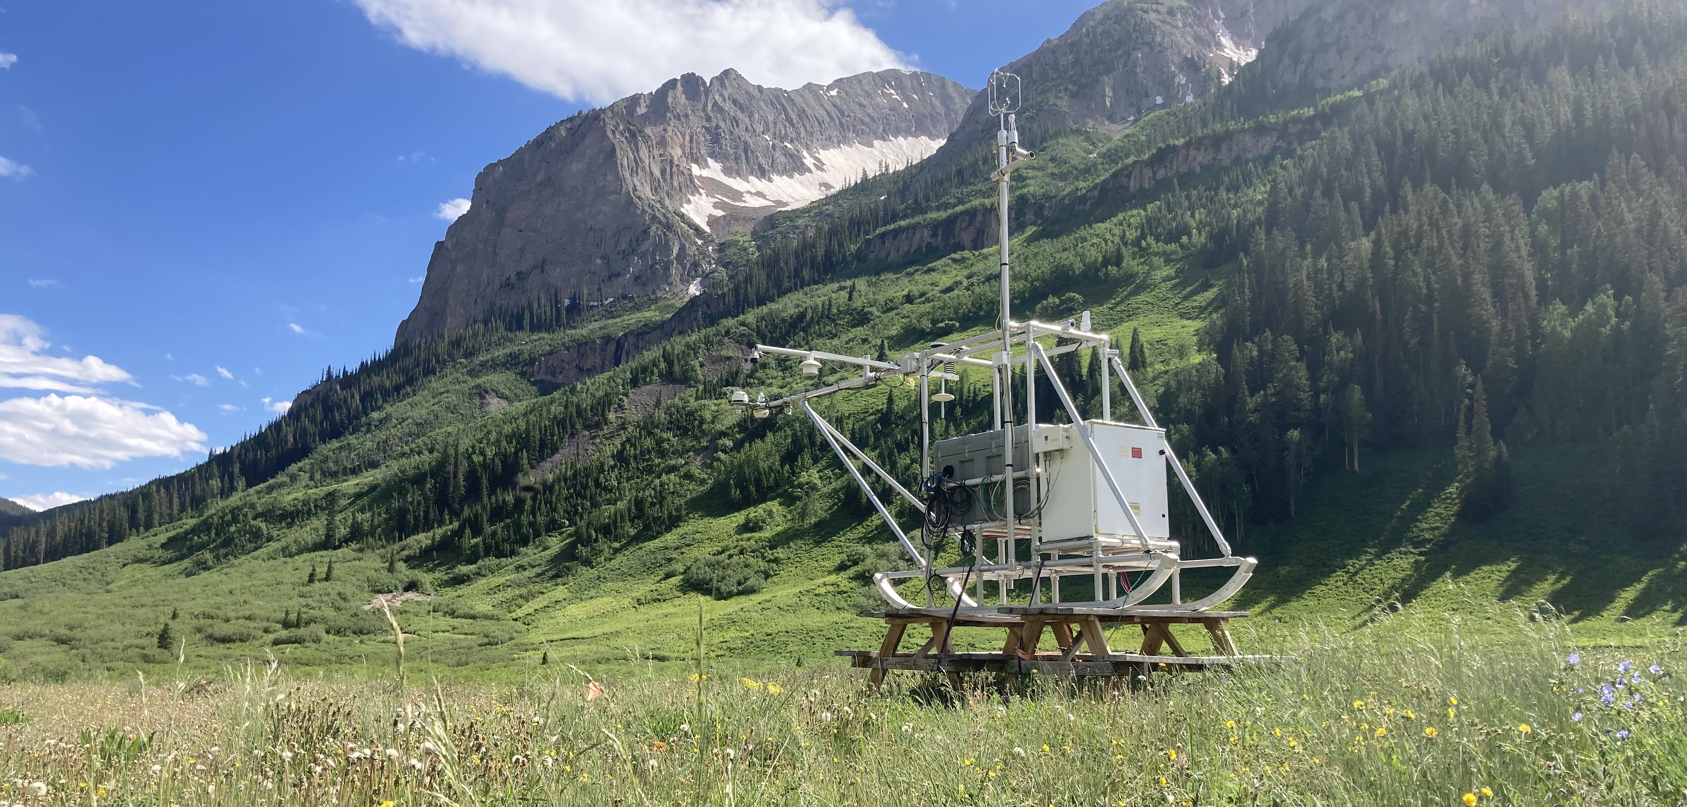
Characterizing the Annual Surface Energy Balance in Gothic Valley during the SPLASH Field Campaign
Brian Butterworth^{1,2}, Christopher Cox², Gijs de Boer^{1,2}, Michael Gallagher^{1,2},
Janet Intrieri², Ola Persson^{1,2}, Matthew Shupe^{1,2}
¹ Cooperative Institute for Research in Environmental Sciences (CIRES), CU Boulder
² NOAA Physical Sciences Laboratory

Slide 2
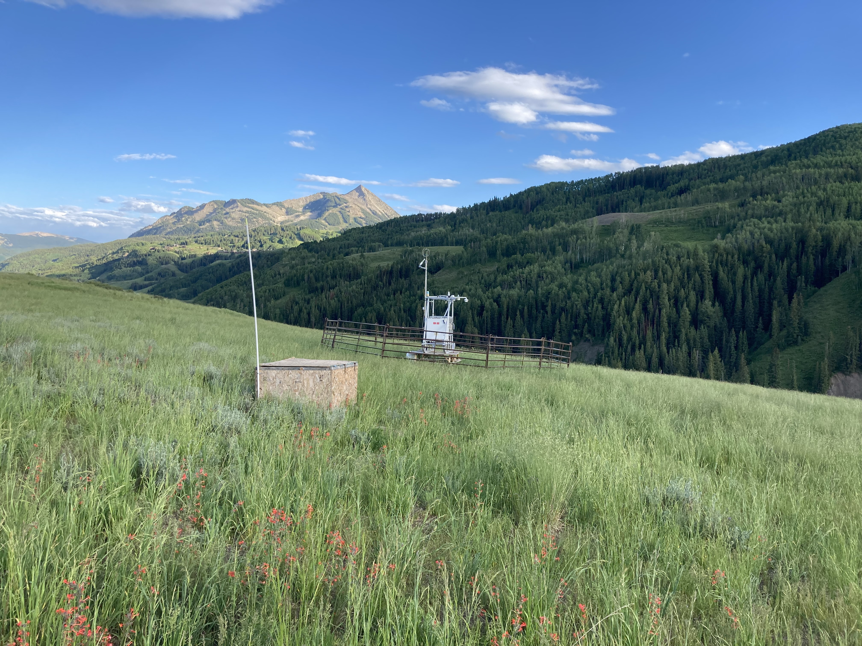
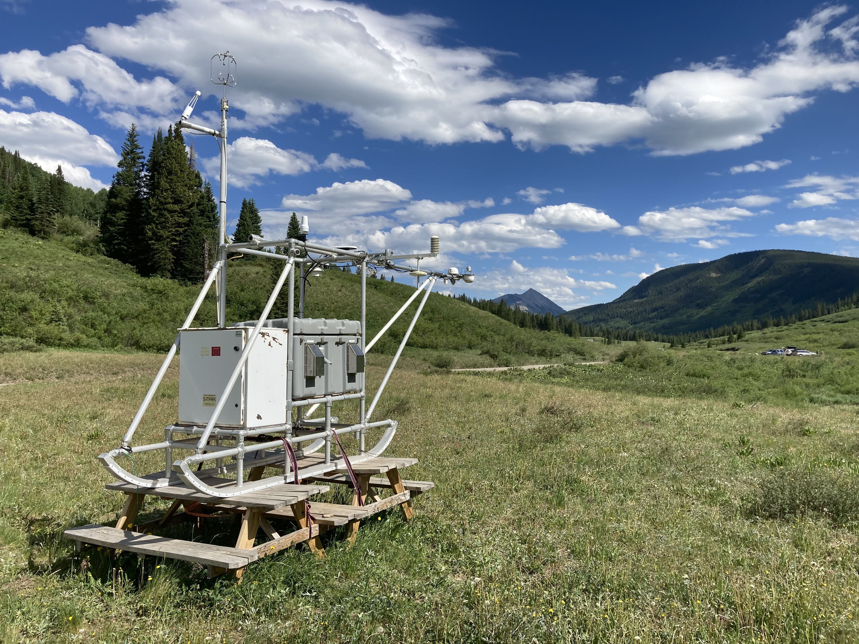
Atmospheric Surface Flux Stations
Here we investigate changes in the surface energy balance that were observed as wintertime snowpack transitioned
to the snow-free
summer environment.
Kettle Ponds Avery
high freq UVW, H₂O, & T
soil flux plates (5 cm)
soil T & VWC (0 - 50 cm)
Near surface T, P, RH, U
System ran continuously
3

Slide 3
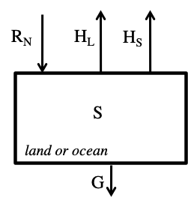
Energy Balance Equation
RN = Net Radiation
G = Ground Flux
HL = Latent Heat Flux
HS = Sensible Heat Flux
S = Storage
$$R_{N}−G=H_{L}+H_{S}+S$$
The Problem:
Energy Balance Non-Closure
It is typical for traditional EC to measure greater incoming energy (net radiation - ground flux) than outgoing energy (sensible + latent heat flux); even though they are expected to balance.
3

Slide 4
As is typical for EC measurements, we observed energy fluxes that were lower in magnitude than the available energy (R_{N} – G), resulting in an energy balance residual (Imb)
A seasonal cycle in Imb was observed – with negative daily mean values in winter and large positive values in summer
Daily mean Imb magnitudes were often larger than each of H_{S}, H_{L}, and G.
4

Slide 5
Snow Melt Period (Avery)
Imbalance increases as snow melt begins
Snow melts over 1 month period
Period coincides with ground water melt
What portion of imbalance is from snow/ground melt energy?
5

Slide 6
Snow Melt Energy Flux
$$melt flux= \frac{m_{water}∙{∆H}_{fus}}{time}$$
$m_{water}$ = mass of water = depth of melt * snow density
${∆H}_{fus}$ = heat of fusion = 334 J / g H2O
6

Slide 7
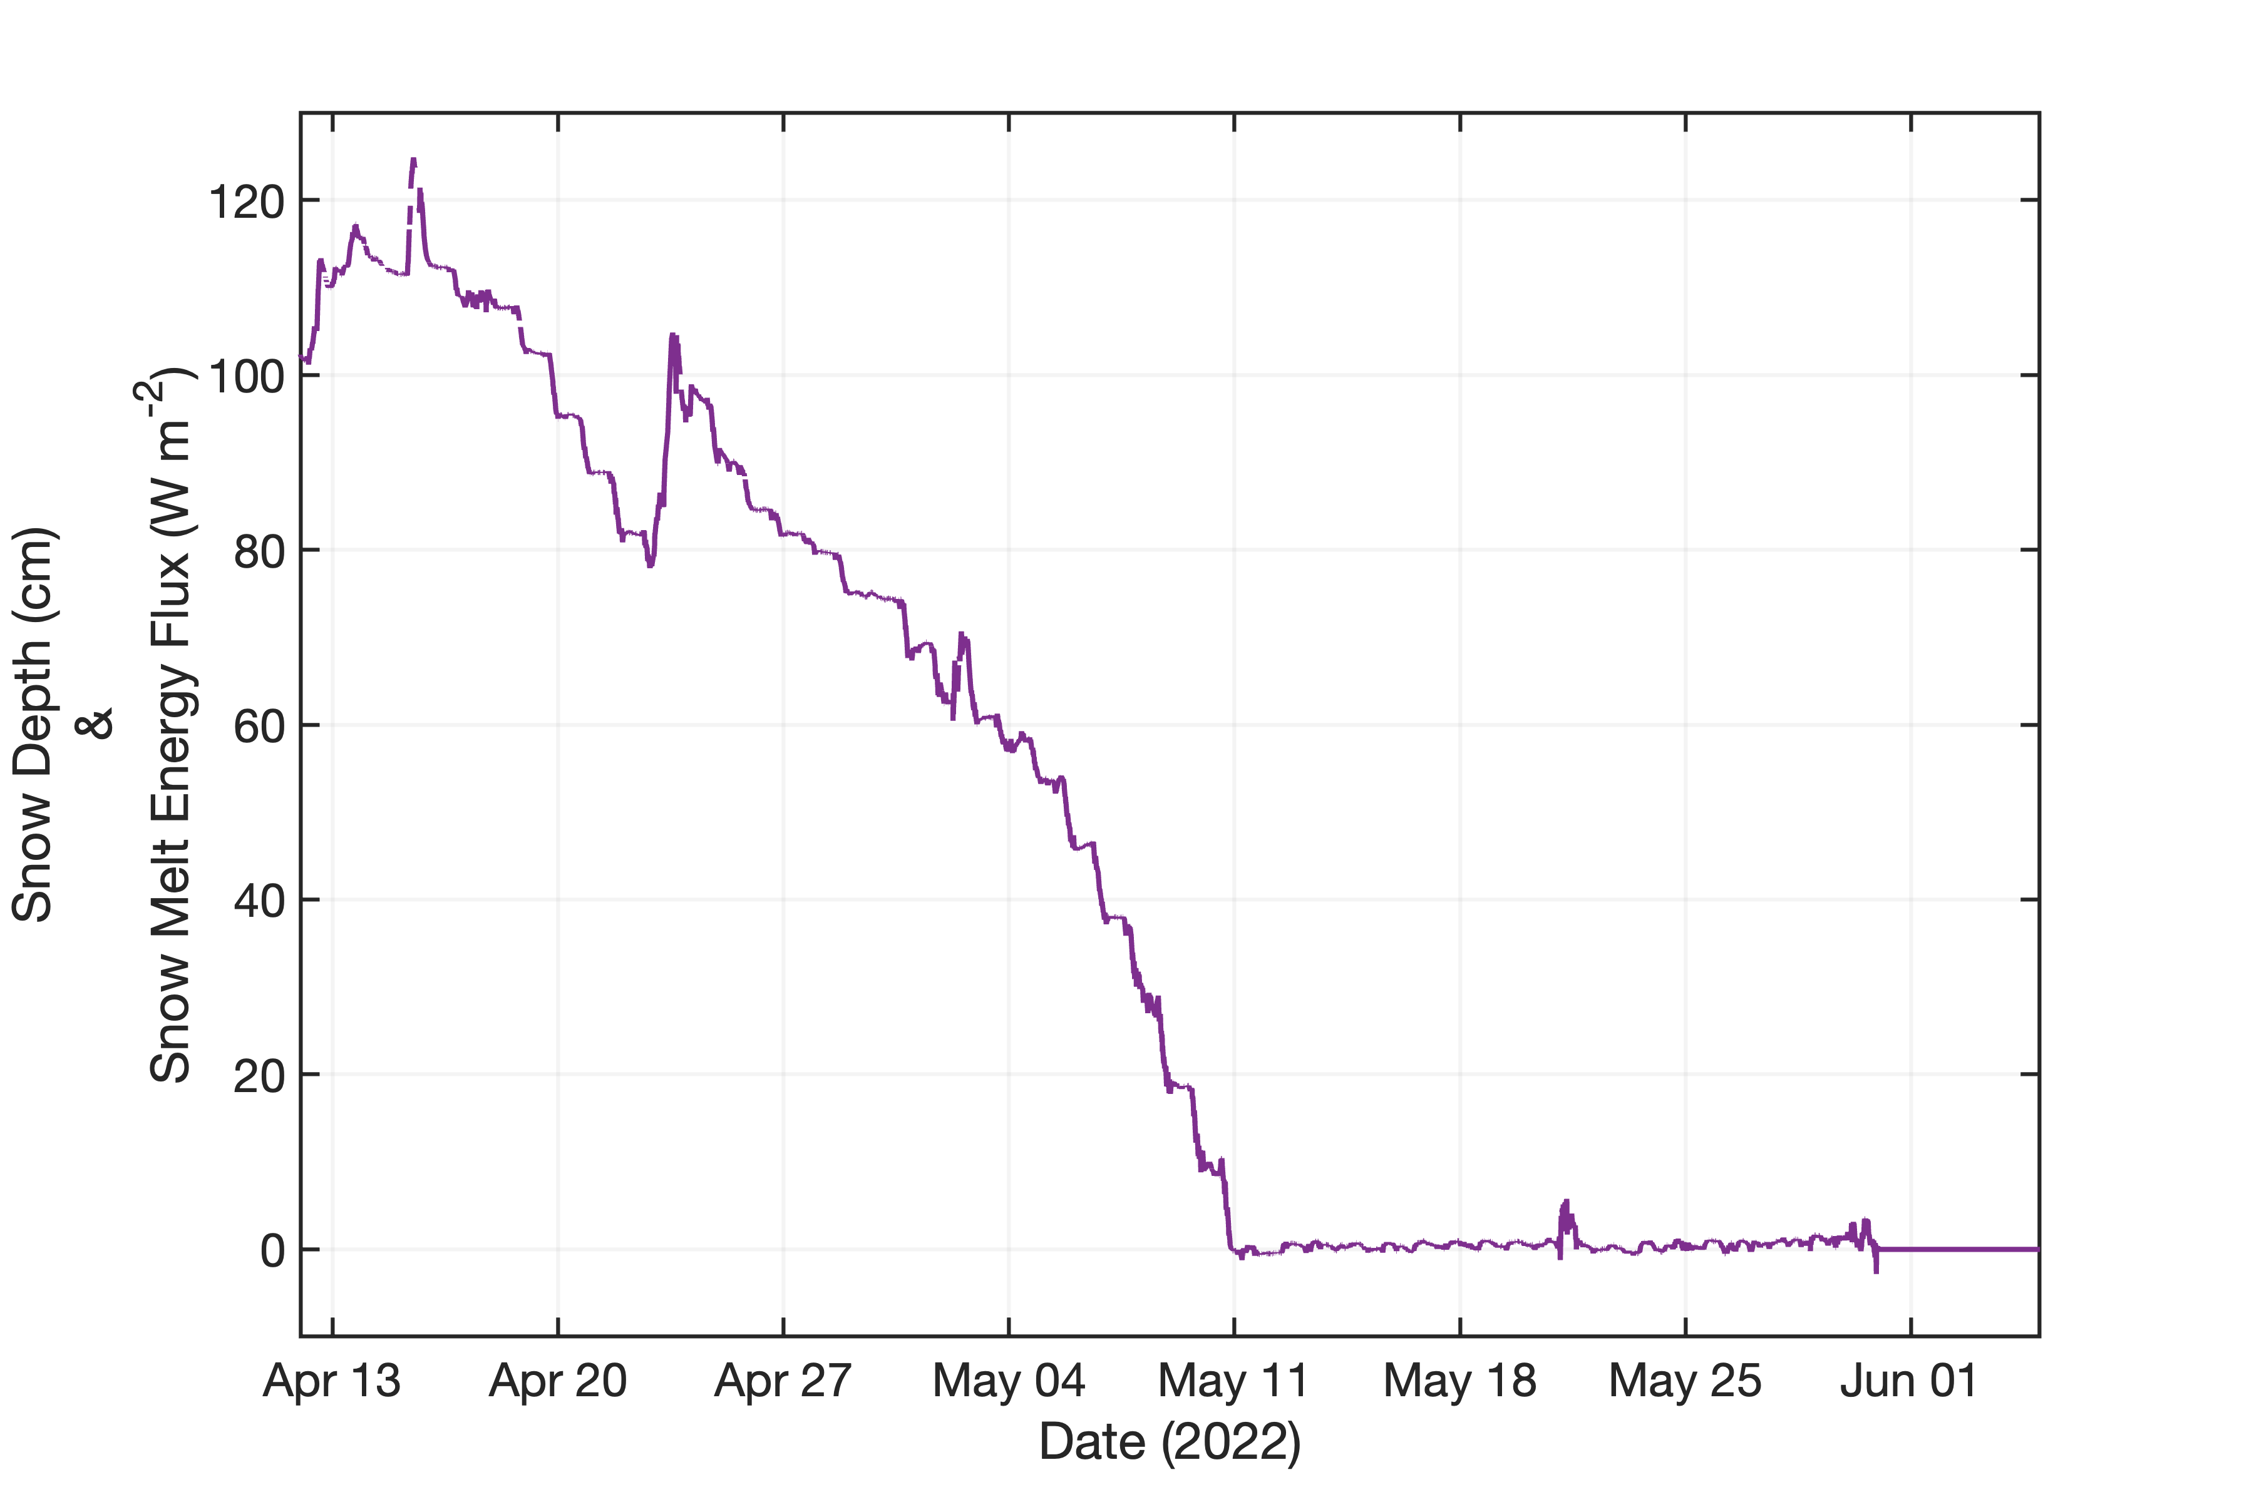
Snow Melt Energy Flux
26 days
Depth of melt =1.2 m
Snow density ~ 0.25
$m_{water}$ = 1.2 m * 1 m² *0.25 = 0.3 m³
$$melt flux= \frac{0.3{ m}^{3} ∙334 \frac{J}{g}∙1e6\frac{g}{m^{3}}}{26 days∙86400\frac{s}{day}}$$
$\overline{melt flux}=$ 45 W m⁻²
1.2 m
7

Slide 8
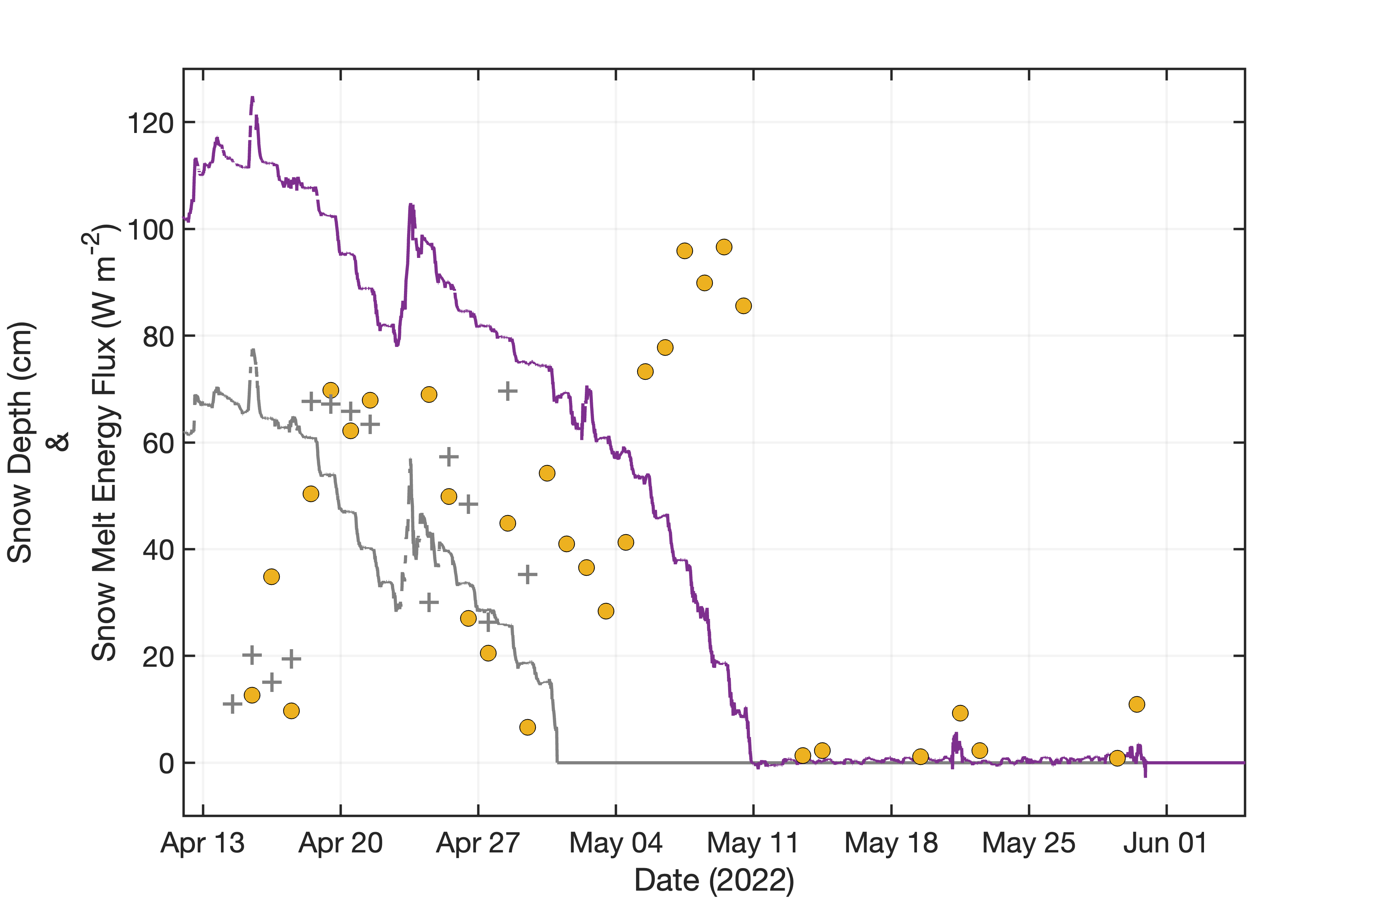
Snow Melt Energy Flux
Avery
$\overline{melt flux}=$ 48 W m⁻²
Kettle Ponds
$\overline{melt flux}=$ 47 W m⁻²
8

Slide 9
SNOTEL
Snow Density = SWE / Snow Depth
Mean snow density was ~25%
Snow density changed throughout season
*Adjustments to
melt flux required
9

Slide 10
Ground Melt Energy Flux
$$ground melt flux= \frac{m_{water}∙{∆H}_{fus}}{time}$$
$m_{water}$ = depth of layer * volumetric water content
$$ground melt flux= \frac{0.5{ m}^{3}∙0.13\frac{m^{3}}{m^{3}}∙334 \frac{J}{g}∙1e6\frac{g}{m^{3}}}{20 days∙86400\frac{s}{day}}$$
$$\overline{ground melt flux}=13 W m^{−2}$$
10

Slide 11
Imbalance minus Melt Energy
Accounting for melt balances the energy budget during snow melt period
Caveats
Doesn’t account for:
Sublimation
Refreezing
11

Slide 12
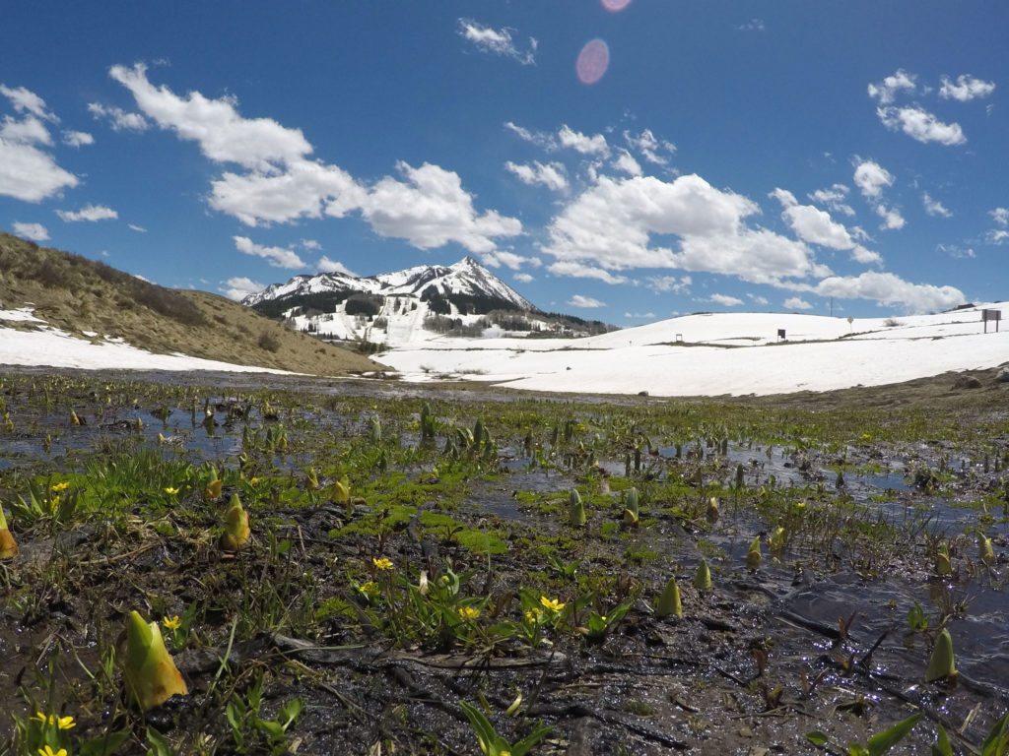
Next Steps
Improve snow density estimate
Determine frozen soil water content
Remove sublimation contribution from melt flux
Identify cause of missing energy during the rest of summer
(Photo credit: Heidi Steltzer)

Slide 14
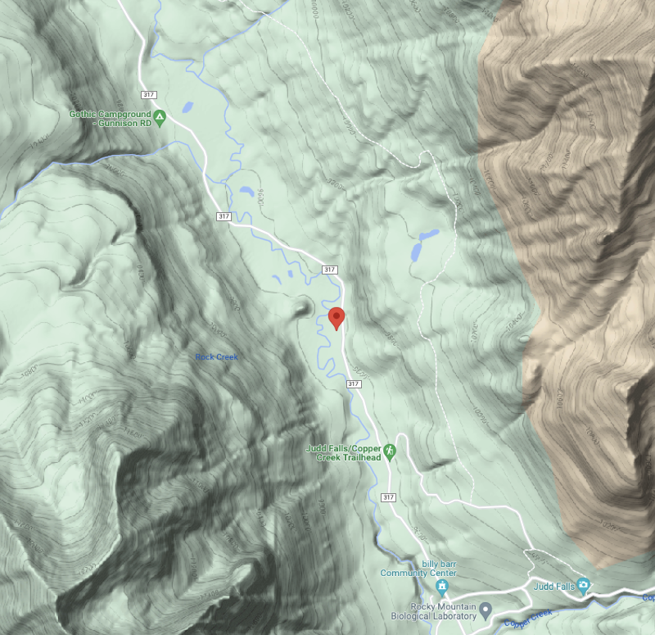
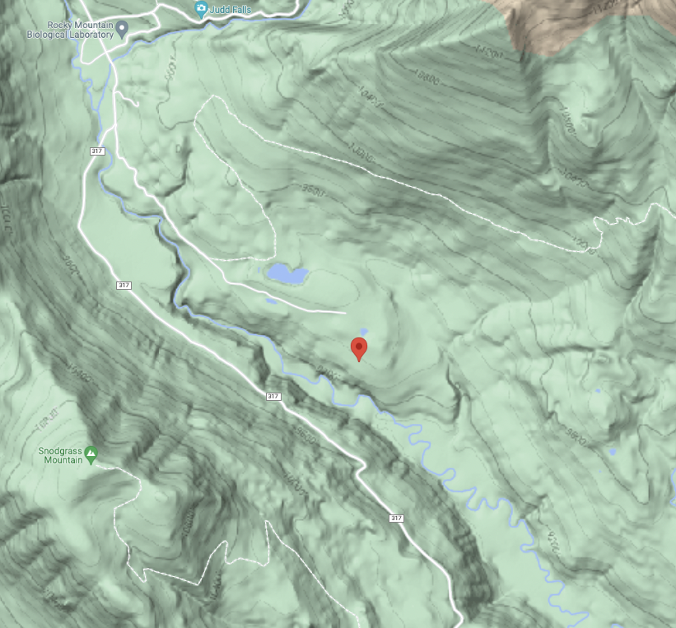
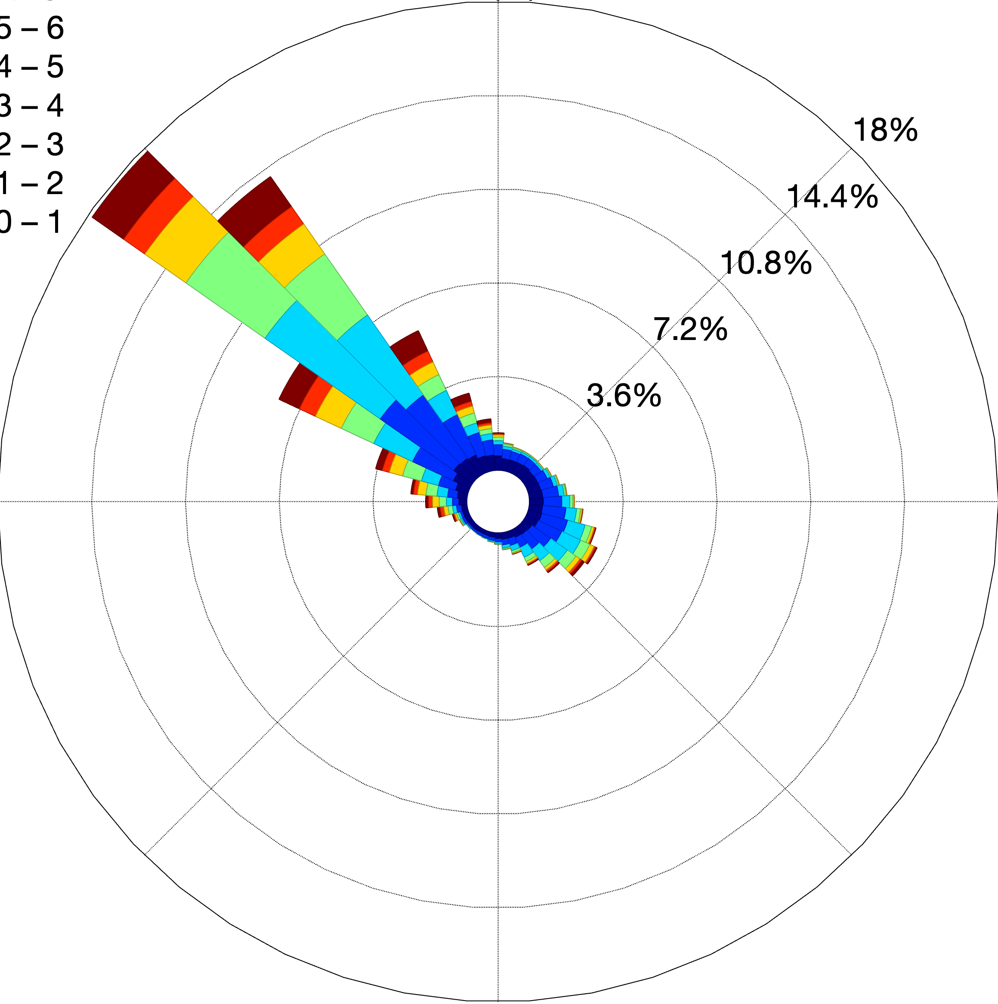
Avery Kettle Ponds
4

Slide 15
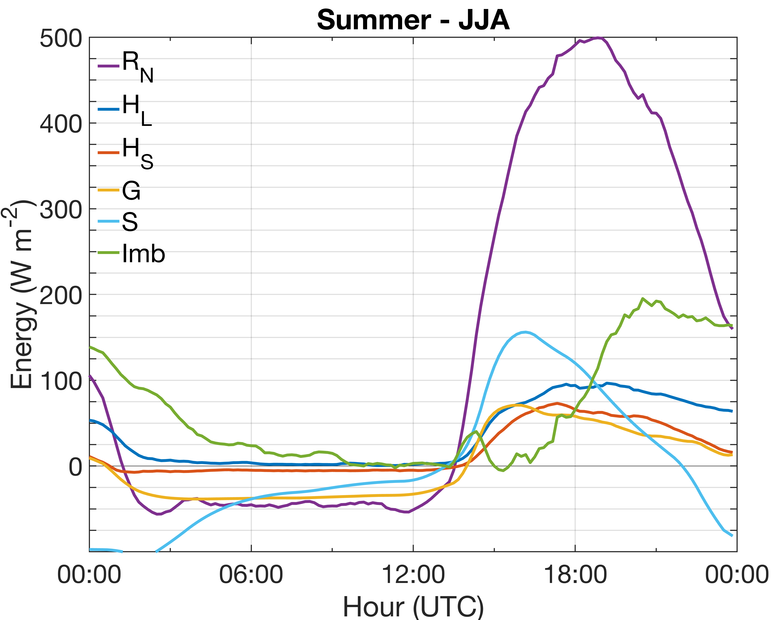
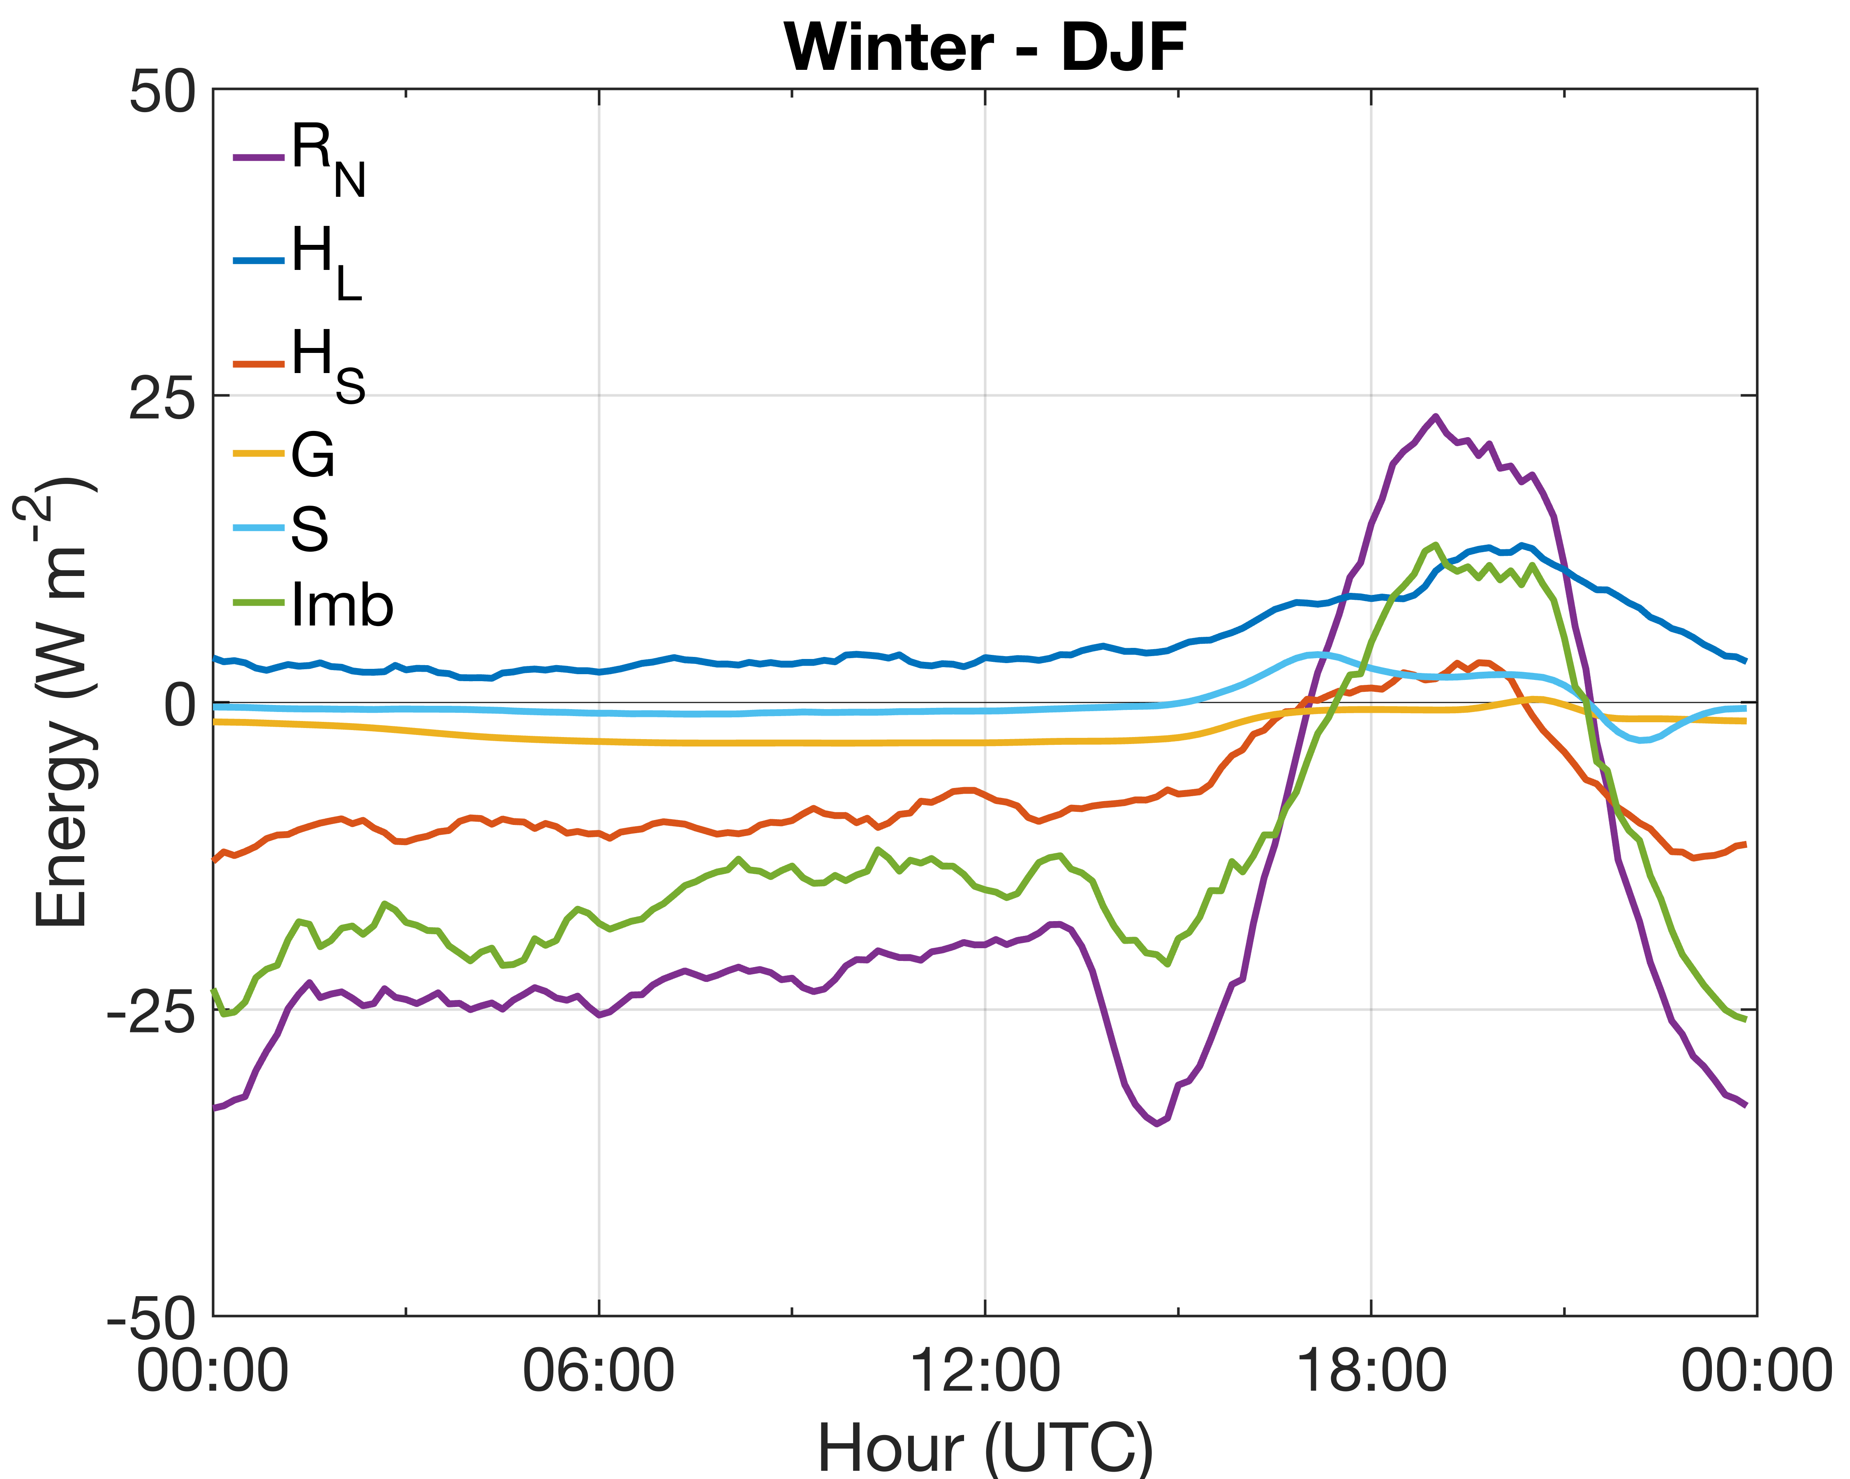
Diurnal Imb values were largest during the daytime
Imb magnitudes were roughly 40% of R_{N} magnitudes. This is particularly large and may be due to the omission of advection, flux divergence, and/or topographic effects

