Slide 1
Exploring impacts of mountain hydrologic processes on atmospheric boundary layer using SAIL/SPLASH/SOS observations
Siwei He (siwei.he@montana.edu)
Civil Engineering Department, Montana State University

Slide 2
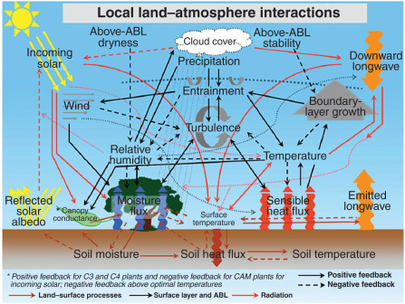
Motivation
From Santanello et al., 2018
Courtesy of M. Ek

Slide 3
Motivation
Understanding and modeling hydrological processes are important for advancing the study of land–atmosphere interactions.
From Santanello et al., 2018
Courtesy of M. Ek

Slide 4
Challenges in coupling hydrological and atmospheric processes
﻿Heterogeneities

Slide 5
Challenges in coupling hydrological and atmospheric processes
Heterogeneities
  Snow

Slide 6
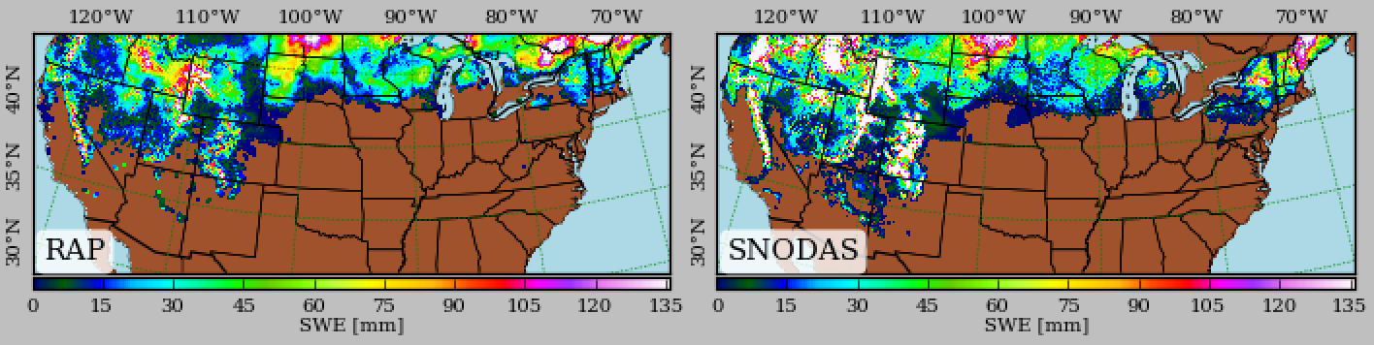
An example from RAP: simulated SWE vs SNODAS
RAP 6-h SWE forecast and SNODAS (Jan 4, 2017)

Slide 7
An example from RAP: simulated SWE vs SNODAS
RAP 6-h SWE forecast and SNODAS (Jan 4, 2017)
The simulated SWE was lower than SNODAS

Slide 8
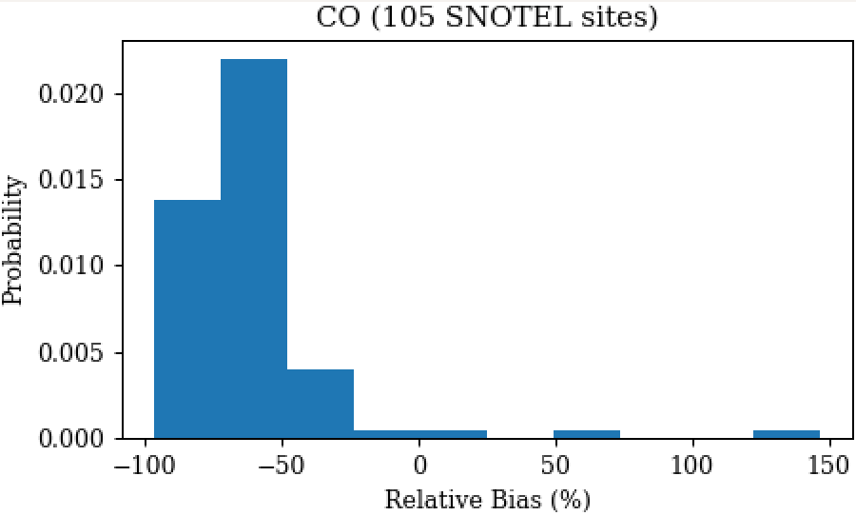
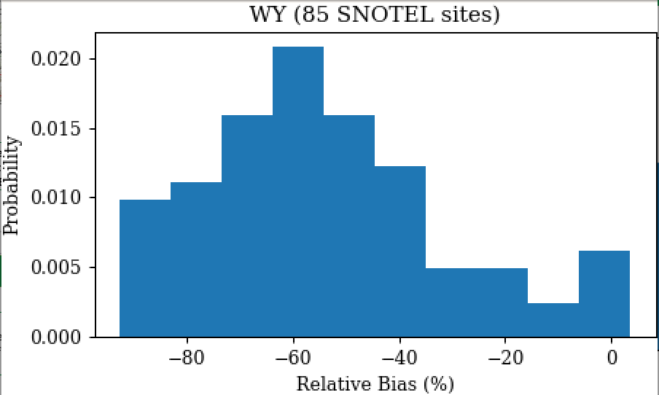
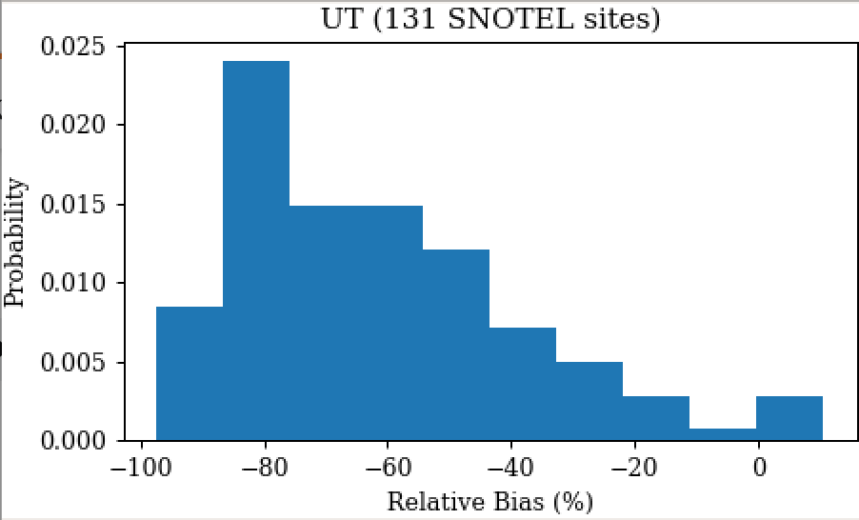
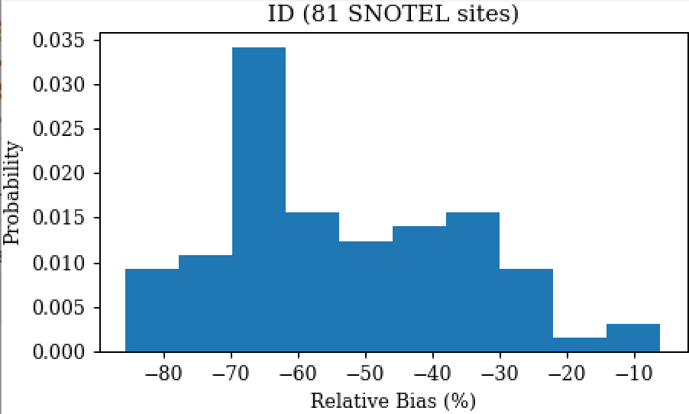
An example from RAP: simulated SWE vs SNOTEL obs

Slide 9
An example from RAP: simulated SWE vs SNOTEL obs
The simulated SWE was smaller than SNOTEL

Slide 10
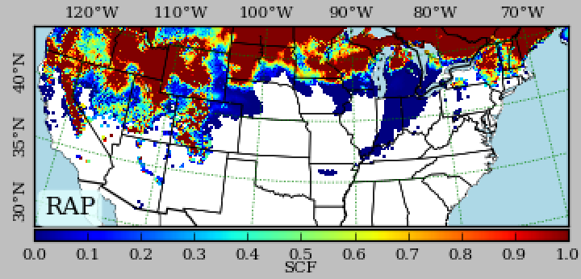
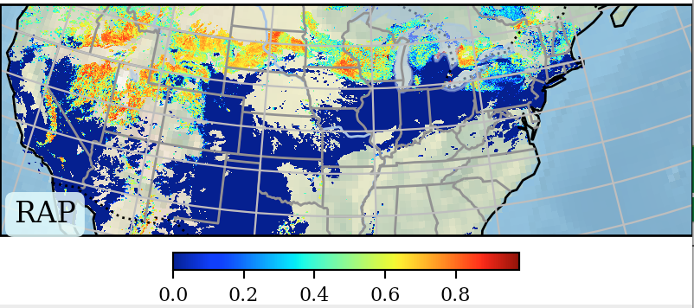
An example from RAP: simulated SCF vs MODIS
MODIS
RAP 6-h snow cover fraction forecast and MODIS (Jan 4, 2017)

Slide 11
An example from RAP: simulated SCF vs MODIS
MODIS
RAP 6-h snow cover fraction forecast and MODIS (Jan 4, 2017)
The simulated SCF was higher than MODIS

Slide 12
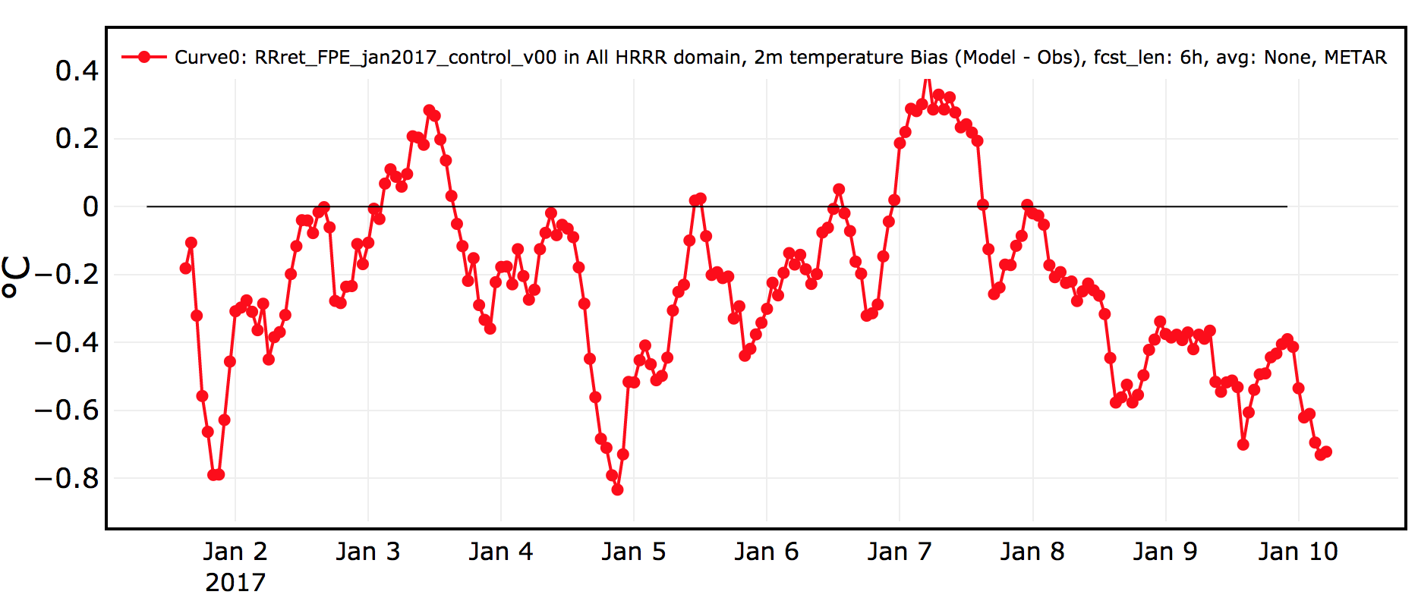
An example from RAP: simulated 2-m temperature
2-m temperature bias of RAP 6-h forecast

Slide 13
An example from RAP: simulated 2-m temperature
The simulated 2-m temperature had cold bias
2-m temperature bias of RAP 6-h forecast

Slide 14
Challenges in coupling hydrological and atmospheric processes
﻿Heterogeneities
  Snow
  Soil moisture

Slide 15
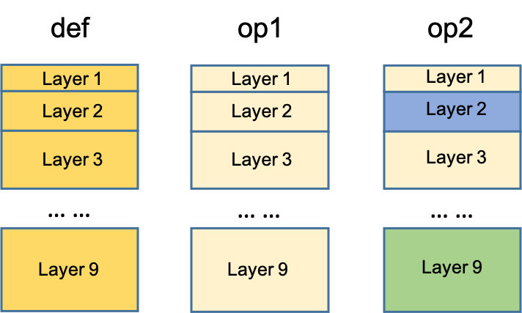
An example from SCM: soil vertical properties

Slide 16
An example from SCM: soil vertical properties

Slide 17
An example from SCM: soil vertical properties

Slide 18
An example from SCM: soil vertical properties

Slide 19
Challenges in coupling hydrological and atmospheric processes
﻿Heterogeneities
  Snow
  Soil moisture
Scale discrepancies between observations and models

Slide 20
An example from SGP site: soil temperature and moisture
Measured soil temperature (May 10 – May 20)
Measured soil moisture (May 10 – May 20)
Measurements were made using three sensors (west, south, east). They are about 1 m from each other.

Slide 21
An example from SGP site: soil temperature and moisture
Comparison of soil temperature
Comparison of soil moisture
Measurements were made using three sensors (west, south, east). They are about 1 m from each other.

Slide 22
Proposed work
Using SAIL/SPLASH/SOS observations to:
Understand and model surface heterogeneities.

Slide 23
Proposed work
Using SAIL/SPLASH/SOS observations to:
Understand and model surface heterogeneities.
Understand and model impacts of surface heterogeneities on atmospheric processes.

