Slide 1



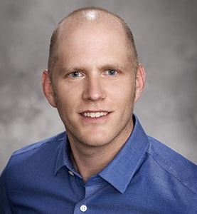






THREAD Overview
LLNL-PRES-852657
SPLASH/SAIL/SOS (S3) Combined Workshop
November 1st , 2023
Yunyan Zhang
This work was performed under the auspices of the U.S. Department of Energy by Lawrence Livermore National Laboratory under Contract DE-AC52-07NA27344.
Yunyan Zhang
Hsi-Yen Ma
Xue Zheng
Peter
Bogenschutz
Hewei Tang
Meng Zhang
Tianning Su
Lin Lin
Jingjing Tian
(now at PNNL)
Steve Klein

Slide 2
Outline
Introduction of THREAD
Progresses and Preliminary Results
  DP-SCREAM
  RRM-SCREAM
  Mixed-phase clouds (COMBLE)
  Clouds in a mountainous region (CACTI)
  Surface coupling (GoAmazon)

Slide 3
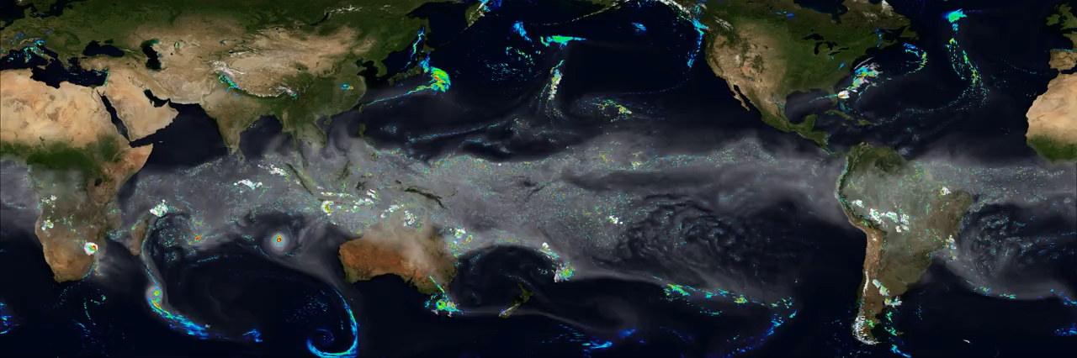
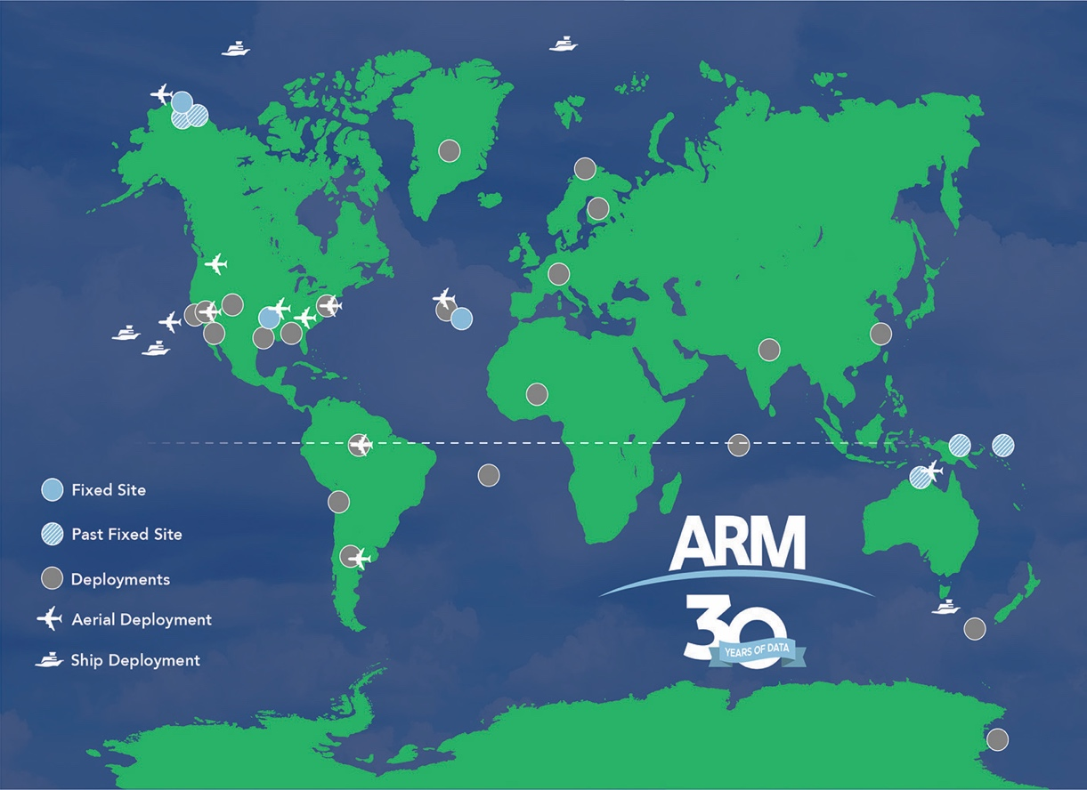

Motivation of THREAD
Booming developments of global storm resolving models (GSRMs)
Process-oriented diagnosis and improvement of E3SM/SCREAM using ARM data
the Simple Cloud-Resolving E3SM Atmosphere Model
(SCREAM, 3.25 km globally)
ARM world-wide deployments
THREAD
LLNL ASR SFA
Courtesy of R. Lang

Slide 4
Science Foci/Questions
How can we effectively diagnose a model’s strengths and weaknesses and transfer process-level understanding based on observations into improvements in global storm resolving models?
How well can SCREAM represent the interactions between the resolved mesoscale variability and the parameterized sub-grid scale turbulence, cloud microphysics, and aerosol processes?
How well can SCREAM represent the fast interactive physics of local land-atmosphere coupling at short-time scales (e.g., land-surface heterogeneity and orographic effects) and the feedbacks to longer time scales?
Model improvement with observations:
Resolved mesoscale versus Sub-grid parameterized processes:
Fast physical interactions with land:

Slide 5
Tying in High Resolution E3SM with ARM Data (THREAD)
In close collaboration with E3SM/SCREAM model development teams and ARM infrastructure teams

Slide 6
Progresses & Preliminary Results

Slide 7
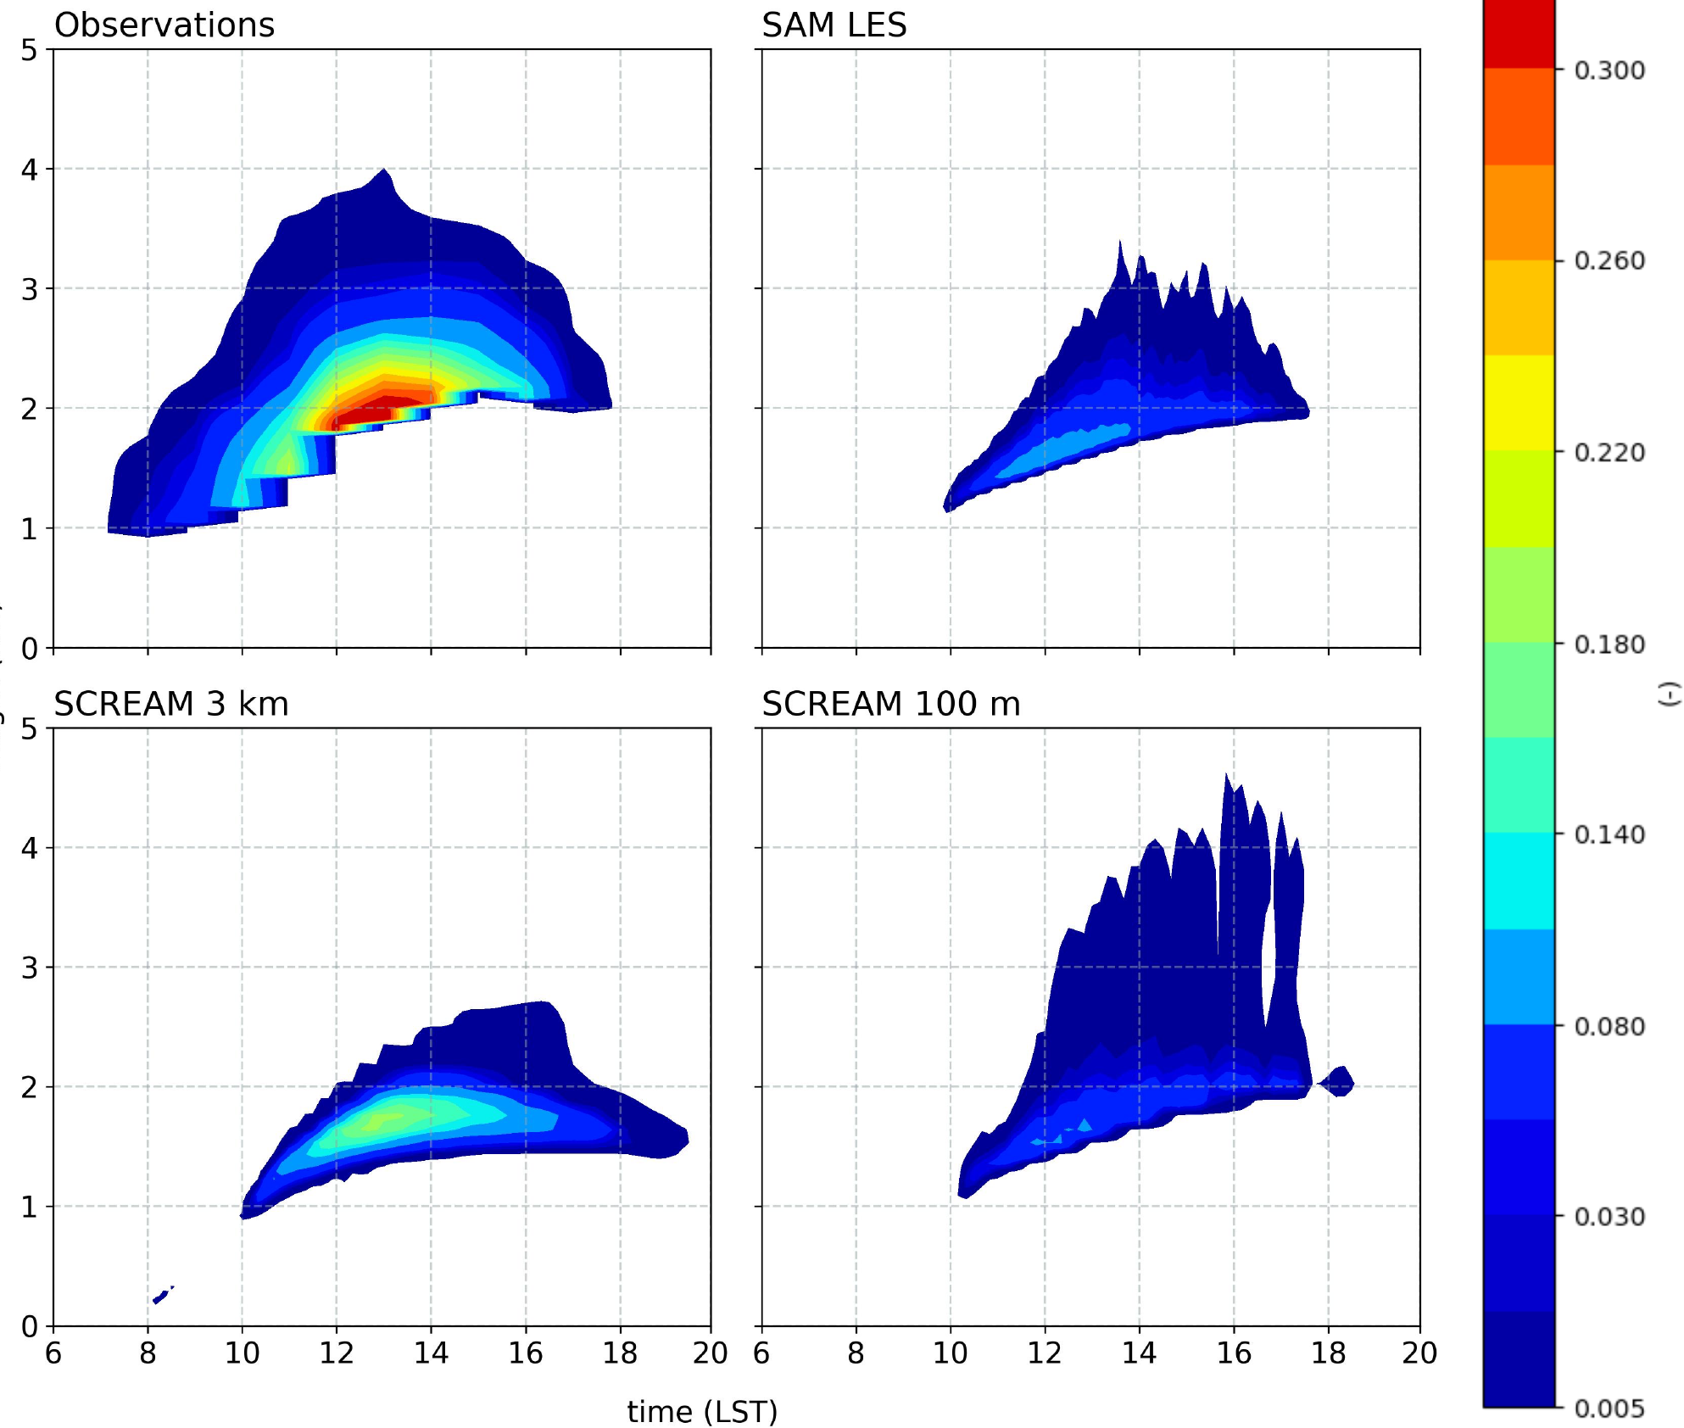


Survey of DP-SCREAM on ARM Convective Cases
Diurnal cycle of Cloud Fraction
Every regime/case: OBS + Forcing + benchmark LES
Tests across a range of horizontal and vertical resolutions
In-depth sensitivity tests on SCREAM physics updates
ARM
LES
SCREAM-3km
SCREAM-100m
Lagrangian Forcing
an example of ARM case
All these cases are available to E3SM low-res model diagnosis through E3SM Single Column Models

Slide 8
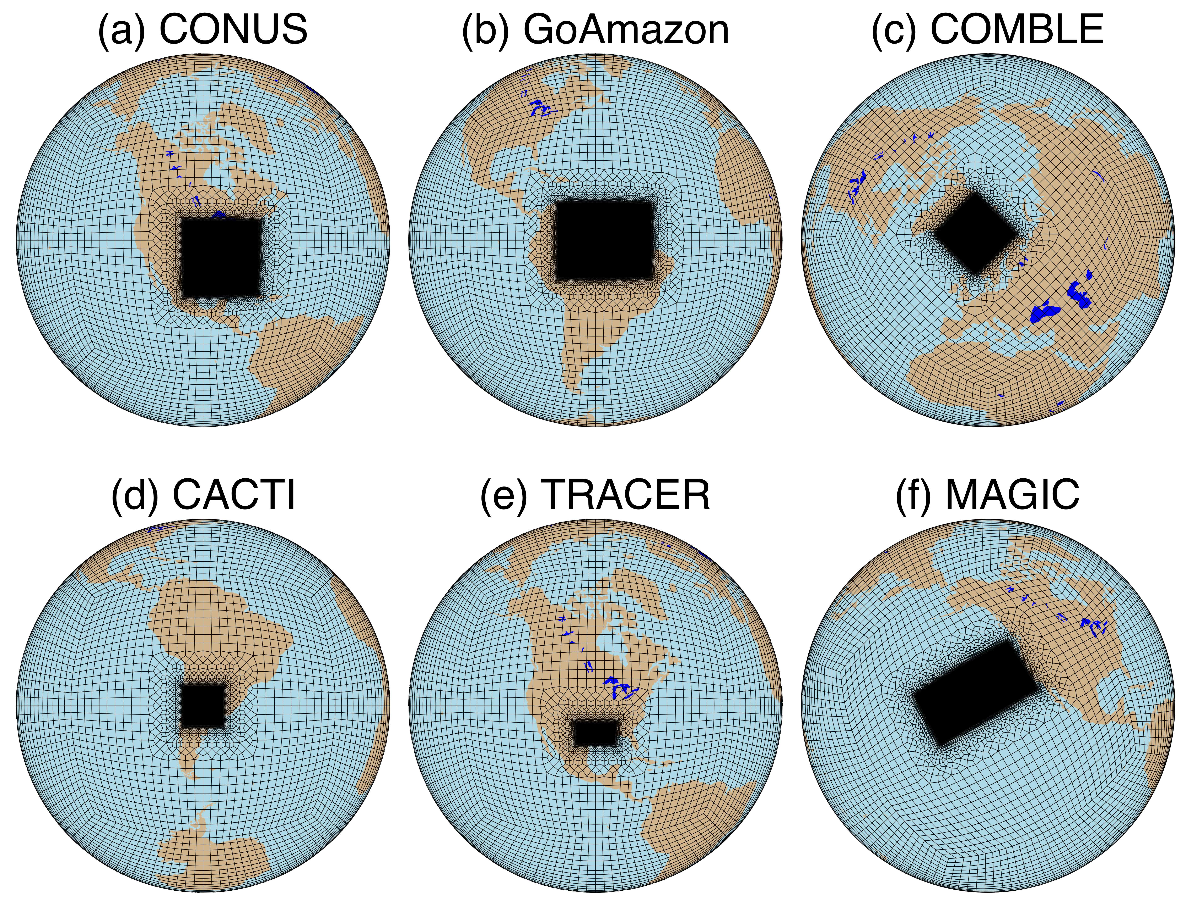
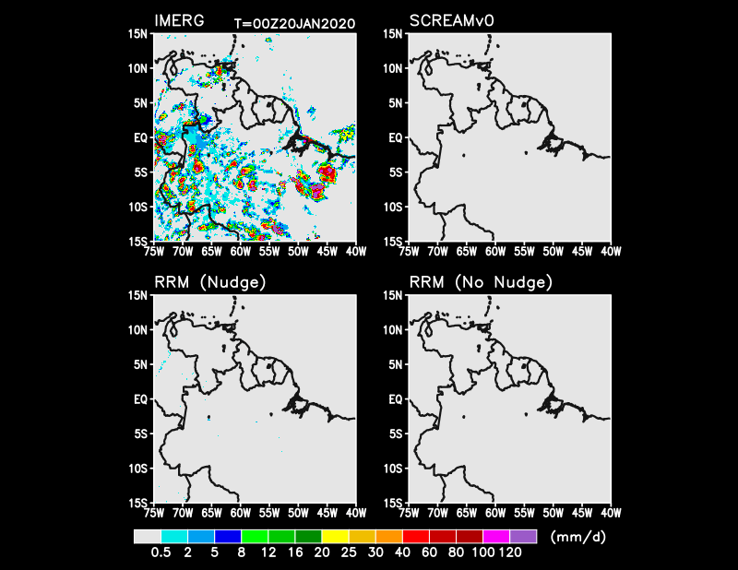
Efficient RRM-SCREAM Hindcasts at ARM sites
RRM-SCREAM: high-res inner refined domain (~3 km) and low-res outer domain (~100 km)
RRM-SCREAM can well reproduce global SCREAM
performance on GoAmazon convection at regional scale.
Precipitation of GoAmazon domain
Global 3-km
run
OBS
/EPCAPE
RRM
3-km
Nudged
RRM 3-km
No
Nudge
Brain Storming / Planning
On-Going effort

Slide 9
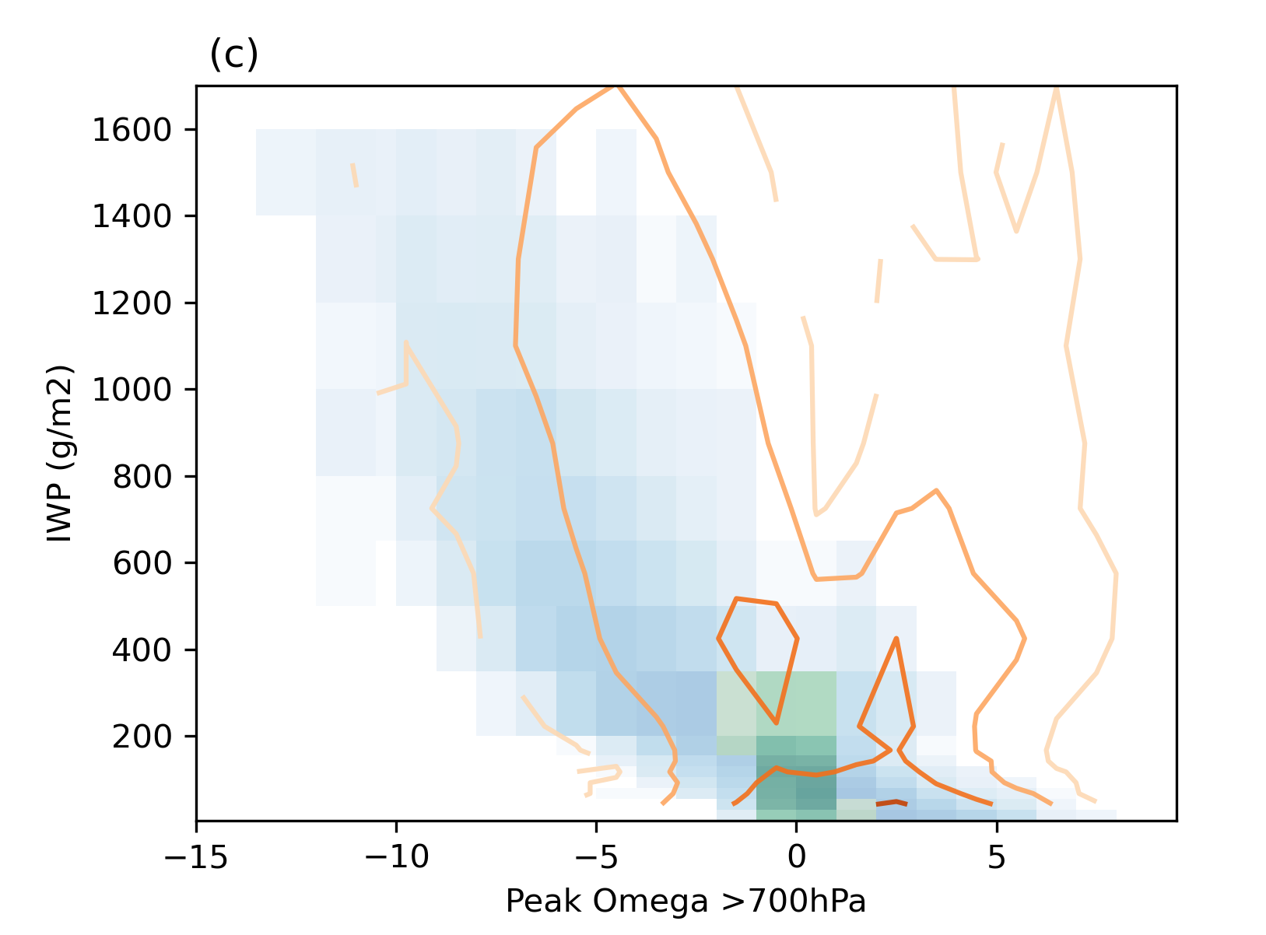
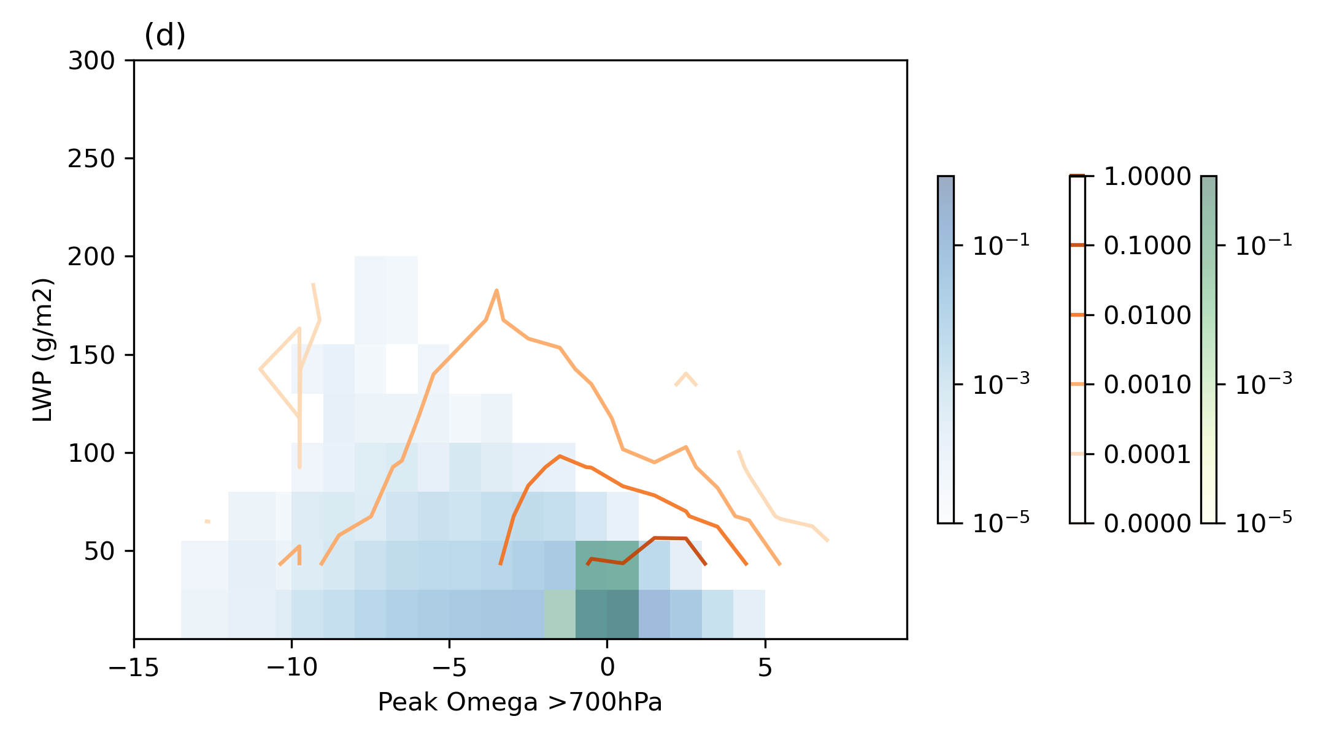
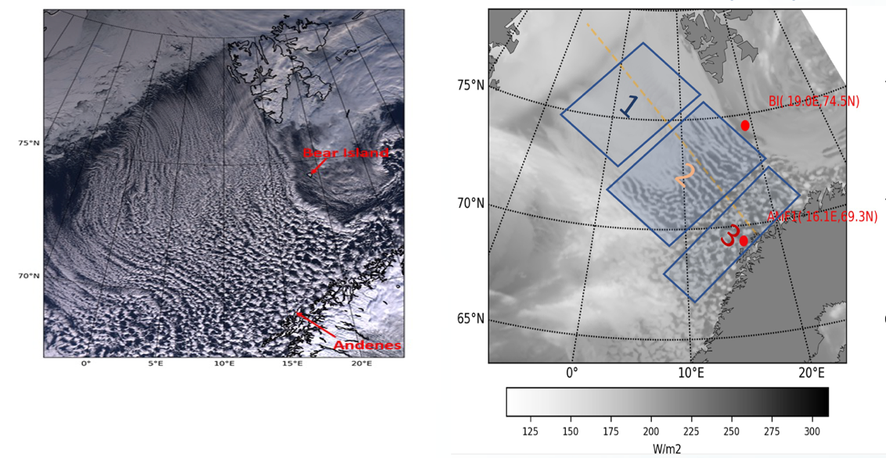
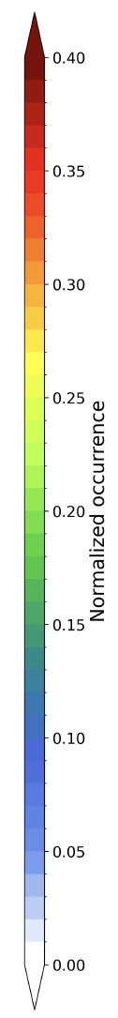
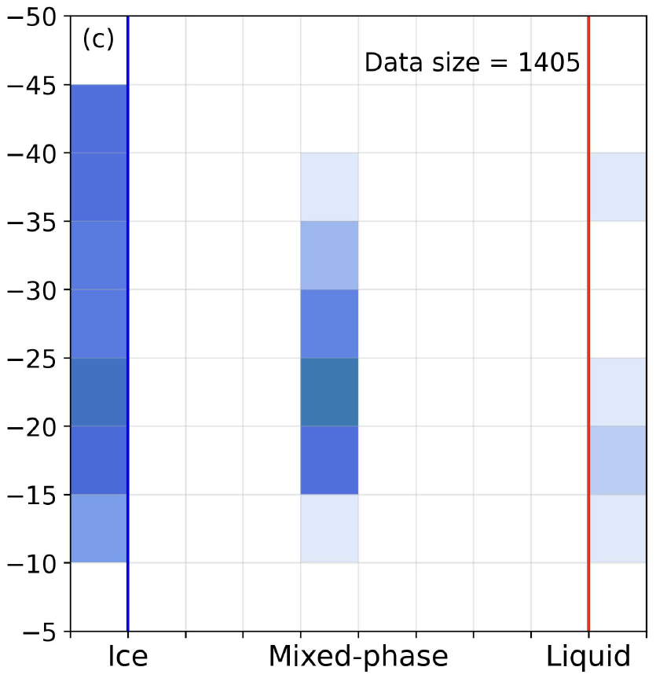
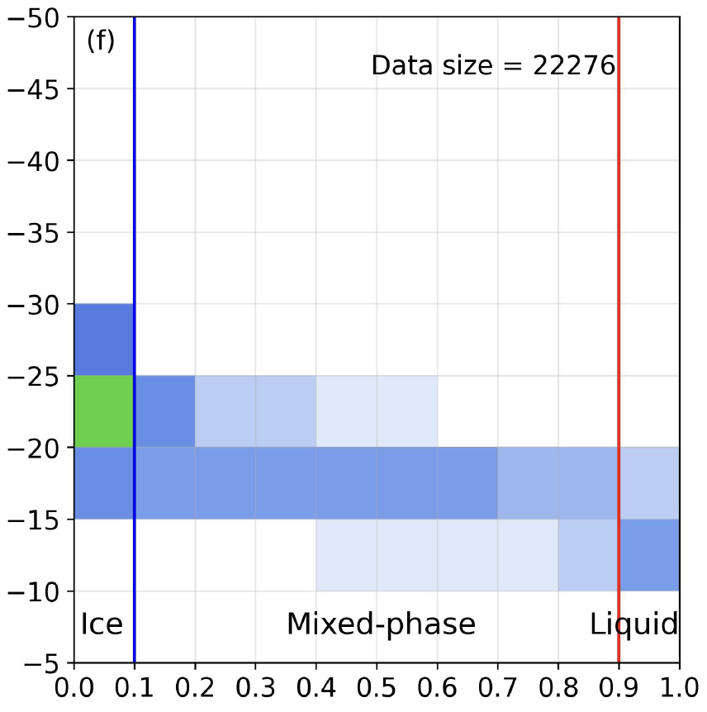
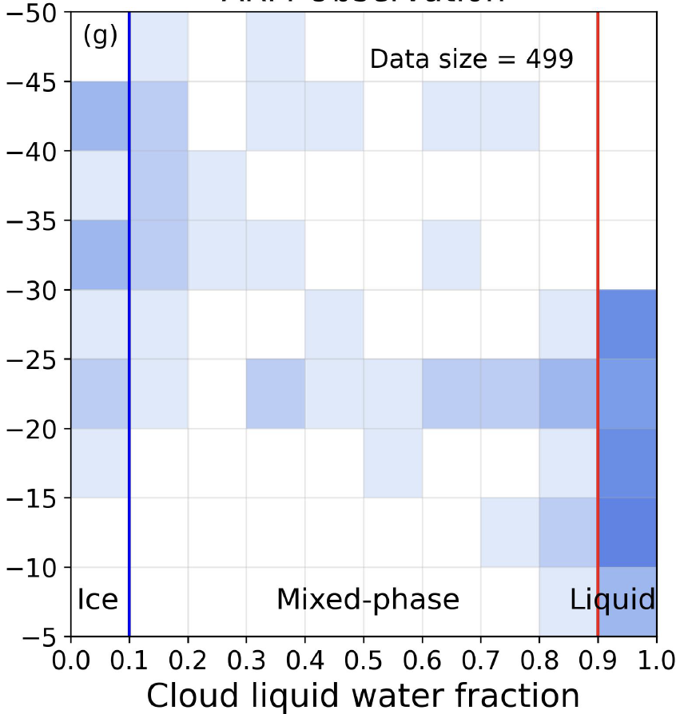
Cold Air Outbreak (CAO) – ARM COMBLE
IWP vs Omega
LWP vs Omega
Reasonable representation of cloud transition
Occurrence in areas
2 3 1 (in left Figs)
MODIS
SCREAMv0
1 2 3
SCREAM ice water path strongly correlated with updraft velocity
(Further observational validation and in-depth DP-SCREAM tests)
CloudSat
SCREAM
ARM
X. Zheng et al. submitted to GRL
In collaboration with Z. Zhang (UMBC) and M. Deng (BNL), P. Wu (PNNL) and T. Juliano (NCAR)
Leading efforts on E3SM/SCM, DP-SCREAM, and RRM-SCREAM tests in the COMBLE model intercomparison project
Cloud Liquid Water Fraction (X) versus cloud top temperature (Y)
Underestimate of liquid water for cloud top temperature < -25ºC

Slide 10
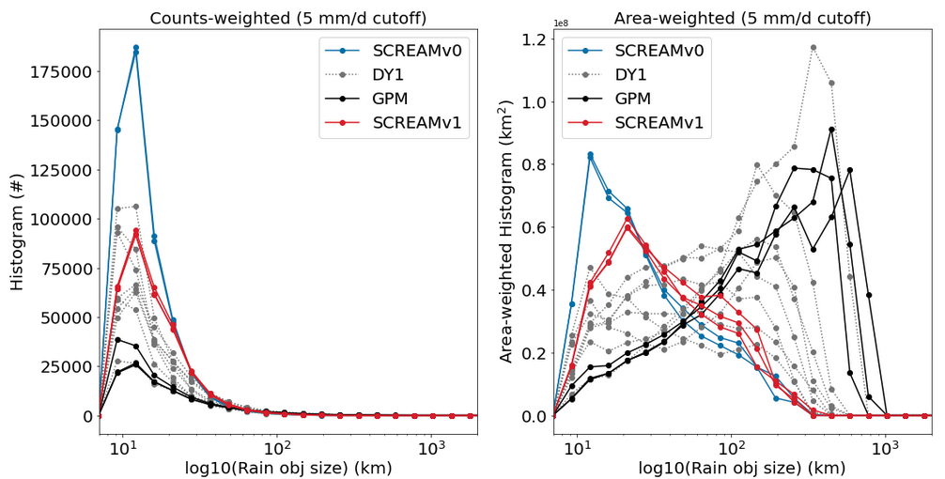
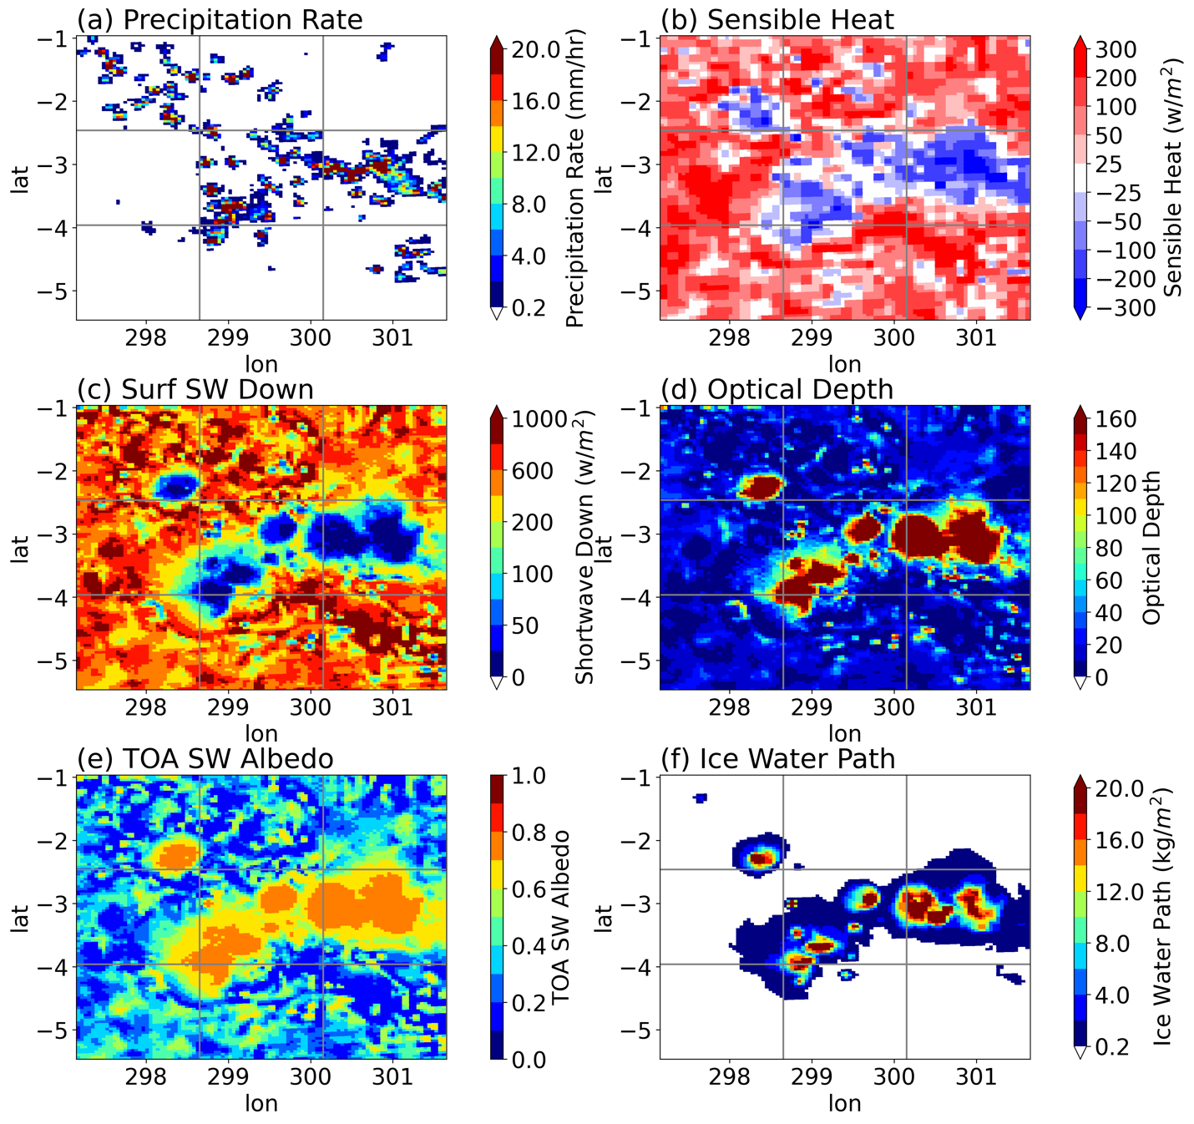
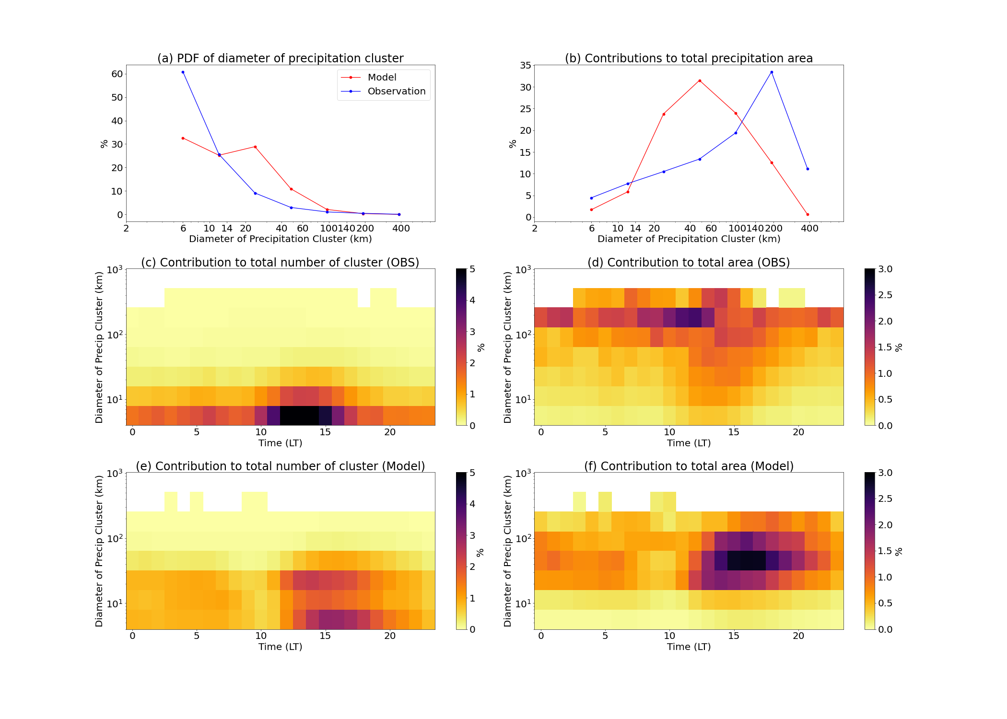
“Popcorn” Convection and Surface Coupling
Large areas of negative sensible heat fluxes cut off convection
A complex interplay of land surface, radiation and microphysics
Figure curtesy of C. Terai and P. Caldwell
SIPAM
SCREAM
GoAmazon
J. Tian et al. submitted to GRL

Slide 11
CACTI clouds and precipitation from SCREAMv0
SDC region, summer convection, lacking of PBL clouds
Deep convective precipitation starts too earlier in middle afternoon and does not sustain to early morning
Figure courtesy of J. Tian

Slide 12
Thoughts about SPLASH/SAIL/SOS (S3)
Assessment of E3SM/SCREAM performance using computational efficient RRM
Model setup
  Domain size ?
  Resolution from 3.25 km to 1.6 km to 800 meters ?
  Input and initial condition of land conditions ?
  Prescribed aerosol conditions ?
  Atmospheric large scale from reanalysis
    Case study, short term hindcasts?
    Ensemble run of one case or multiple cases?
    Seasonal hindcasts versus free runs in RRM domain?
Mixed phase clouds, PBL coupling surface energy budget, aerosol sensitivities, S2S feedbacks
Collaboration with land modelers and hydrometeorology experts ?

Slide 13
Questions or Comments?
This work was performed under the auspices of the U.S. Department of Energy by Lawrence Livermore National Laboratory under Contract DE-AC52-07NA27344. LLNL-PRES-852657

