Slide 1
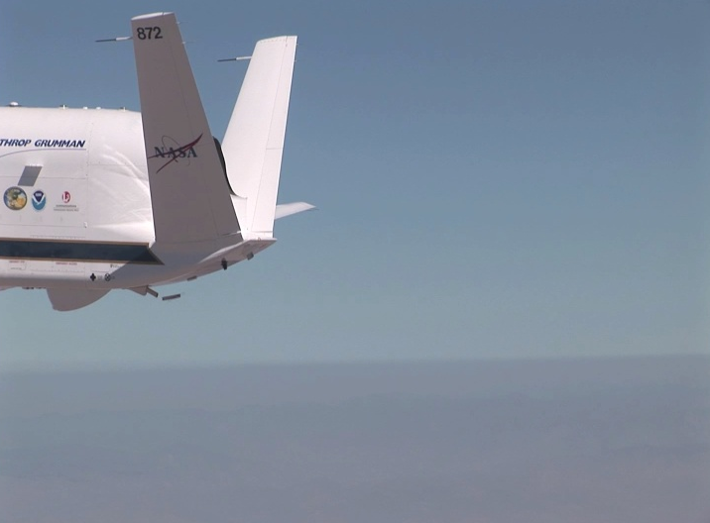


First Global Hawk Dropsonde Launch
The NCAR/NOAA Global Hawk Dropsonde System
Gary Wick¹, Terry Hock², and Ryan Spackman¹
¹NOAA ESRL/PSD, ²NCAR/EOL

Slide 2
Global Hawk Dropsonde Overview
Developed through collaborative partnership between NOAA, NCAR, and NASA
Relies on NCAR/EOL’s long experience with dropsonde development, aircraft launch systems, and data Q/C processing
Uses new Global Hawk sonde: smaller and lighter than standard dropsondes
System has 88-sonde and 8-channel capacity (track 8 sondes simultaneously)
Automated telemetry frequency selection
D-file returned to ground following drop
Ground processing enables GTS transmission

Slide 3

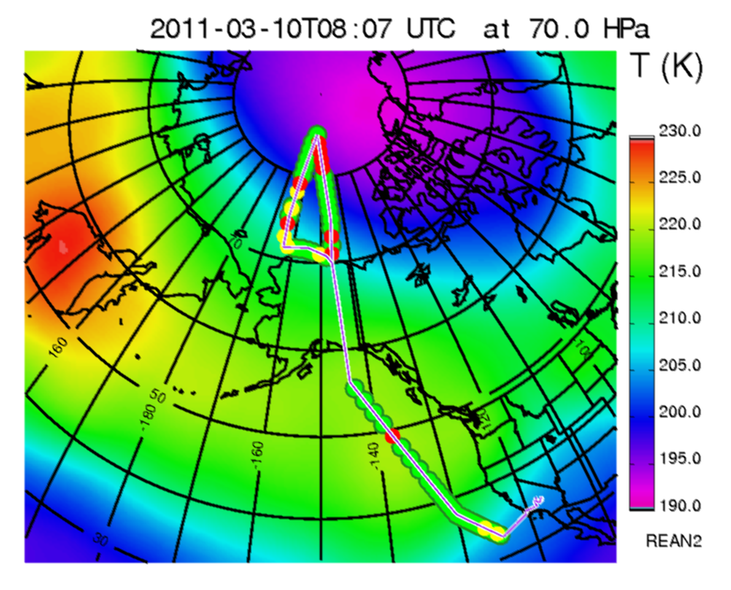
Previous GH Deployments
Winter Storms and Pacific Atmospheric Rivers (WISPAR)
  Feb-Mar 2011, NASA Dryden Flight Research Center
  177 sondes released during 3 long-endurance flights
  Soundings to 85 N
HS3 Test Flights
  September 2011
  45 soundings from Pacific flight
  35 sondes deployed, 27 collocated with NOAA G-IV
Demonstrated flexibility in drop location with FAA

Slide 4
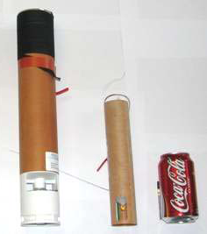
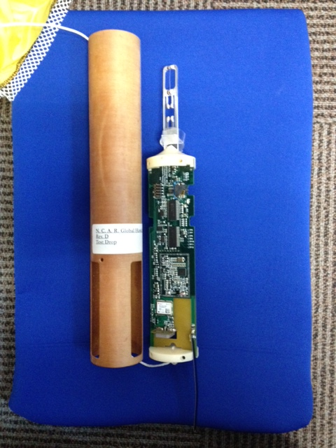
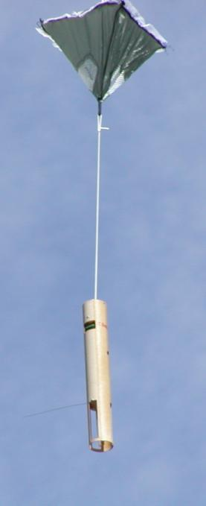
Sonde Specifications
Size: 4.5 cm dia. X 30.5 cm length
Mass: ~167 g
Fall rate: ~11 m/s at surface
Sensors based on Vaisala RS-92 radiosonde sensor module
  Temperature: +60° to -90 ° C , 0.01 ° C resolution
  Humidity: 0 to 100%, 0.1% resolution
  Pressure: 1080 to 3 mb, 0.01 mb resolution
  2 Hz update rate
Winds based on OEM GPS receiver and position
  4 Hz update rate
Stable cone parachute design
Remote control of power on/off and sonde release
Designed for extreme environmental conditions

Slide 5

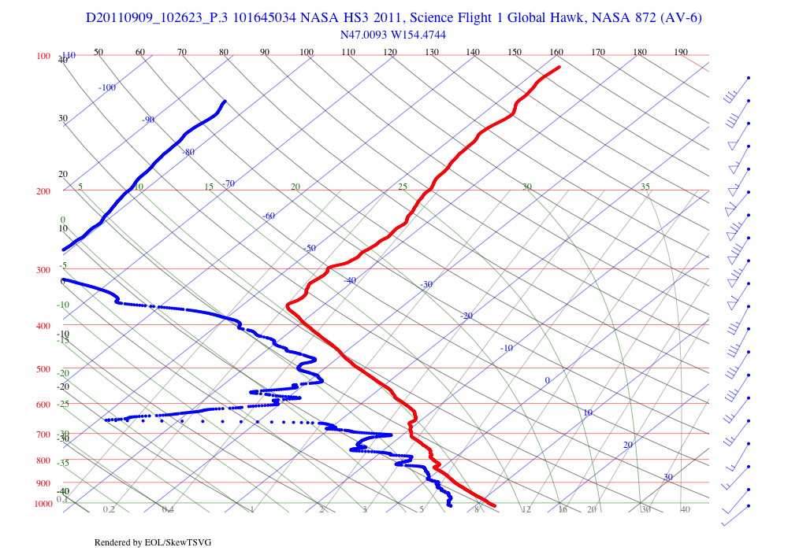
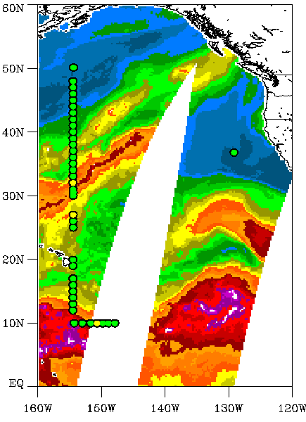
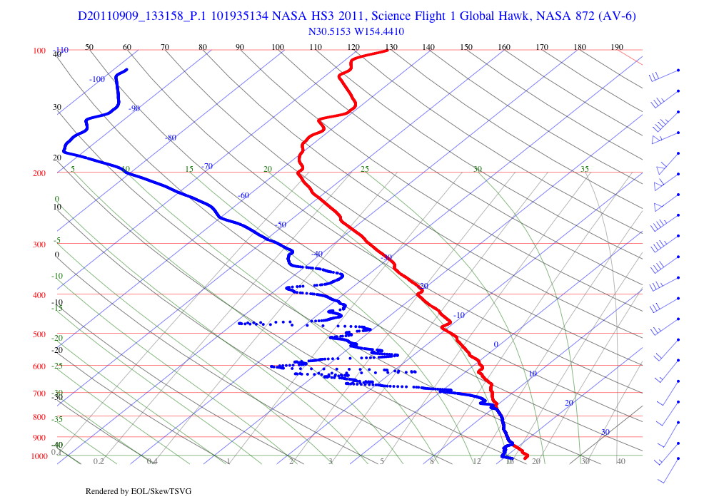
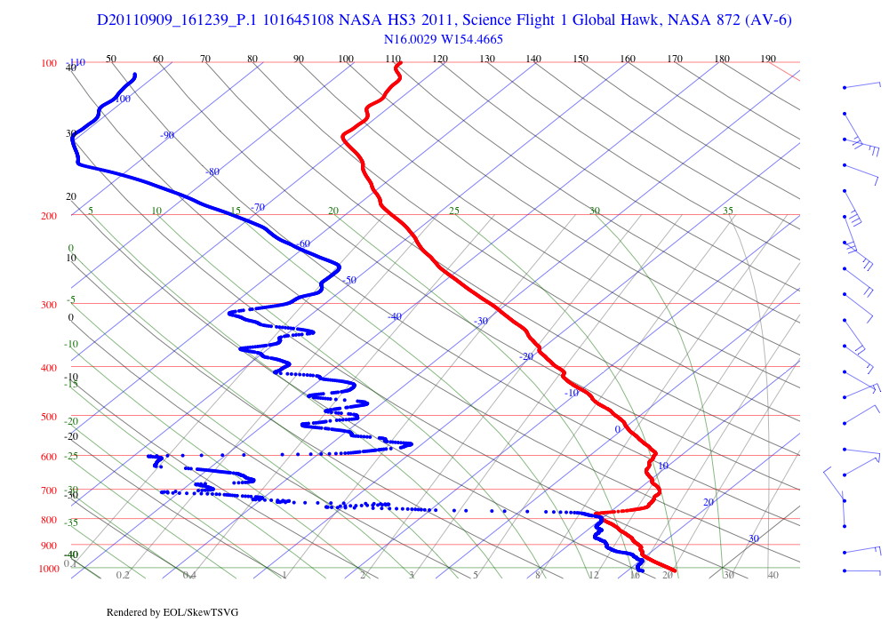
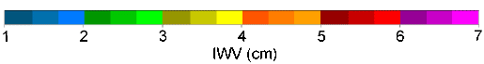
HS3 Pacific Test Flight
AMSR-E Integrated Water Vapor
Western Pass ~1300 UTC
1026Z
Dropsondes sampled an extremely wide range of atmospheric conditions during N-S transect
45 sondes deployed
Northern, mid-latitude soundings show strong polar jet stream
Sounding within atmospheric river shows high moisture content but relatively weak transport at low levels
Southern, tropical sounding shows moist boundary layer capped by inversion and drier air aloft
Northern
Mid-latitude
1331Z
Atmospheric River
Sub-tropical
1612Z
Green: Full data
Yellow: Partial data
Notes:
Dropsonde locations are plotted on top of total precipitable water vapor image derived from AMSR-E. Green circles correspond to sondes with full data return while yellow circles corresponds to sondes with partial data. Two sondes lacked wind data while a third was a fast fall. Skew-T diagrams are shown for 3 selected soundings capturing the wide range of atmospheric conditions sampled during the flight. The northern sounding clearly shows the tropopause and a very strong jet. The central profile was obtained while crossing the atmospheric river. The atmosphere is very moist at low levels in the core of the atmospheric river. The southern sounding illustrates tropical conditions with a moist boundary layer, a strong inversion, and drier air aloft.

Slide 6
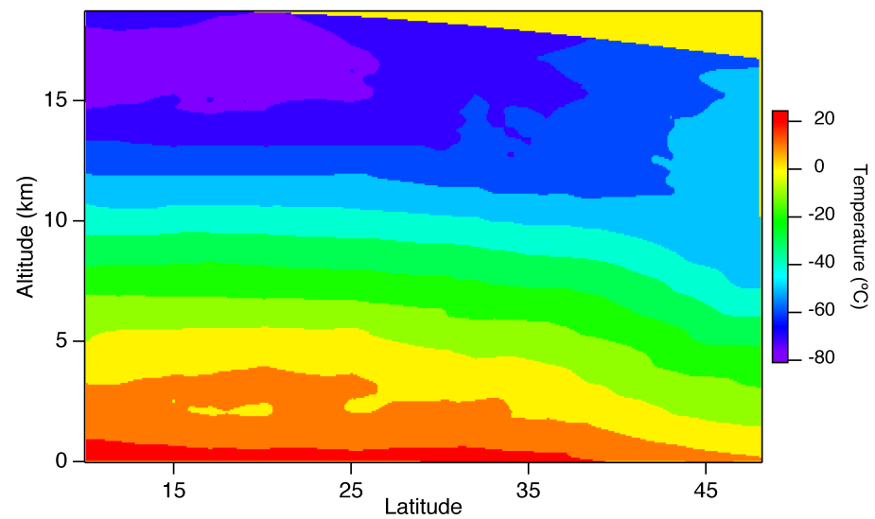
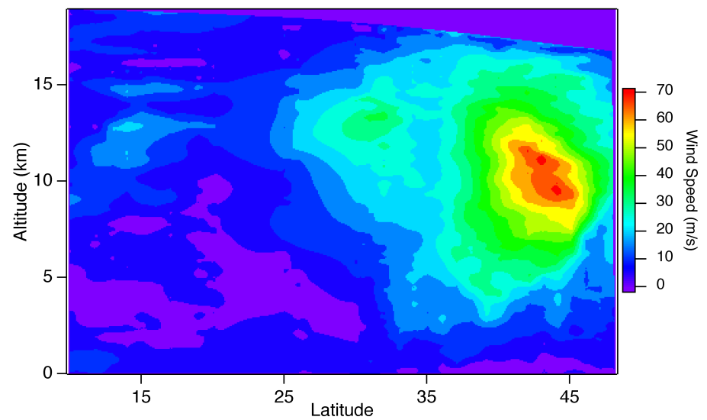
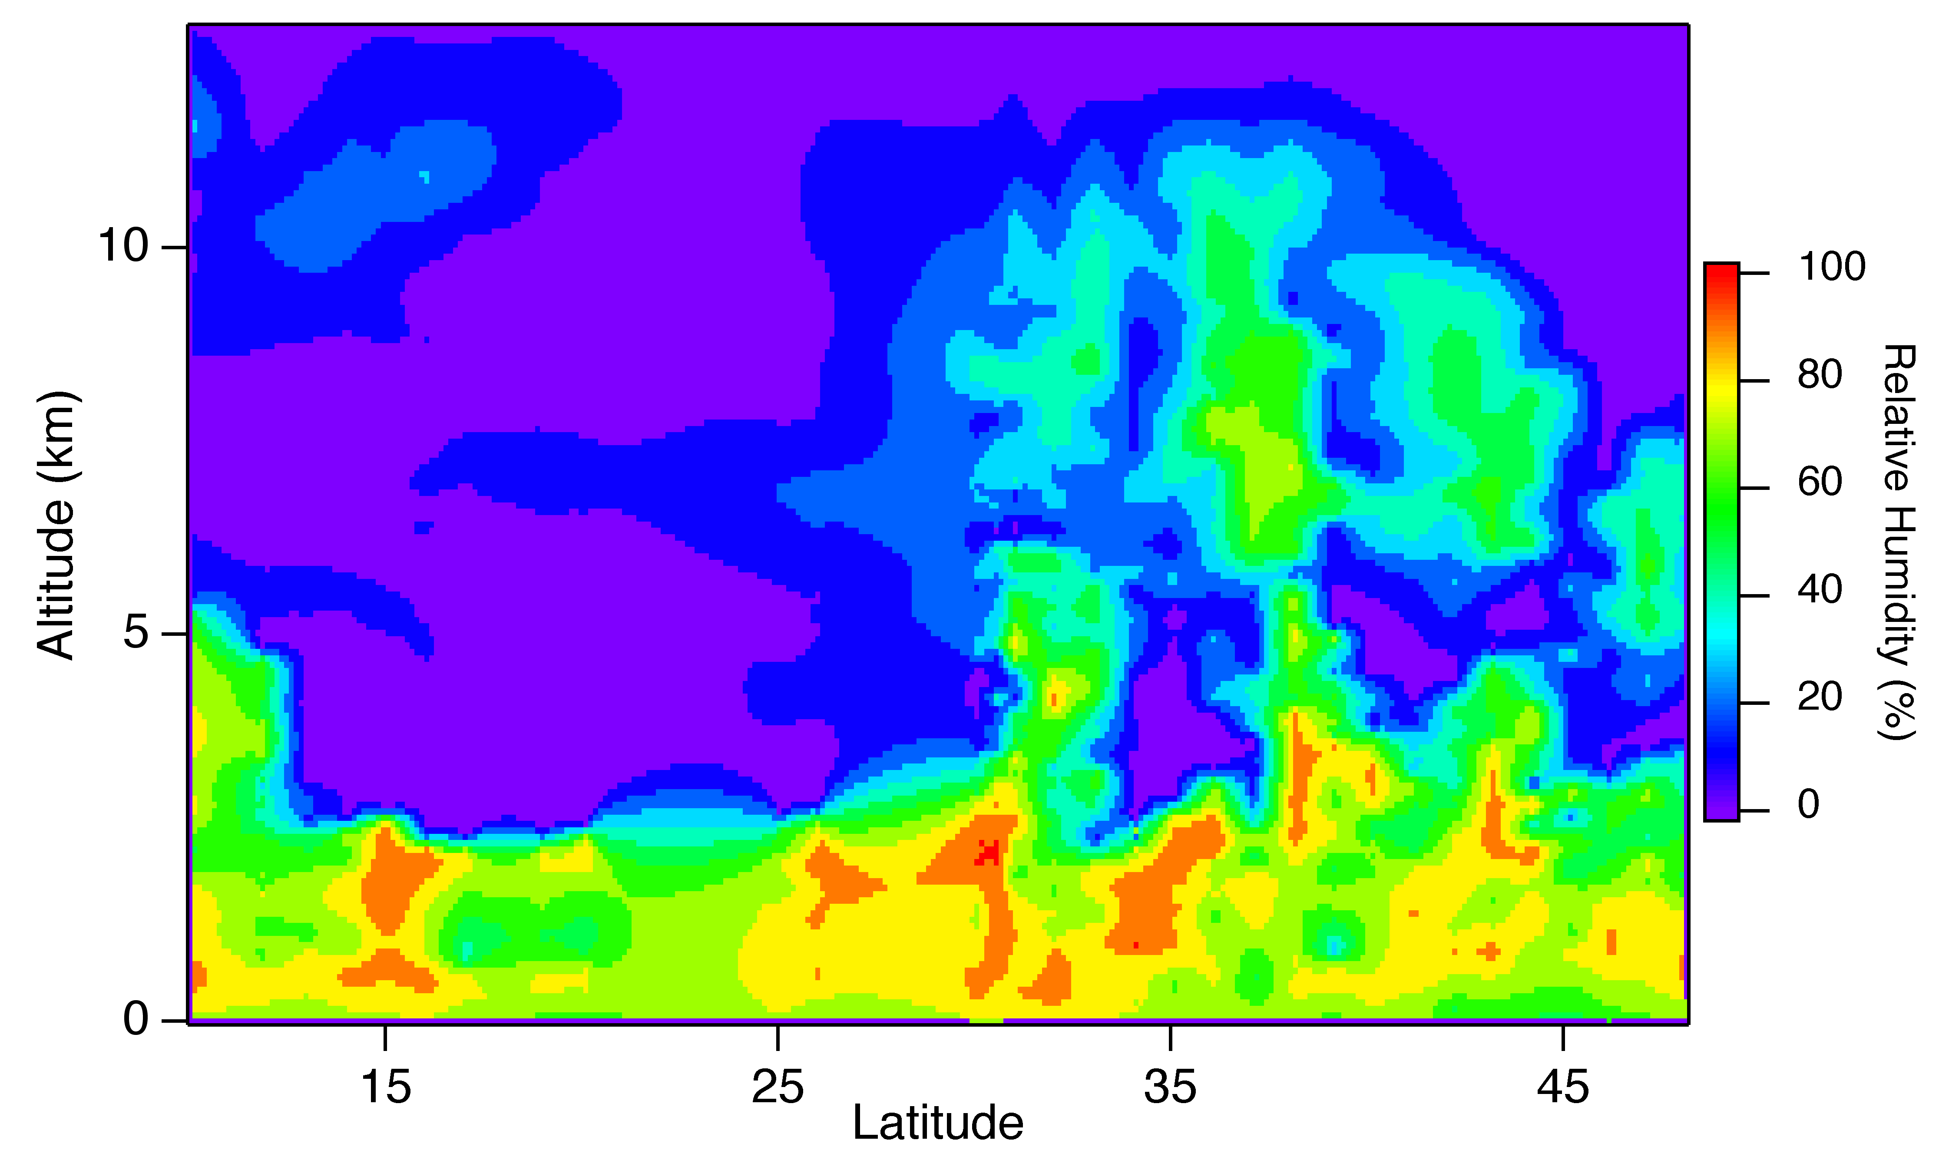
North Pacific Cross Sections
32 Dropsondes, 10°N – 48°N
Cold tropical
tropopause
Temperature
Stratospheric air
Wind Speed
Extratropical
storm
Relative Humidity
Strong polar jet stream in the upper troposphere at midlatitudes
Dry
subtropics
Atmospheric River
Notes:
The above cross sections were made by plotting all information from all drops along the north-south transect. Fields shown are temperature, wind speed, and relative humidity. The temperature field shows isotherms sloping downward from left to right, indicating the polar front north of 30-35°N. The cold tropical tropopause is also seen. Consistent with thermal wind balance, the wind speed field shows the wind maximum associated with the polar jet, with winds near 70 m/s. A much weaker secondary maximum is found at upper levels near 32°N. The relative humdity field shows the moist zone associated with the polar front and the atmospheric river. Interestingly, the moisture field is characterized by three vertical plumes of higher relative humidity. Further southward, one can see the very dry subtropics, the dryness caused by large-scale subsidence associated with the Hadley circulation. South of about 12°N can be seen the moist tropical region of the Pacific Inter-Tropical Convergence Zone (ITCZ) region.

Slide 7
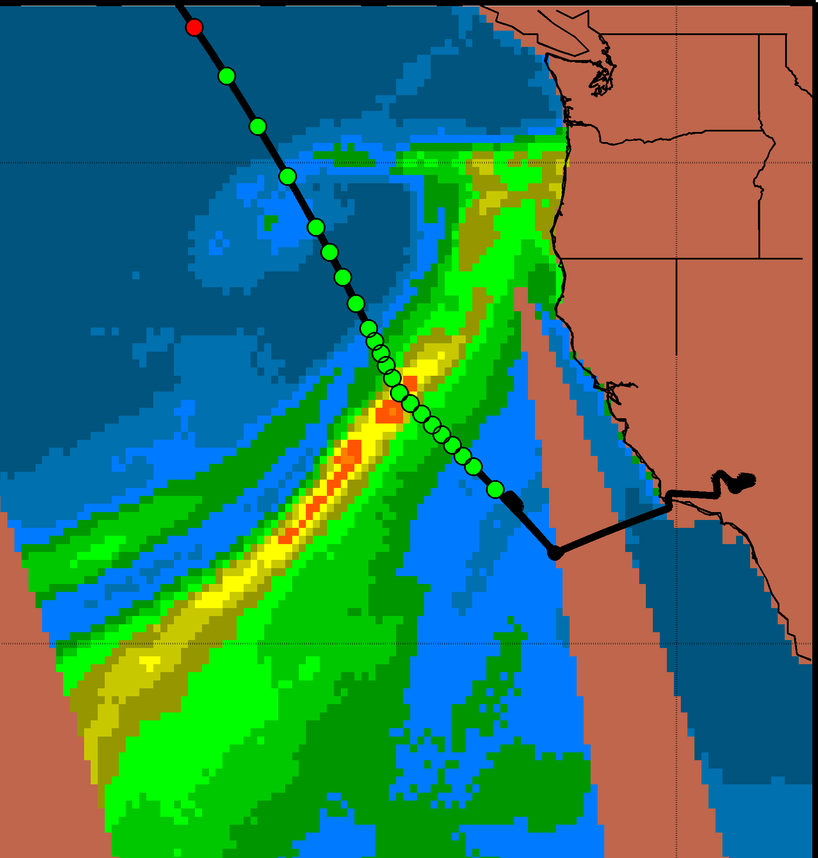
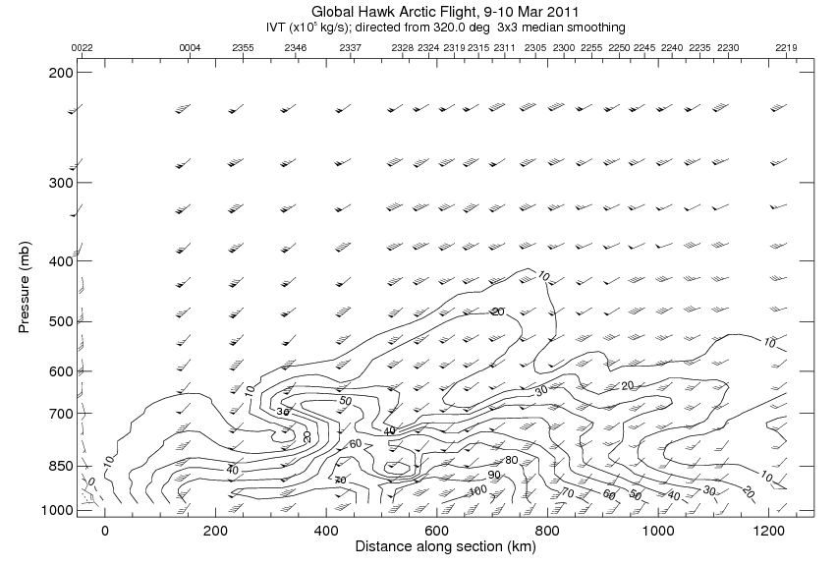
ATMOSPHERIC RIVERS – WATER VAPOR TRANSPORT
Jet Stream
AR Core
Notes:
Water vapor transport is product of the specific humidity and wind speed. Contoured here is component along inferred axis direction of the AR
Can further integrate in the vertical to get Integrated Vapor Transport (IVT)

Slide 8
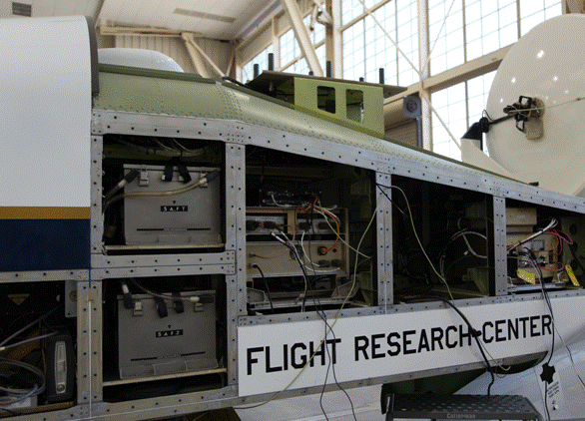
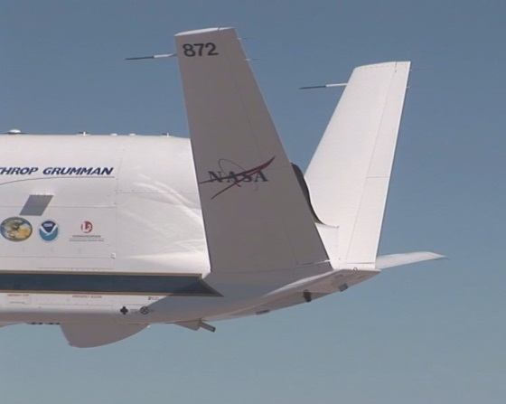
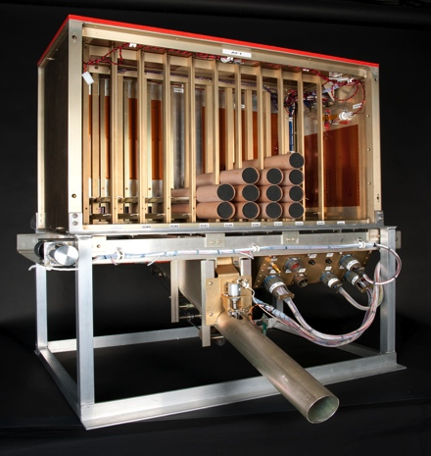
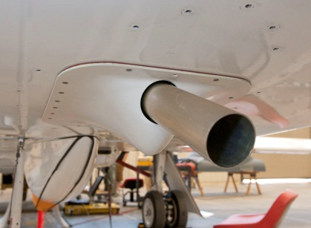
NCAR/NOAA GH Dropsonde System
Dropsonde System Launch Tube
Dropsonde System Electronics
Dropsonde Launch Assembly

Slide 9
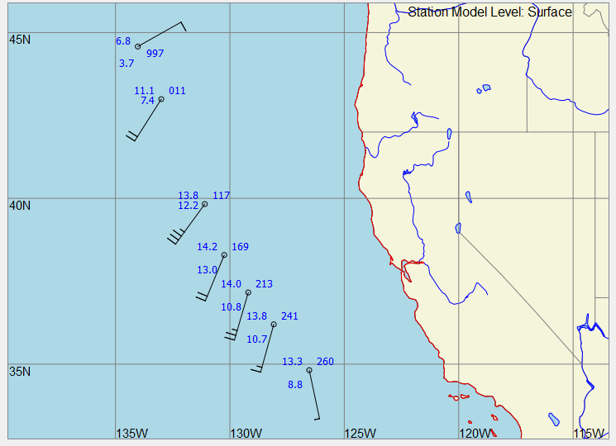
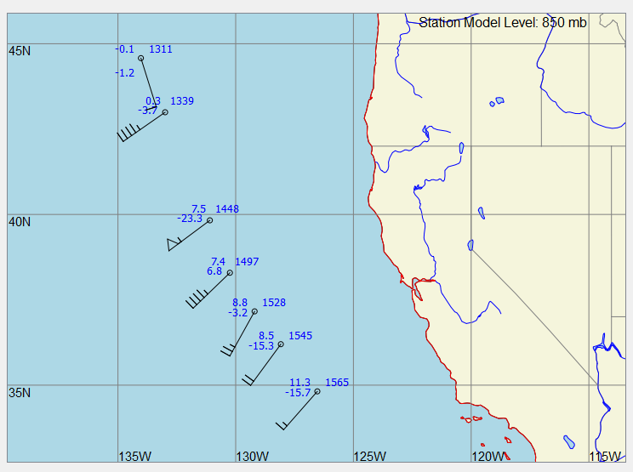
New for 2012
Full 8 channel capability implemented
First operation with Ku-band communications
Real-time GTS transmission
Sonde diagnostics on power-up
Automated logging of additional parameters at launch in PMHOF
New version of Aspen
  Synoptic map capability
  Mac/Linux/Windows support
Operation in new Flight Information Regions

Slide 10
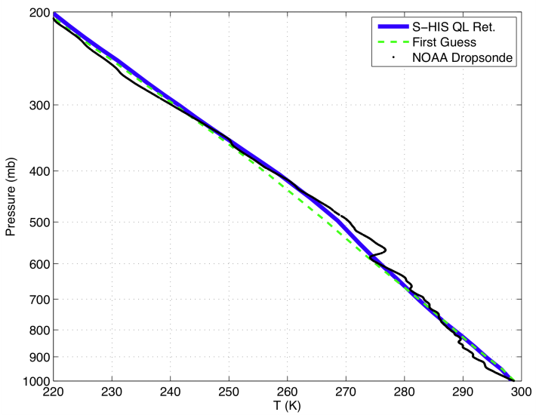
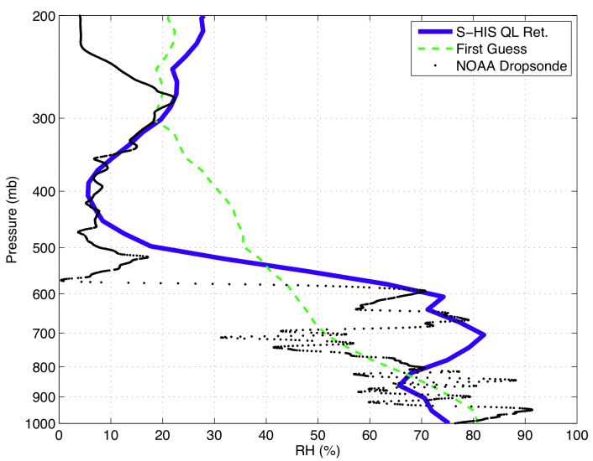
Sonde Status
500 dropsondes for 2012
First batch off production line “outstanding”
Extensive characterization of previous soundings
  Meetings with Vaisala on sensor performance
  GH/G-IV intercomparison – Hock to follow
  Further chamber testing planned to explore dry bias above 250 mb
UW Scanning-HIS Dropsonde Comparison (Courtesy H. Revercomb)
Dropsonde
9/9/2011
16:58 UTC

Slide 11
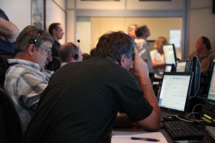
Staffing
Installation period
  Engineering team at DFRC
  G. Wick and NCAR software engineer at Wallops
Mission period
  2 NCAR engineers at Wallops throughout
  2 NOAA scientists at Wallops throughout
  Additional NOAA (HRD/ESRL) personnel offsite to assist with real-time sonde processing

Slide 12
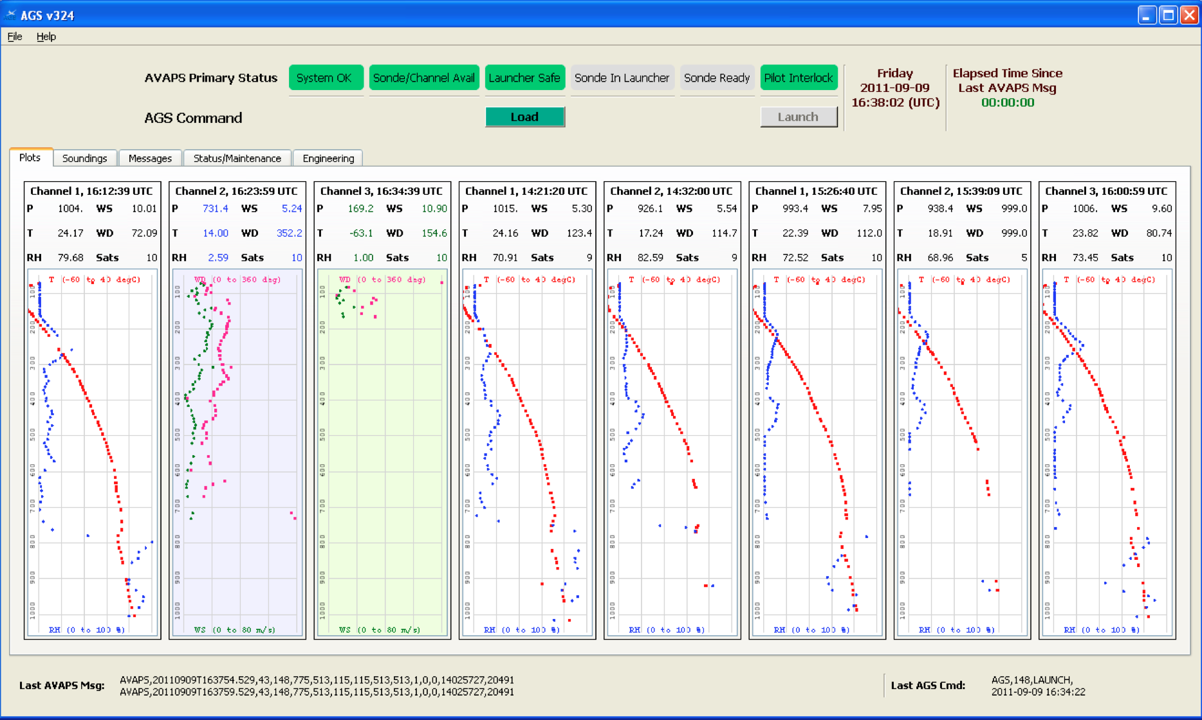
HS3 Operations and Data Flow
System operation and real-time data monitoring from PMOF
Most recent dropsonde: Data being received during descent

Slide 13

HS3 Operations and Data Flow
System operation and real-time data monitoring from PMOF
ftp of D-file to ground following sounding completion
Sounding assessment and skew-T generation in PMOF

Slide 14
HS3 Operations and Data Flow
System operation and real-time data monitoring from PMOF
ftp of D-file to ground following sounding completion
Sounding assessment and skew-T generation in PMOF
Transfer of D-file to NOAA offsite location
Remote Aspen processing and generation of temp drop message
GTS transmission of temp drop message
Preliminary D-files available to science team post flight
Post-mission QC by NCAR scientists

Slide 15
Closing Thoughts
Post-mission data access
Modified launcher mounting to support leveling good-to-go?
Transmission of data on GTS a NOAA priority
Work to facilitate assimilation of data underway

