Slide 1
An Overview of Instruments & Datasets Collected by NOAA PSL During
PSL instruments, observations, data
availability, documentation
Janet Intrieri, NOAA PSL
https://psl.noaa.gov/splash/

Slide 2
AYP
Focus | PSL System | Location | Primary Measurements
Precipitation | Snow-Level Radar Disdrometer | BCK, KPS BCK, KPS | Z, VDoppler, snow-level DSD, precip type
 | Scanning X-band Radar | RJY | Z, Zdiff, VDoppler, SW, etc.
 | Snow Depth Stakes | KPS, Remote Sites | Snow depth, Tair, RH
Lower Atmosphere | ASSIST/AERI* | RJY | IR spectral radiance, atmos T, RH, LWP, PW
 | Ceilometer* | RJY | Cloud base ht, cloud fraction
 | Microwave Radiometer* | RJY | Tb, atmos T, RH, LWP, PW
 | Sfc Met | RJY, BCK, KPS, KPS-A, AYP | Tair, RH, P, Wind speed/dir
Sfc Energy Budget | Atmospheric Surface Flux Stations (ASFS) | KPS-A, AYP
 | Thermistor String | AYP | Snow profile temp
Surface | S2 UAS | KP, AYP surveys | Soil moisture, multispectral imagery, topography, NDVI, sfc cover, Tsfc
 | E2 UAS | KP, AYP surveys | Soil moisture, multispectral imagery, topography, NDVI, sfc cover, Tsfc
 | HeliX UAS | KP, AYP surveys | Sfc Albedo, up-/down-welling irradiance, multispectral imagery, surface cover, Tsfc
 | TDR Soil Probe | KP, AYP surveys | Soil VWC, temp
*Only from Sept 2021- Jan 2022

Slide 3
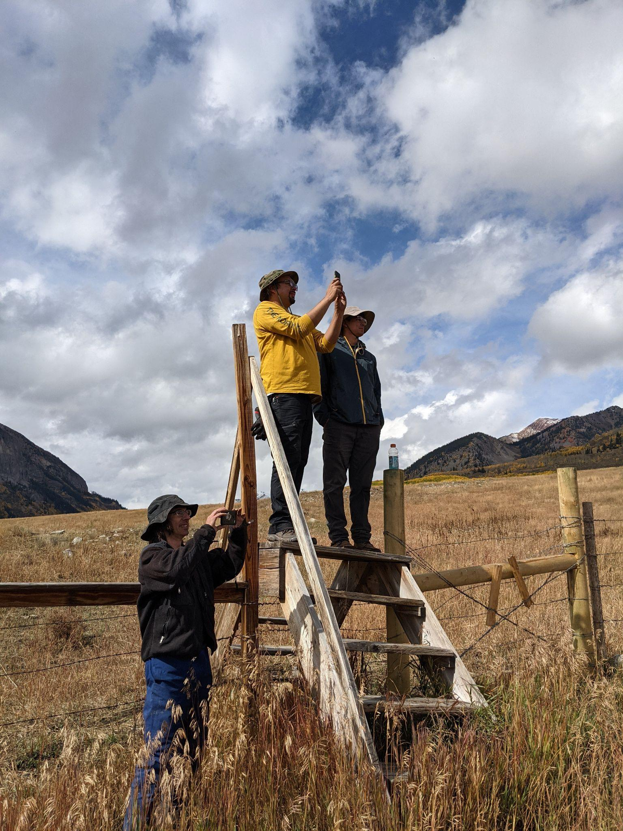
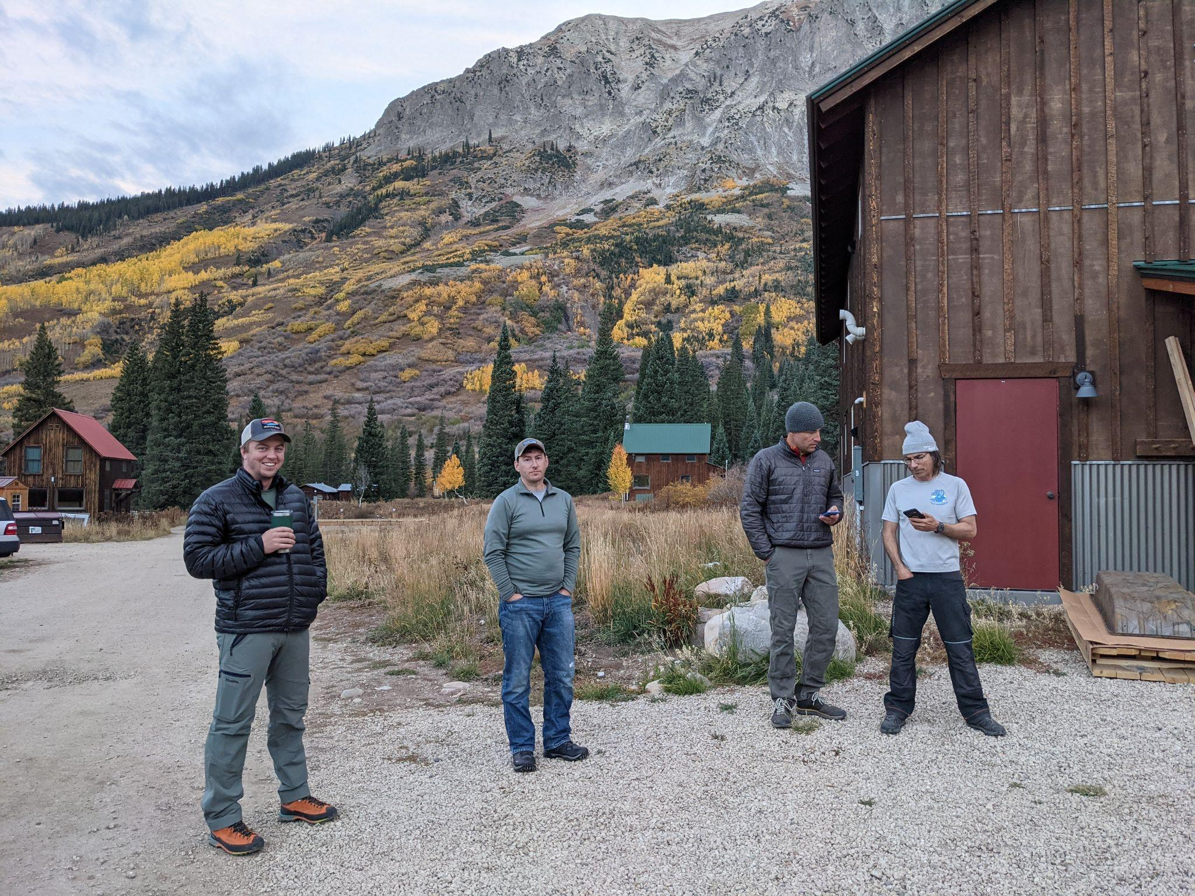
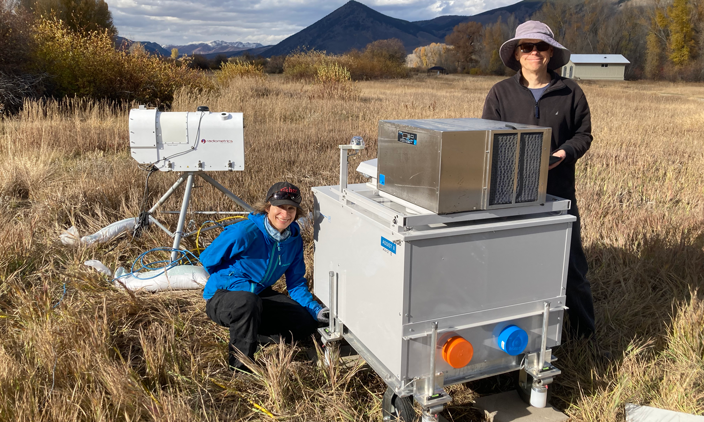
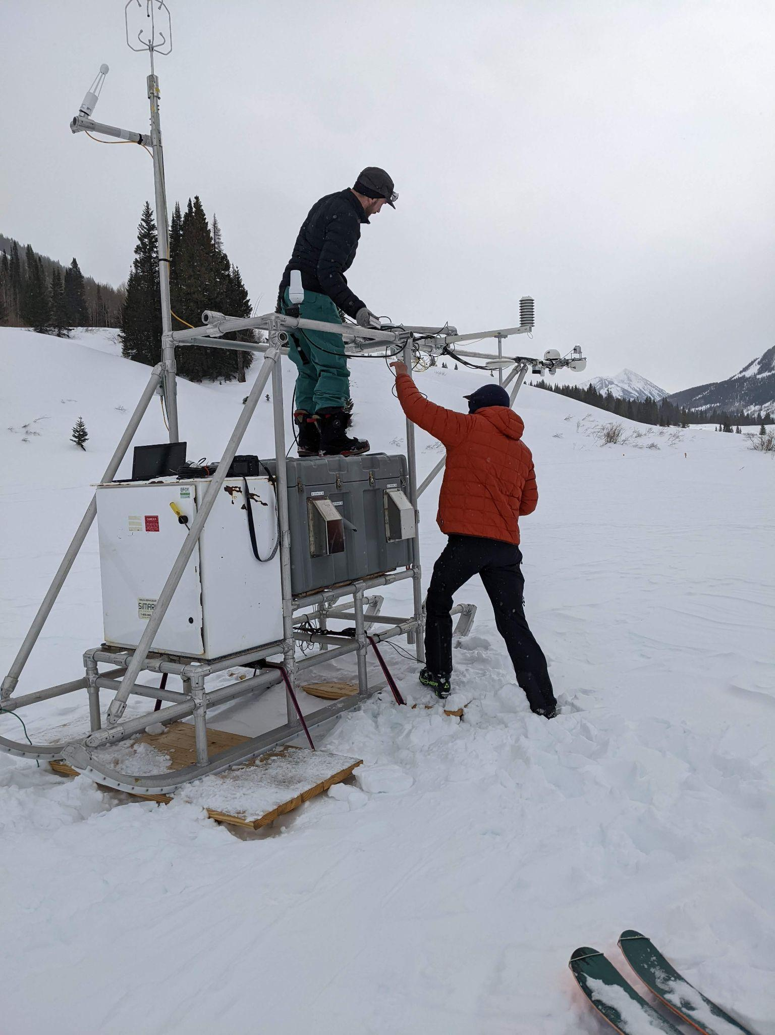
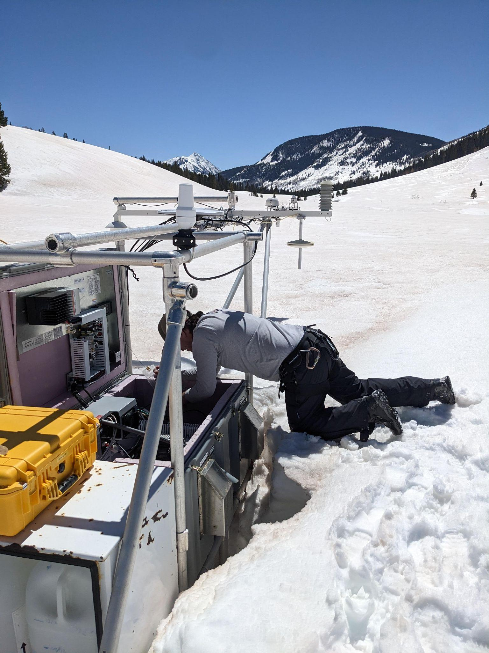
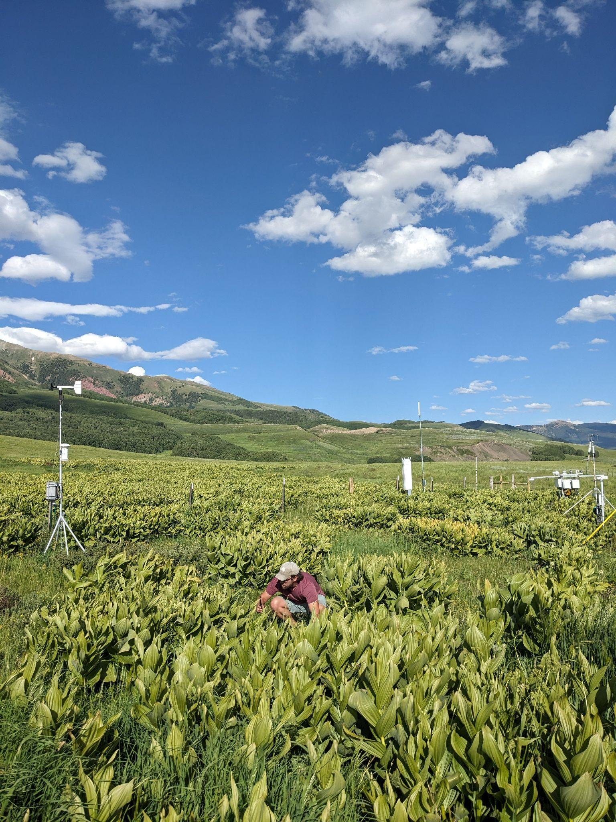
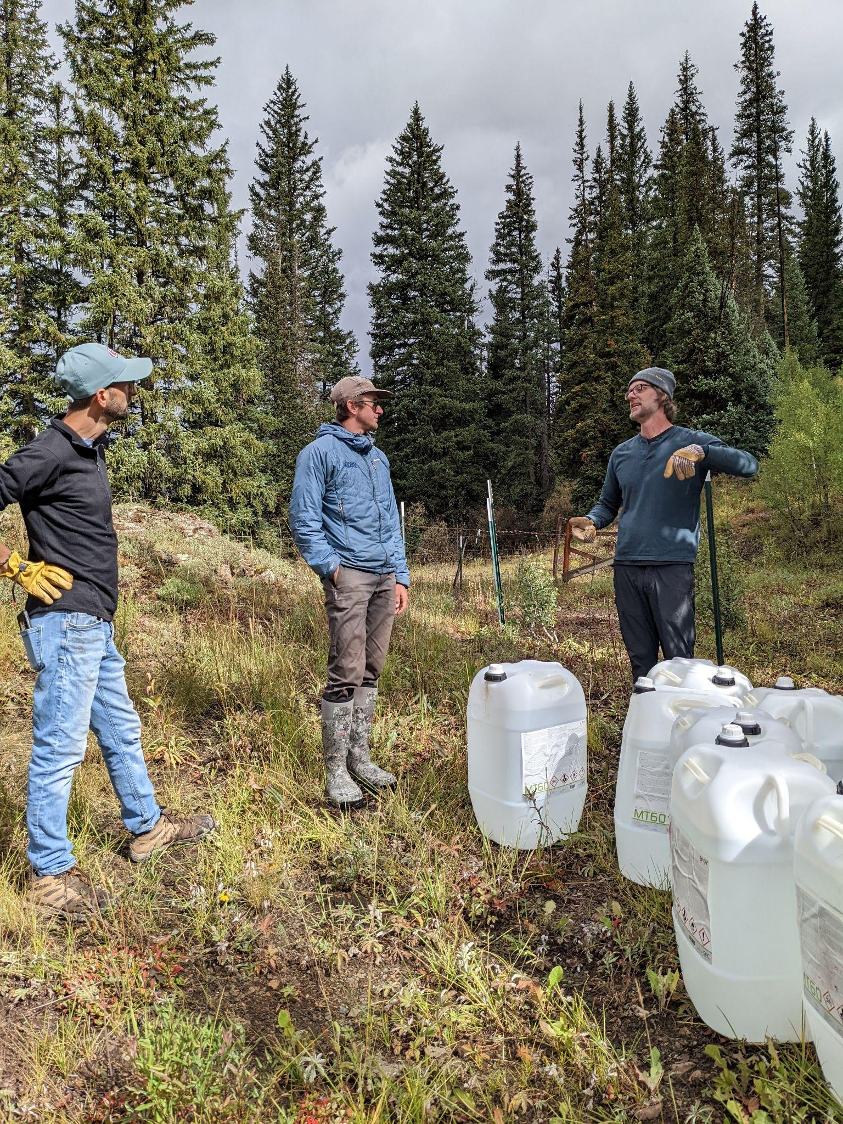
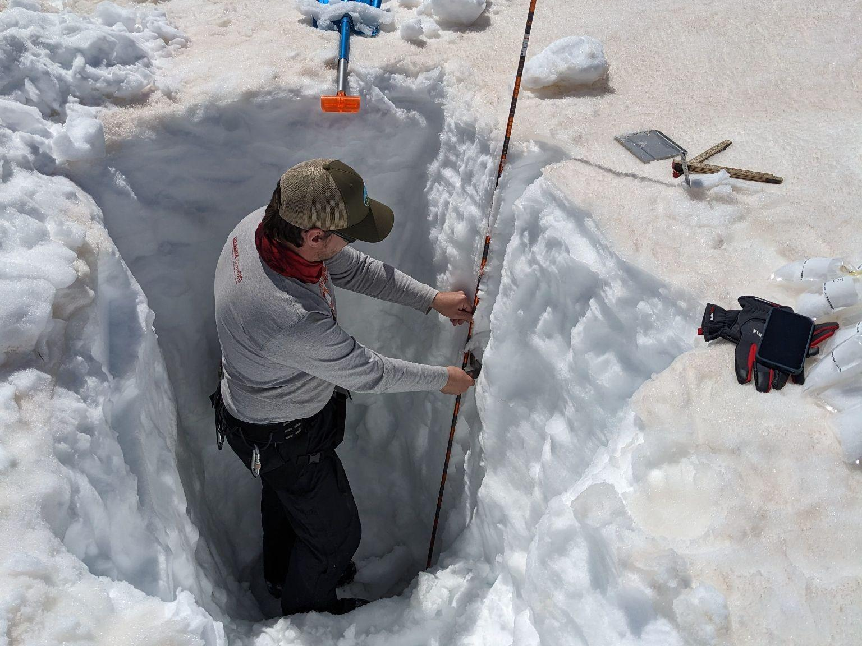
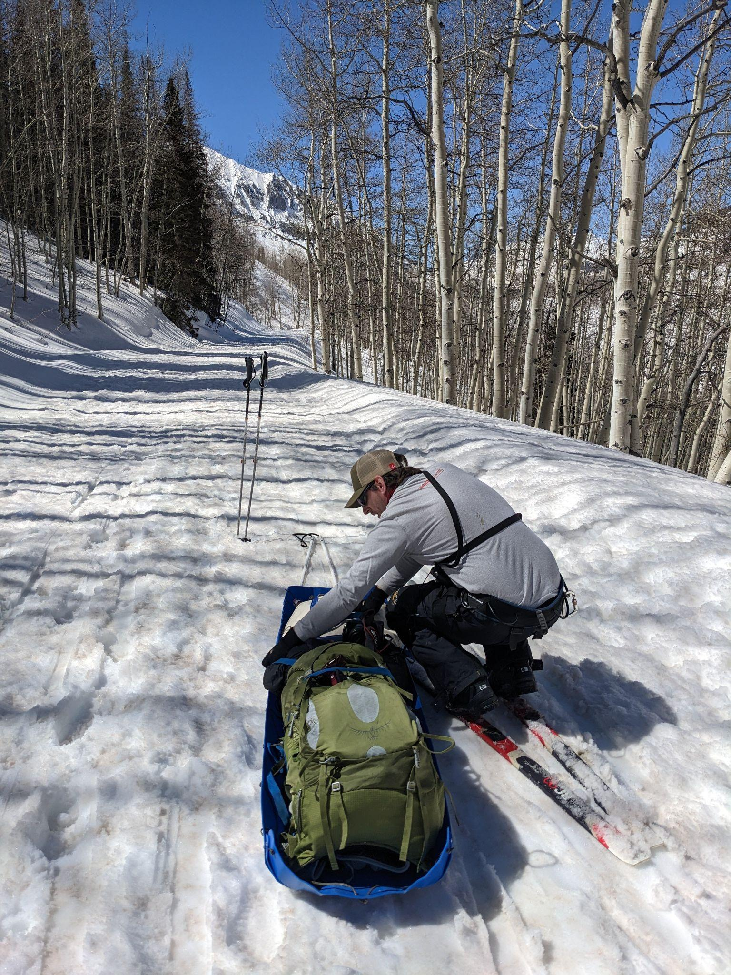
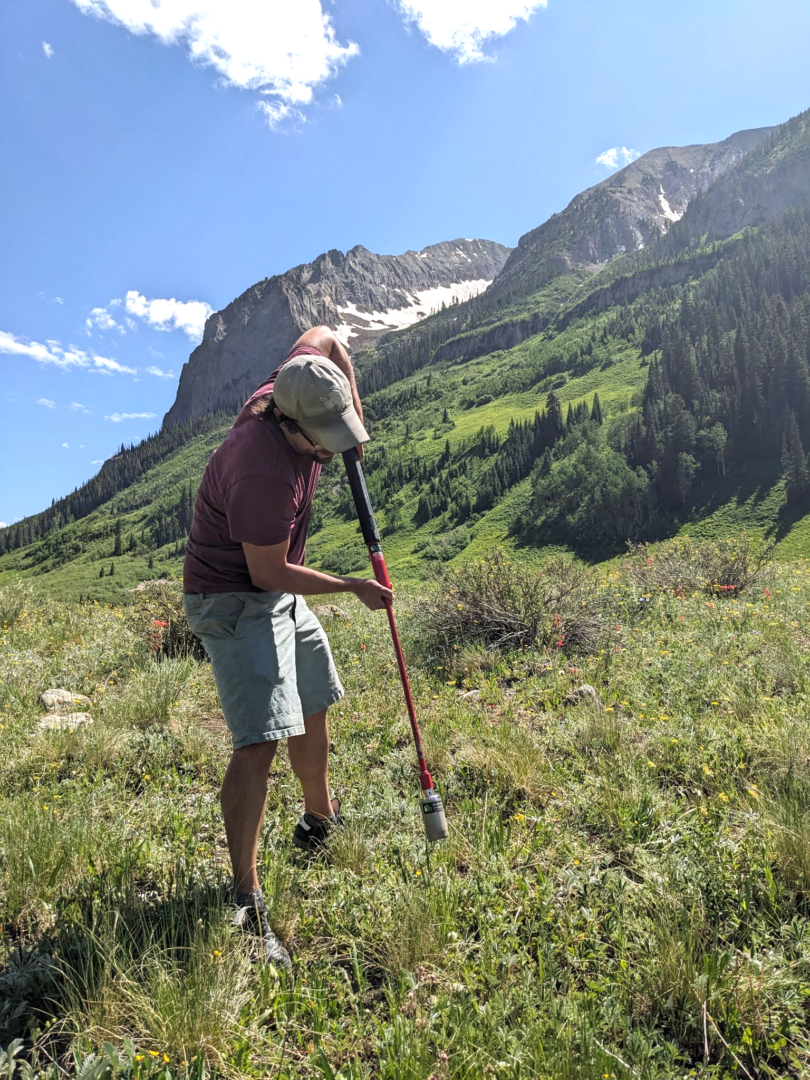
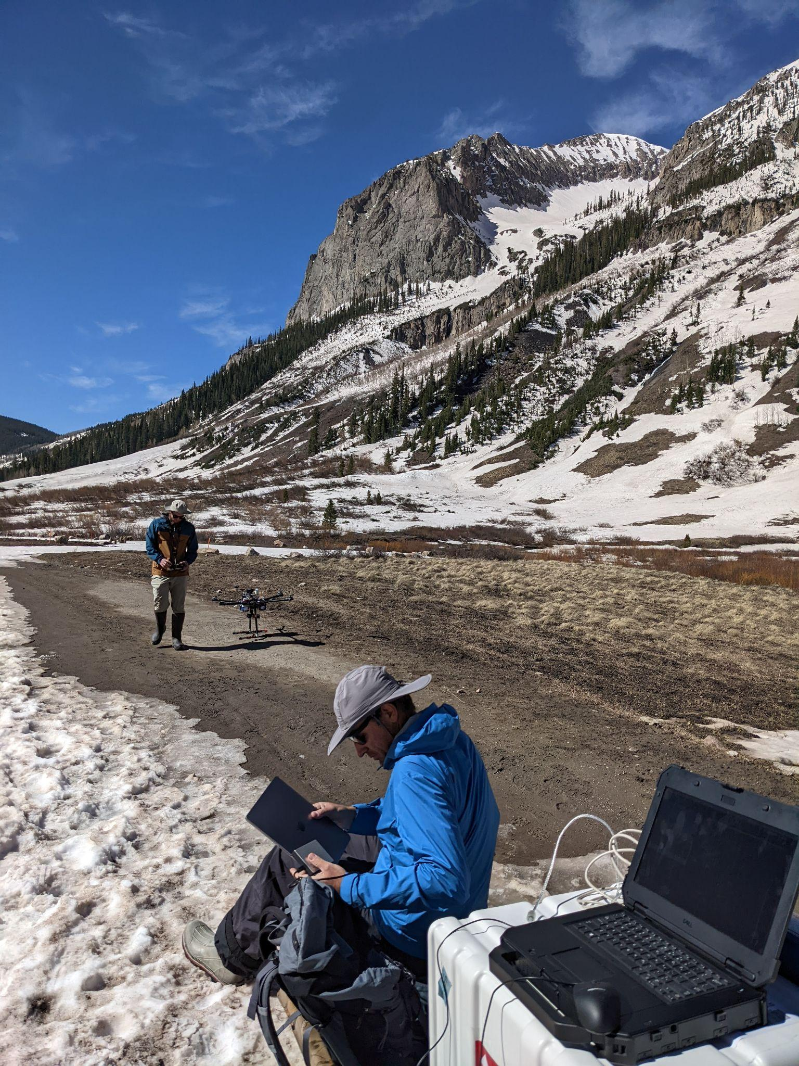
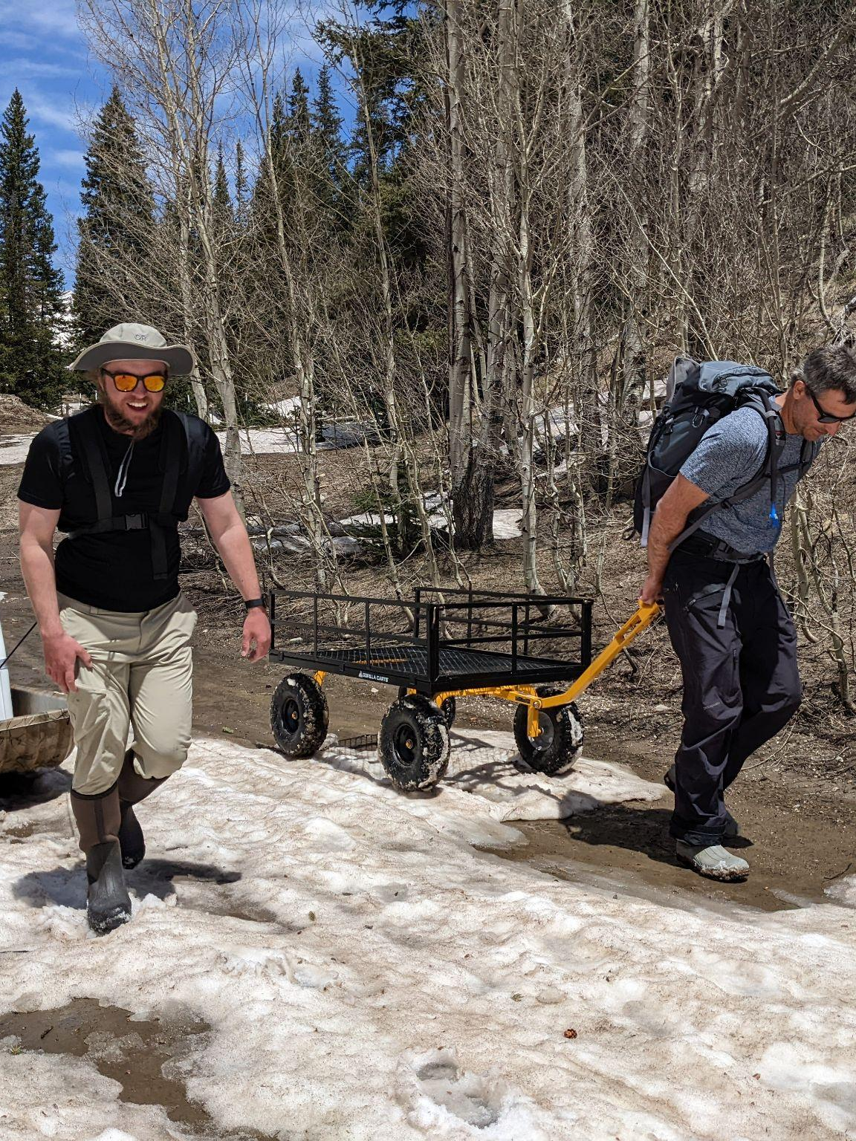
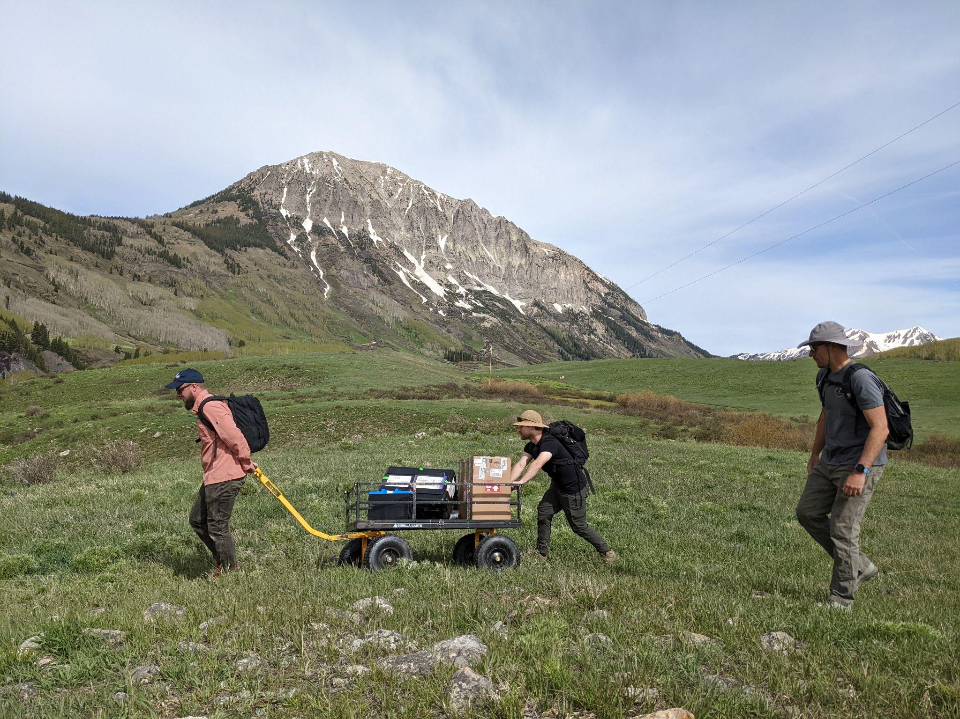
Out Standing in Our Fields

Slide 4
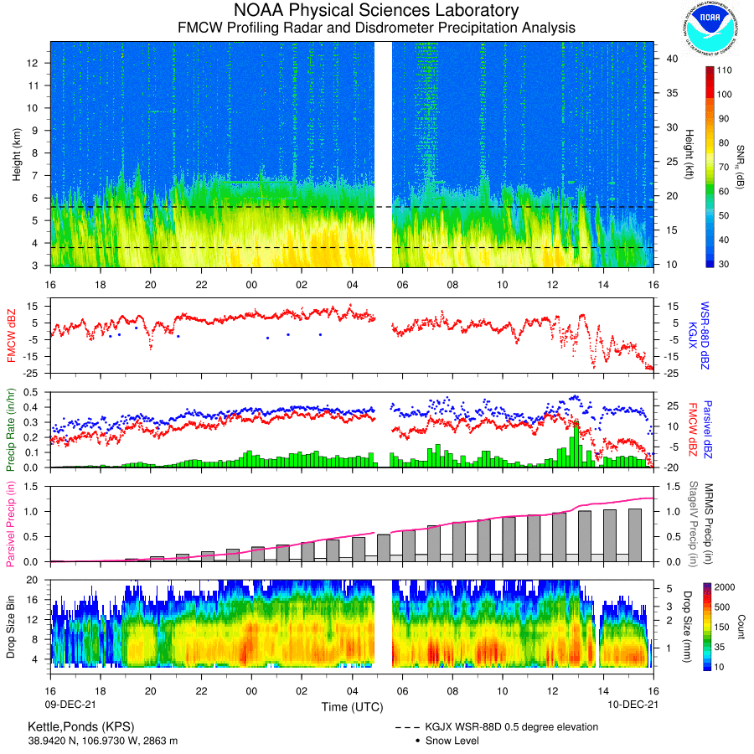
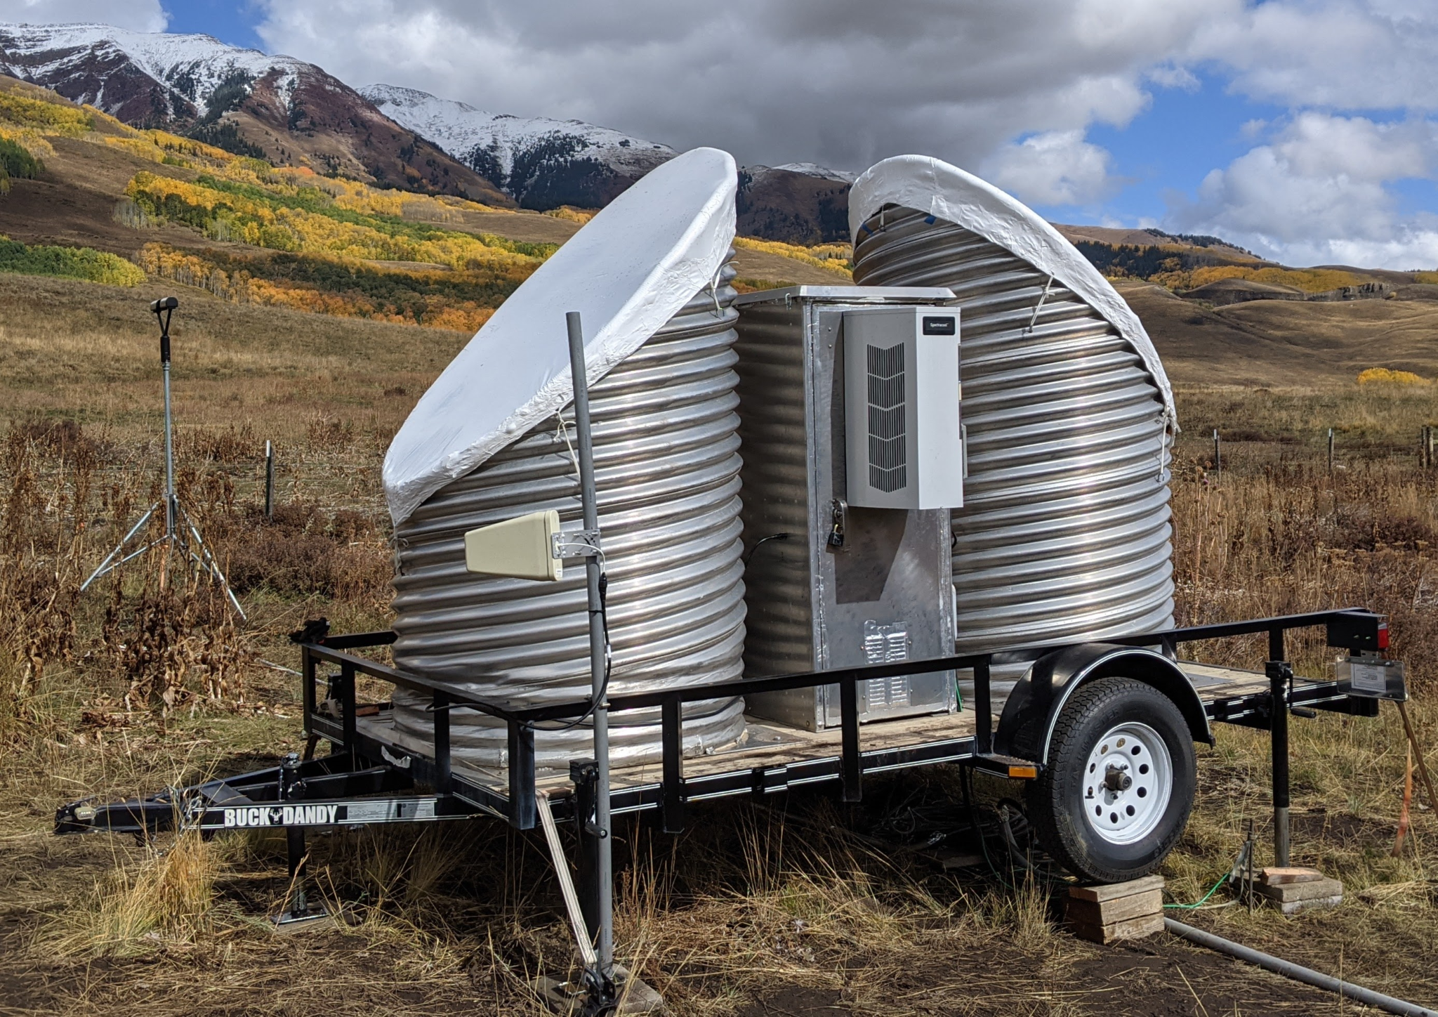
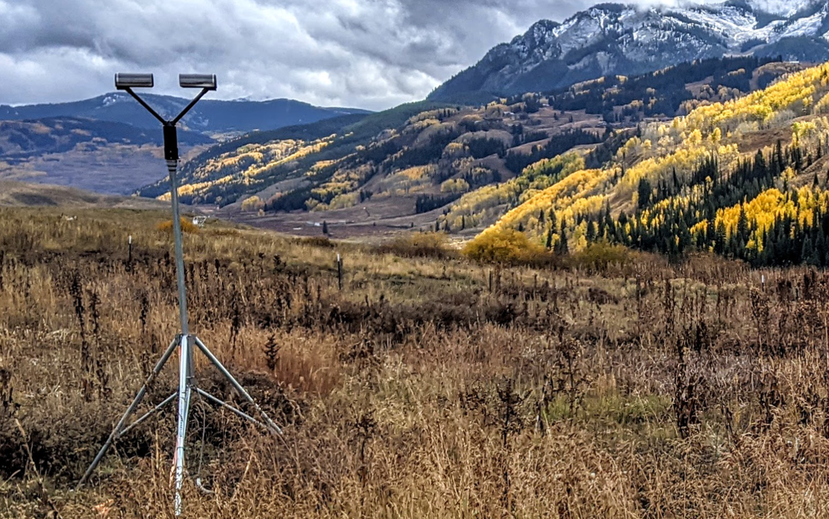
Snow-Level Radar & Disdrometer profiling & characterizing precipitation properties (KPS, BCK)
Snow-level Radar measures vertical profiles of:
Radar reflectivity
Doppler velocity
Spectral width
40 m vertical resolution from 40 m to 10 km
32 s temporal resolution
The Parisvel laser disdrometer measures 2-min values of:
Drop-size distribution from 0.312 mm to 24.5 mm in 30 bins
Precipitation rate
Equivalent radar reflectivity
Precipitation type (derived)
S-band FMCW Radar, Disdrometer & Sfc Met data files, QL’s & info available at:
https://psl.noaa.gov/data/obs/data/
https://psl.noaa.gov/data/obs/download/DownloadUsage.html
POC: Allen.B.White@noaa.gov

Slide 5
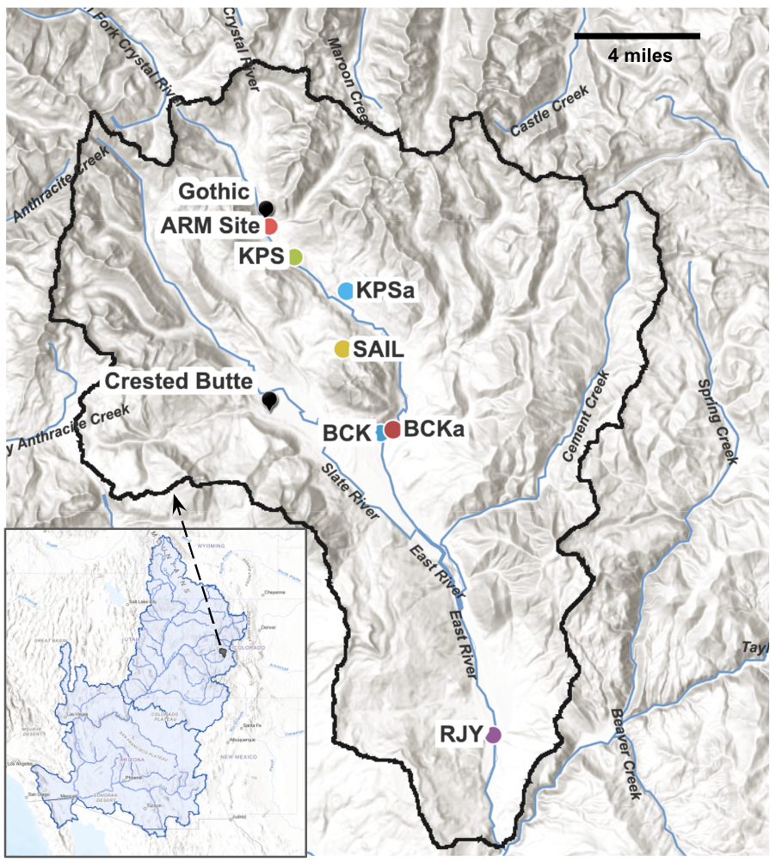
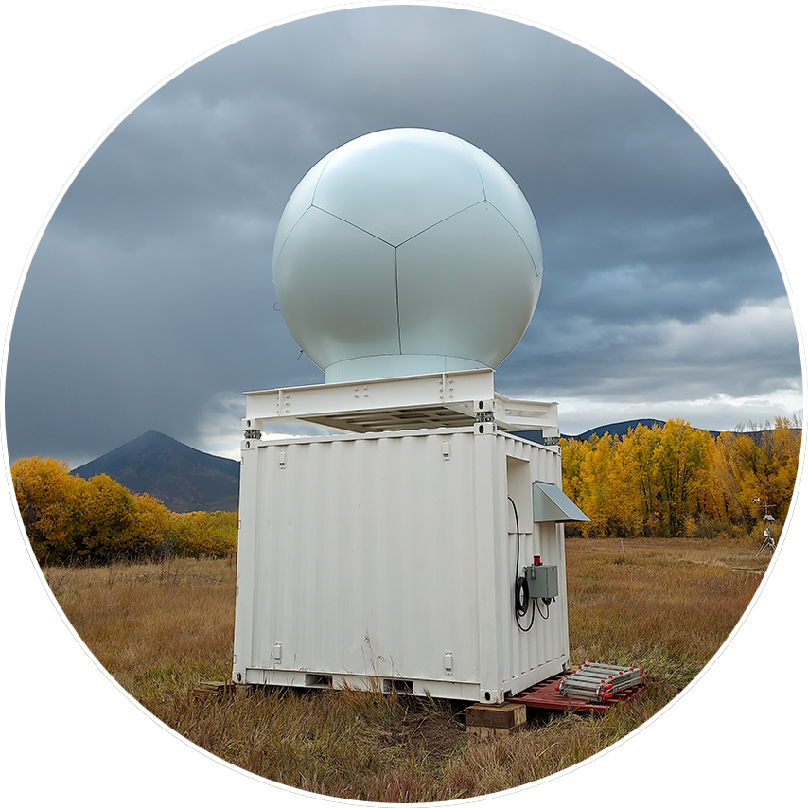
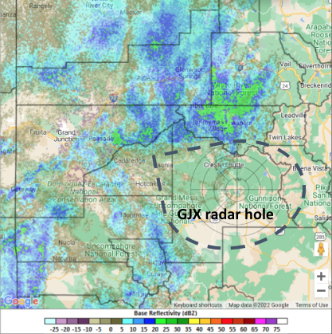
Scanning X-band Radar mapping precipitation & microphysical processes in the East River Valley & surrounding terrain (RJY)
PPI’s every ~5 min at elevations (2, 12, 2)
RHI’s every ~5 min along azimuths:
N Sector (332, 352, 2)
S Sector (175, 185, 1)
Scanning X-band radar data available at: https://psl.noaa.gov/data/obs/data/

Slide 6
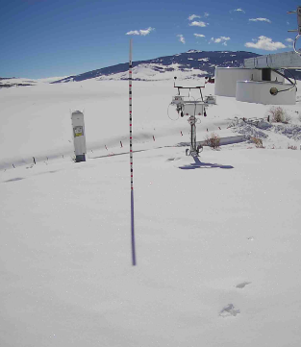
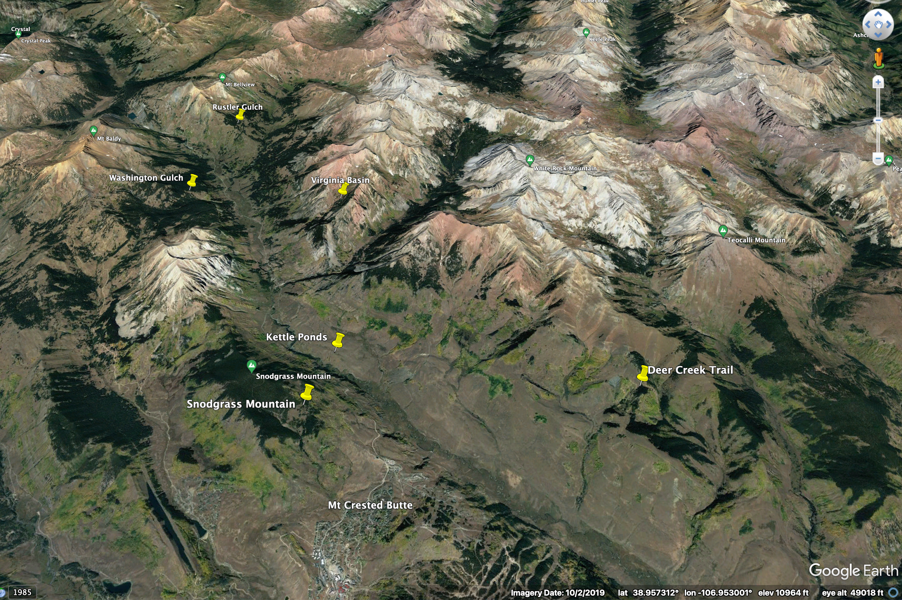
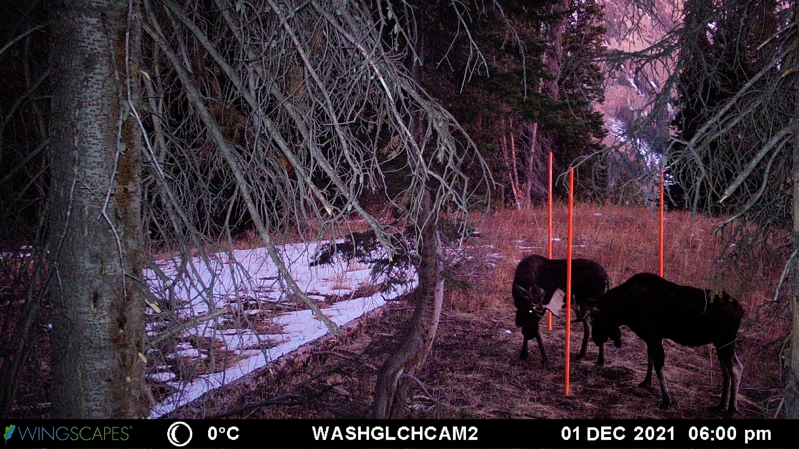
Snow Stakes capturing snow depth, T/RH in the greater Gothic Valley area (KPS + 5 remote locations)
Temperature and Relative Humidity Measurements
Moose visit the Snow Depth Monitoring site
6 sites: 5 remote snow depth and temperature/RH locations + KPS
Derived cold air pool and surface lapse rates from surface temp observations
POC: William.R.Currier@noaa.gov

Slide 7
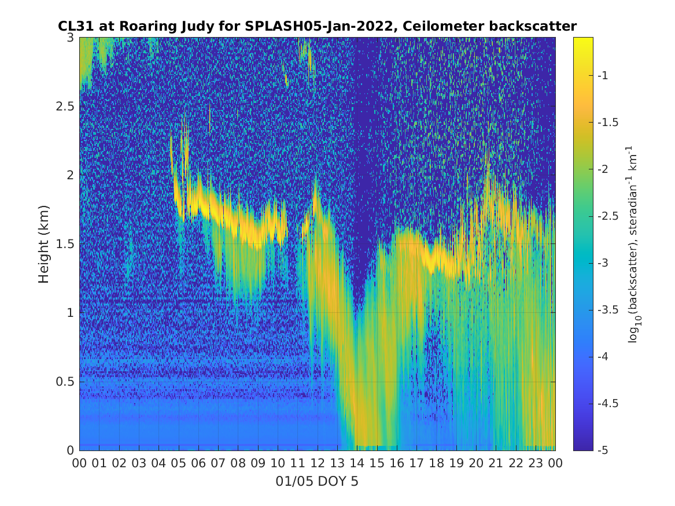
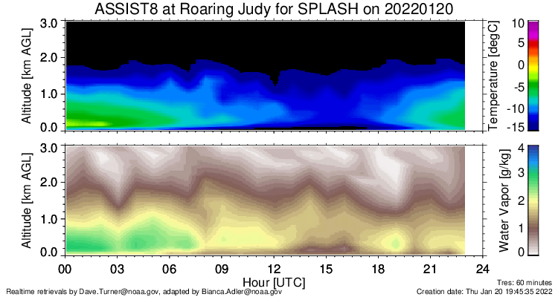
ASSIST-II profiling BL atmospheric thermodynamic properties (RJY*)
Ceilometer identifying cloud base height, fraction, PBL height estimates (RJY*)
Microwave Radiometer providing RT thermodynamic profiles (RJY*)
Continuous temperature profiling with infrared spectrometer at RJY
Retrieval of temperature profiles with optimal estimation physical retrieval TROPoe every 10 min
*Only from Sept 2021- Jan 2022
Adler, Bianca, et al. (2022). NOAA PSL CL31 Ceilometer Backscatter and Cloud Base Height Data for SPLASH (1.0.0) [Data set]. Zenodo. https://doi.org/10.5281/zenodo.7438524
Adler, Bianca, et al, (2022). NOAA PSL thermodynamic profiles retrieved from ASSIST infrared radiances with the optimal estimation physical retrieval TROPoe during SPLASH (1.0.0) [Data set]. Zenodo. https://doi.org/10.5281/zenodo.7435060

Slide 8
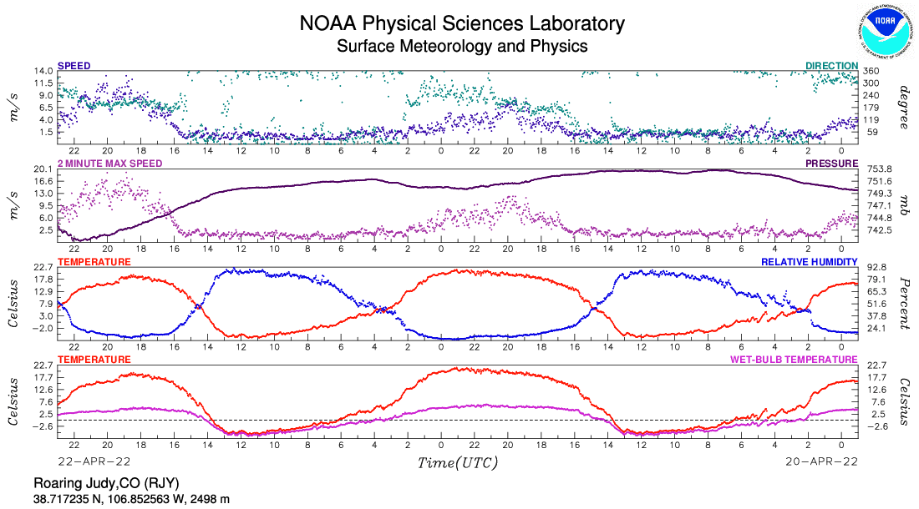
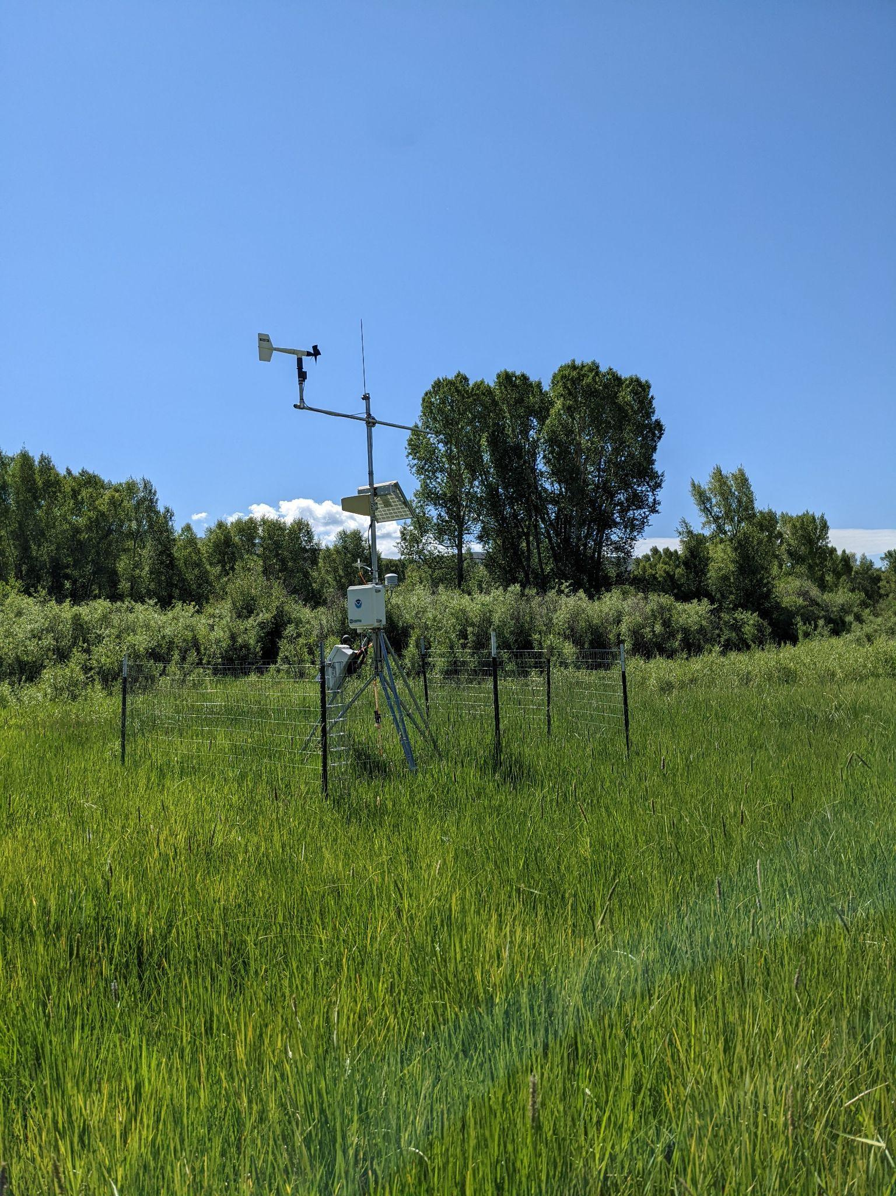
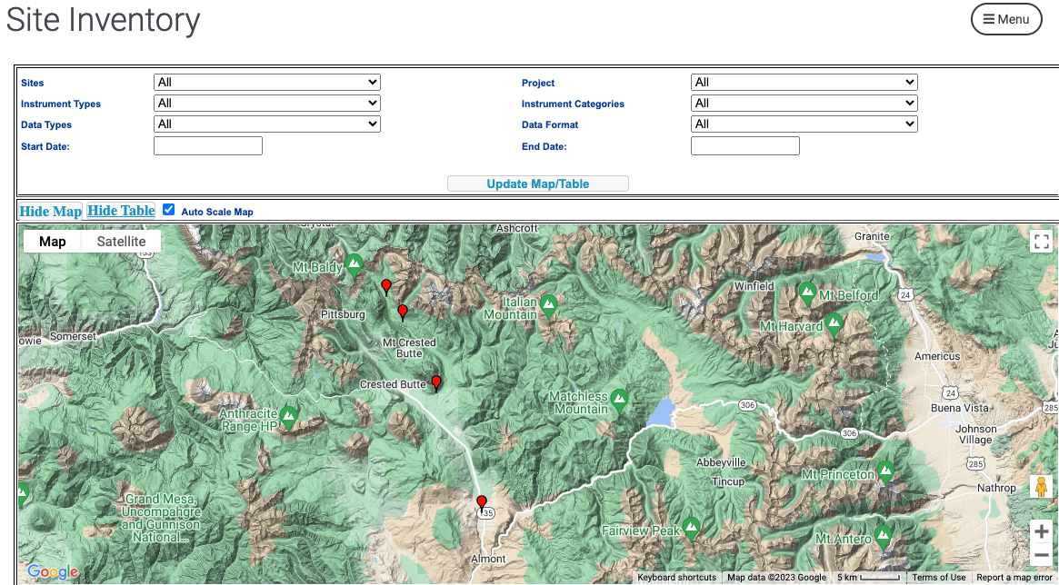
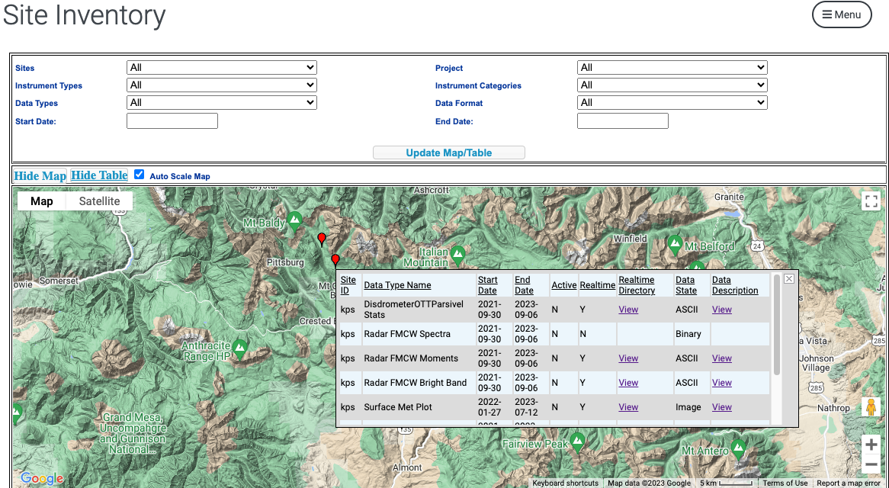
Surface Meteorology measuring sfc conditions & evolution (RJY, BCK, KPS)
Data files & images: https://psl.noaa.gov/data/obs/data/
POC: Allen.White@noaa.gov

Slide 9
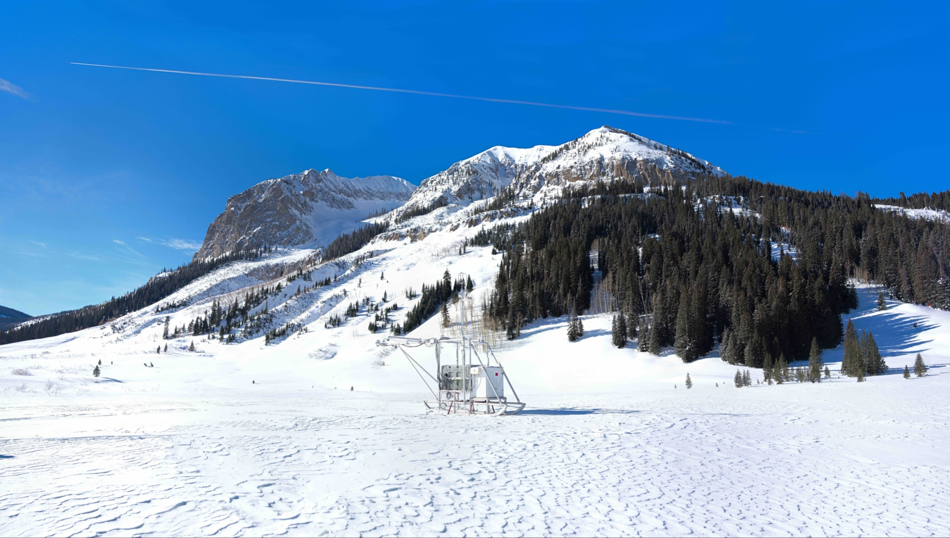
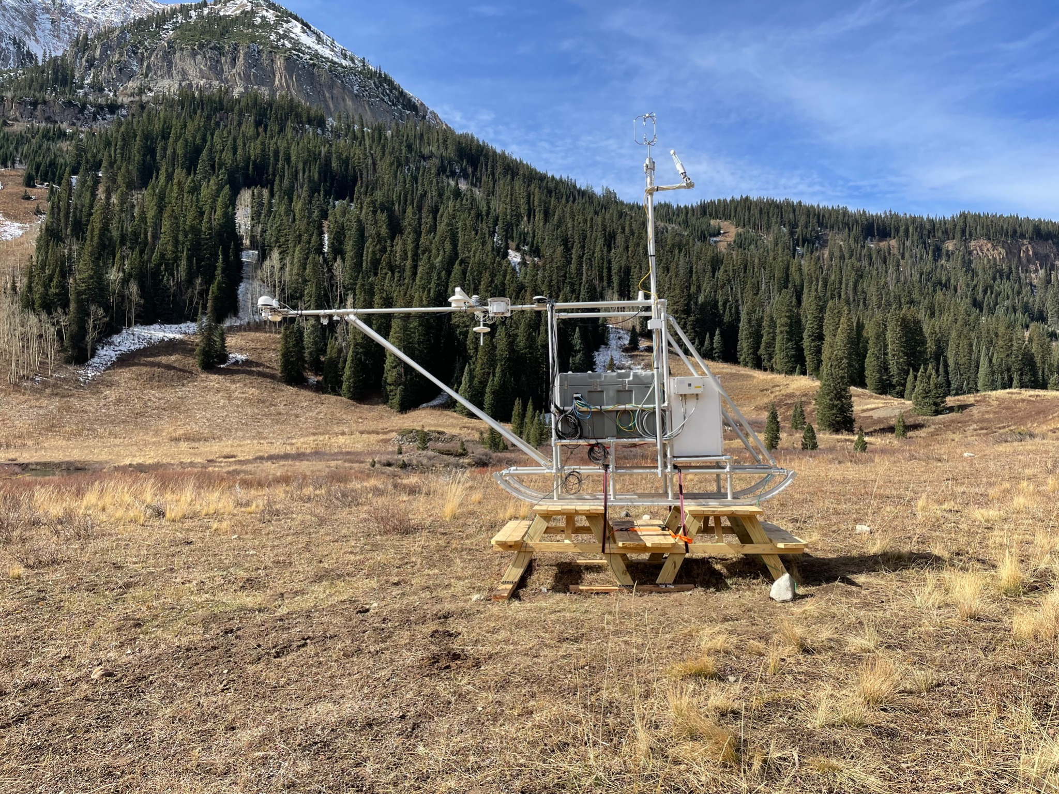
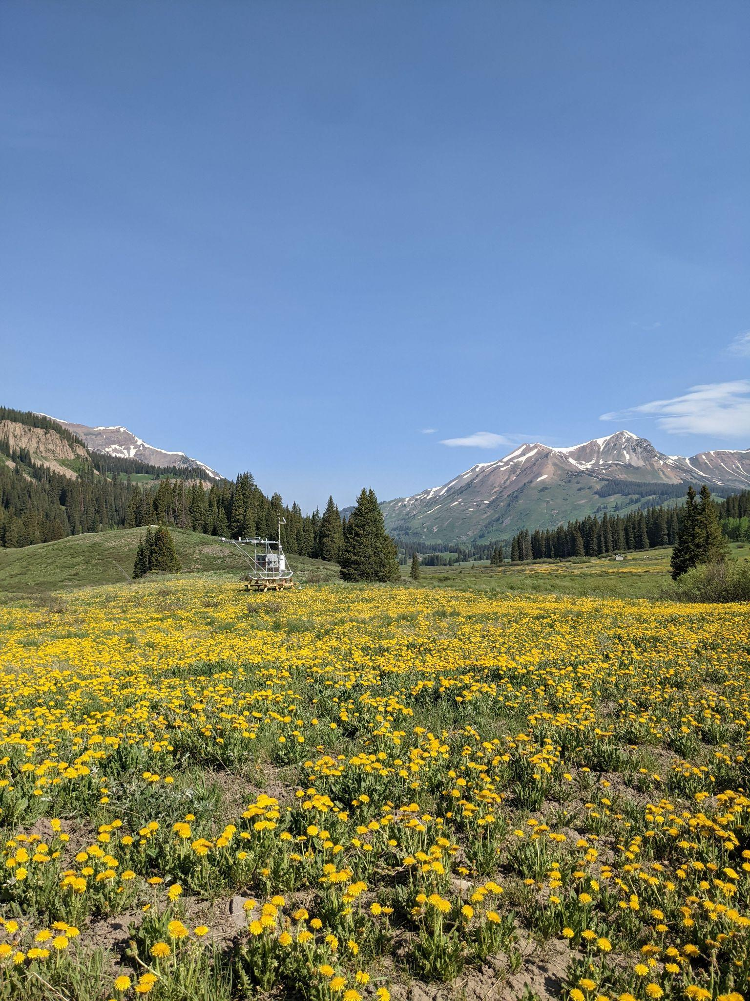
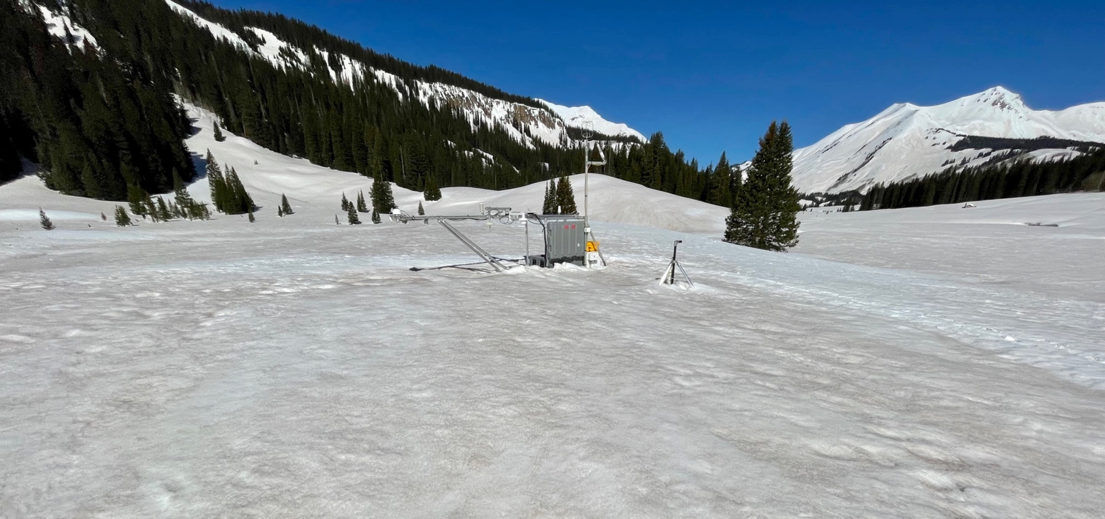
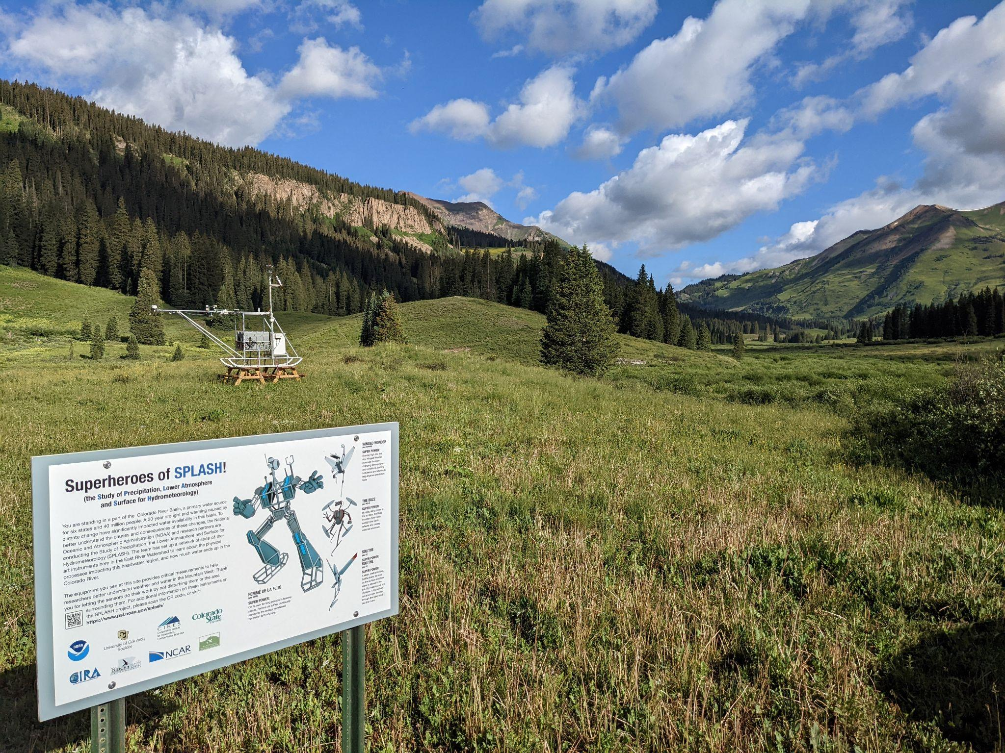
Atmospheric Surface Flux System characterizing surface energy exchanges (AYP, KPA)
January
October
Peak Dandelion
3d winds, gas analyzer
up/down SW/LW radiation
April
T, RH, P
April
Tsfc, sfc height
Picnic tables
50 cm soil probe
Conductive flux plates
Thermistor string
(2023)
July
Photo: M. Gallagher

Slide 10
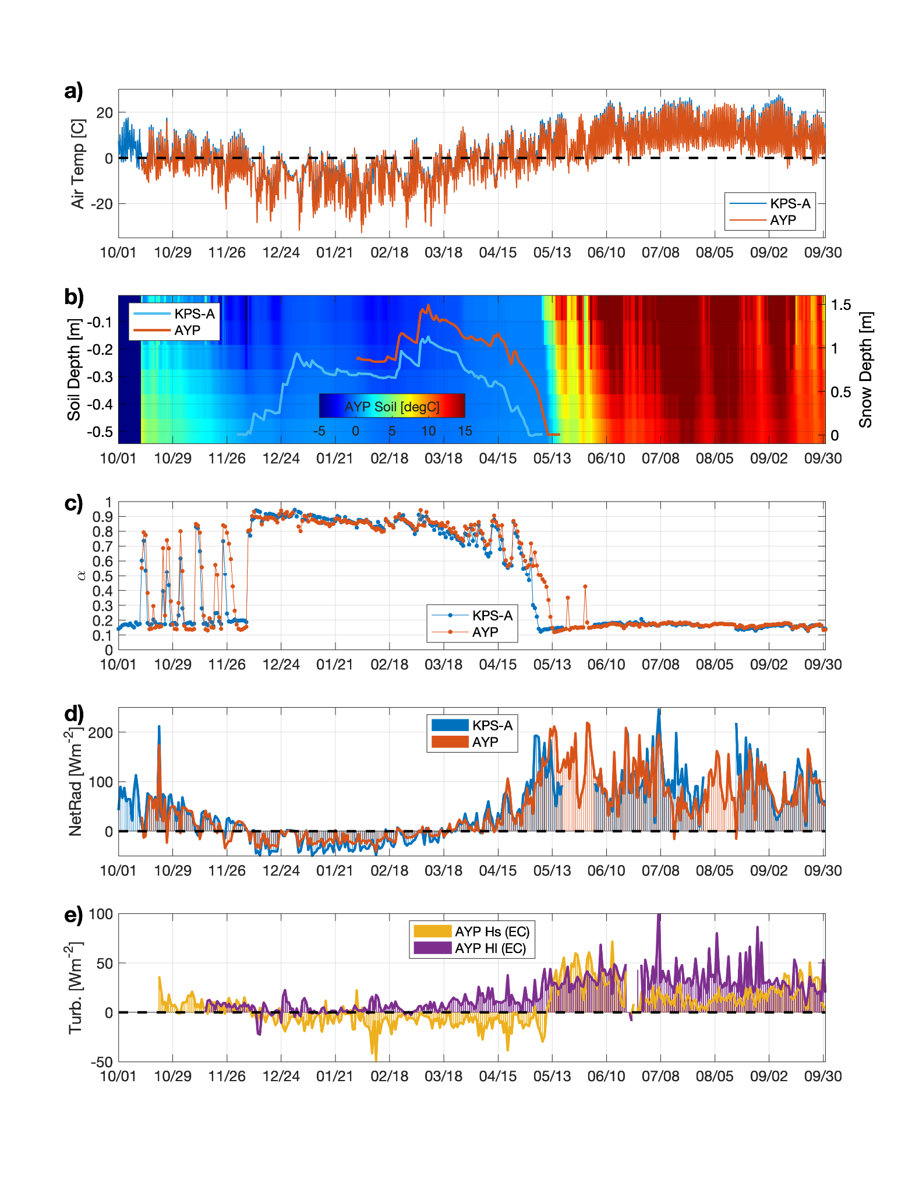
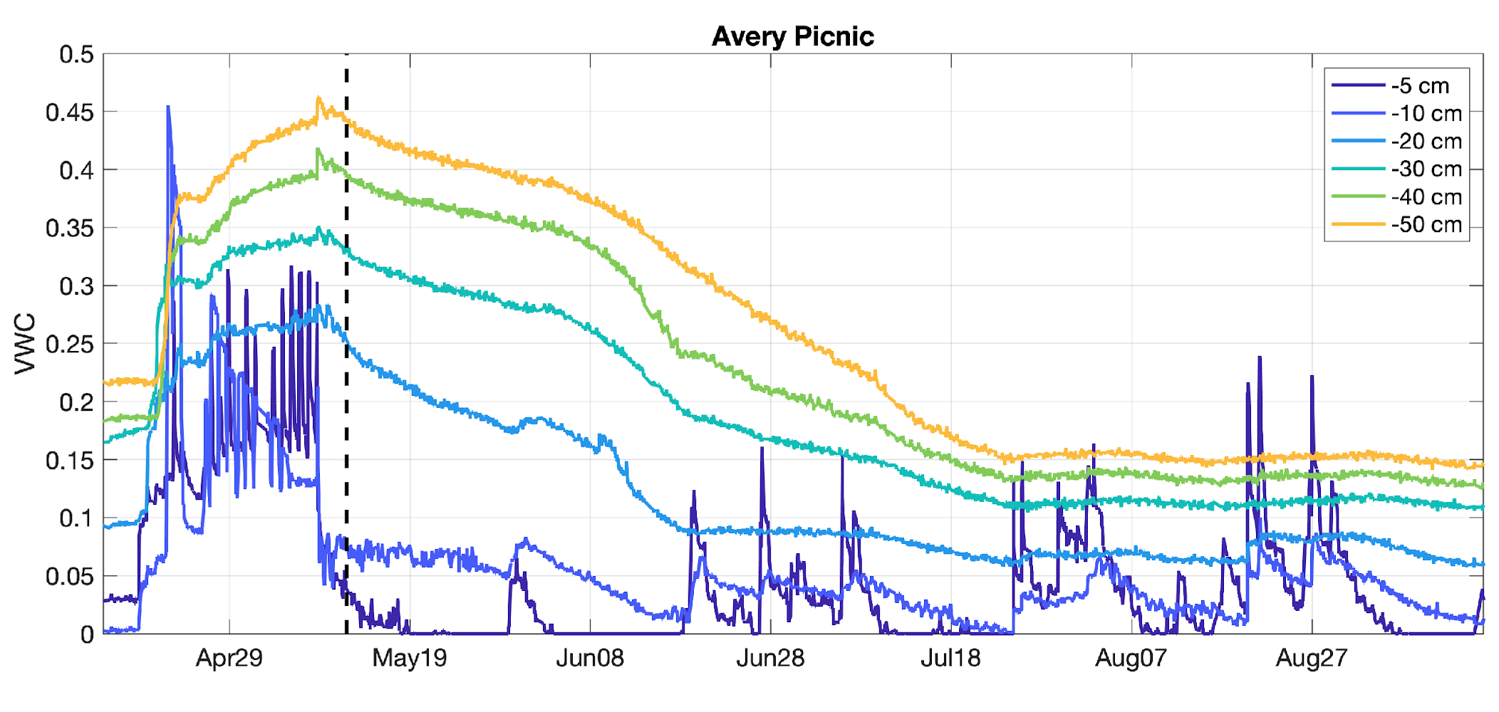
ASFS Data & Uptime
Data paper in preparation for Earth System Science Data
Daily netCDF upload to Zenodo, planned for November 2023
POC: Christopher.J.Cox@noaa.gov
28 September 2021 - 19 July 2023
]
]
97% uptime (most)
87% (latent)
only year 1
cable damage summer 2021
sensor not installed at this site
12 October 2021 - 21 June 2023
]
90% uptime (most)
74% (latent)
72% (snow)
]
only second winter

Slide 11
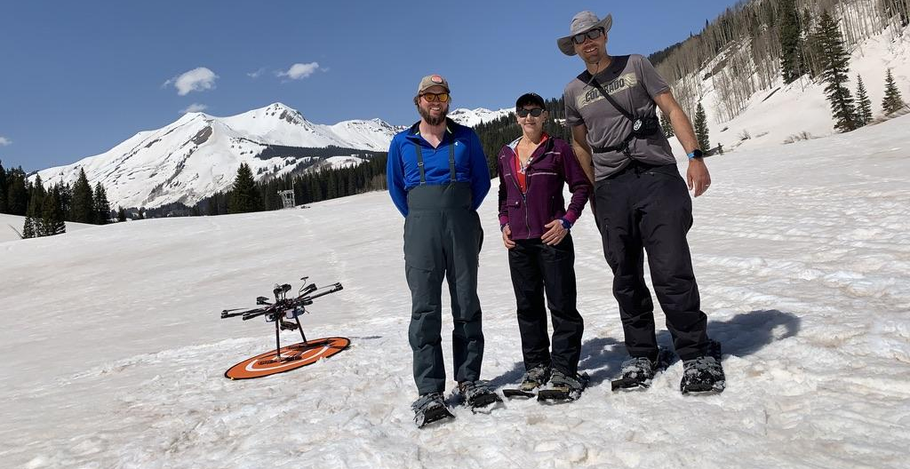
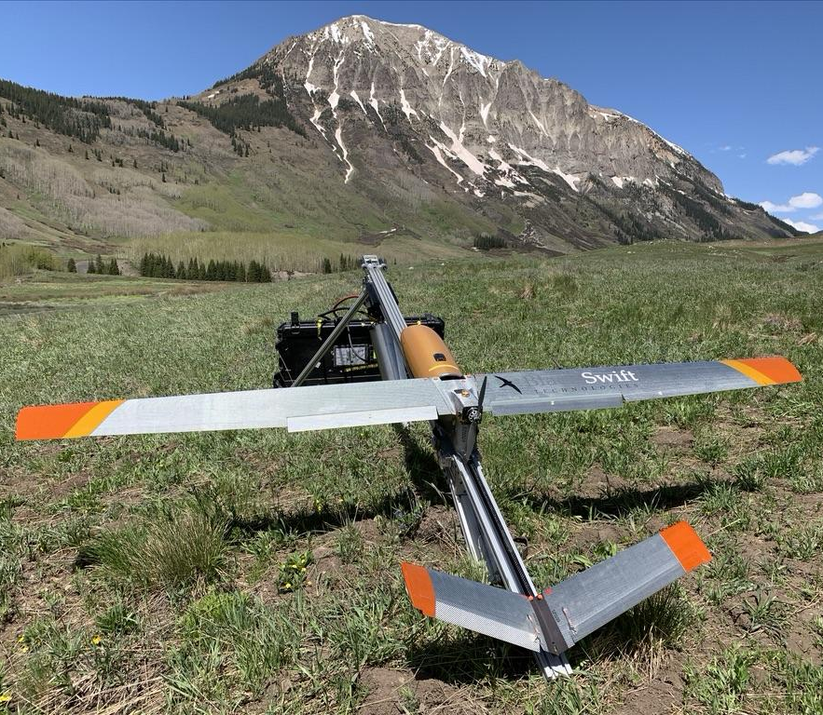
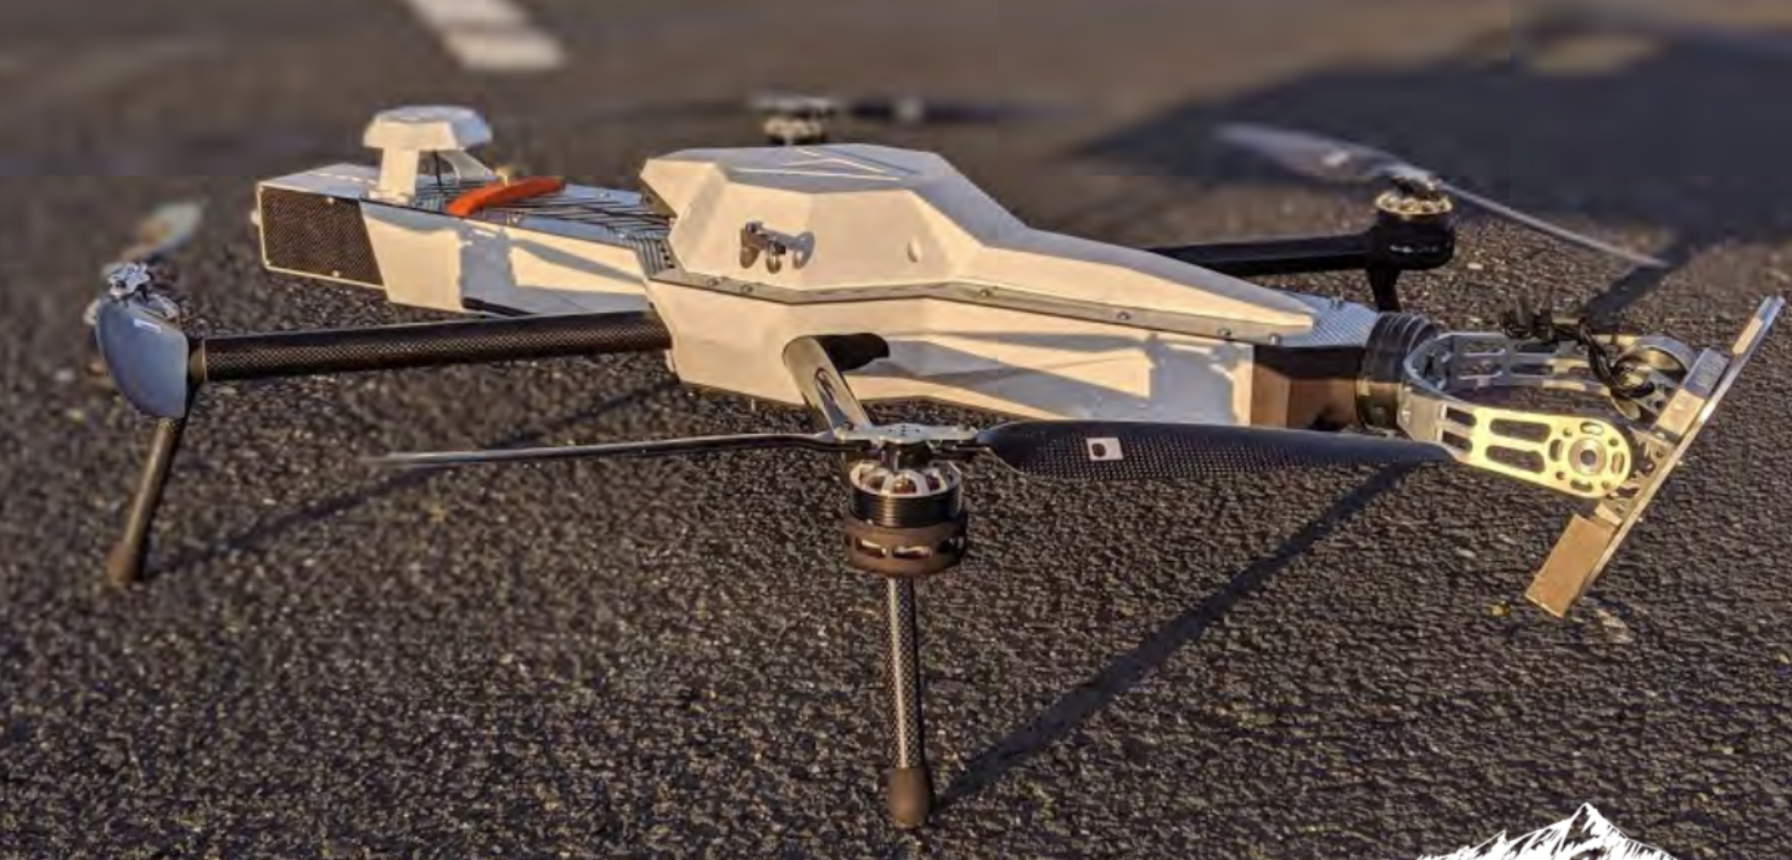
Surface UAS Obs (AYP, KPA areas)
Stabilized Kipp & Zonen Pyranometer (x2)
RedEdge-MX 5-channel camera
University of Colorado HELiX (deployed with custom pyranometers & multispectral camera) measured up- & downwelling shortwave irradiance, albedo, surface features, NDVI, & more
Deployments in March, April, May, and June 2022
Observed impacts of dust on snow and surface albedo evolution over spatial area
-de Boer, G., et al. HELiX UAS data for SPLASH 2022 (v1.0) [Data set], Zenodo, https://doi.org/10.5281/zenodo.7701558
-Elston, J., et al. BST/NOAA PSL Level 3 UAS Soil Moisture, Digital Elevation, Normalized Difference Vegetative Index, and Surface Temperature for SPLASH (v1.0) [Dataset], Zenodo, https://doi.org/10.5281/zenodo.7668270Elston, J., et al. BST/NOAA PSL Level -2 UAS Soil Moisture, Digital Elevation, Normalized Difference Vegetative Index, and Surface Temperature for SPLASH (v1.0) [Dataset], Zenodo, https://doi.org/10.5281/zenodo.7622355.
Black Swift Technologies S2 & E2 deployed with L-band radiometer and multispectral camera to measure soil volumetric water content, surface temperature, surface elevation and NDVI
Deployments in mid-October, early June, September & October for two years
Significant sensor development and enhancement

Slide 12
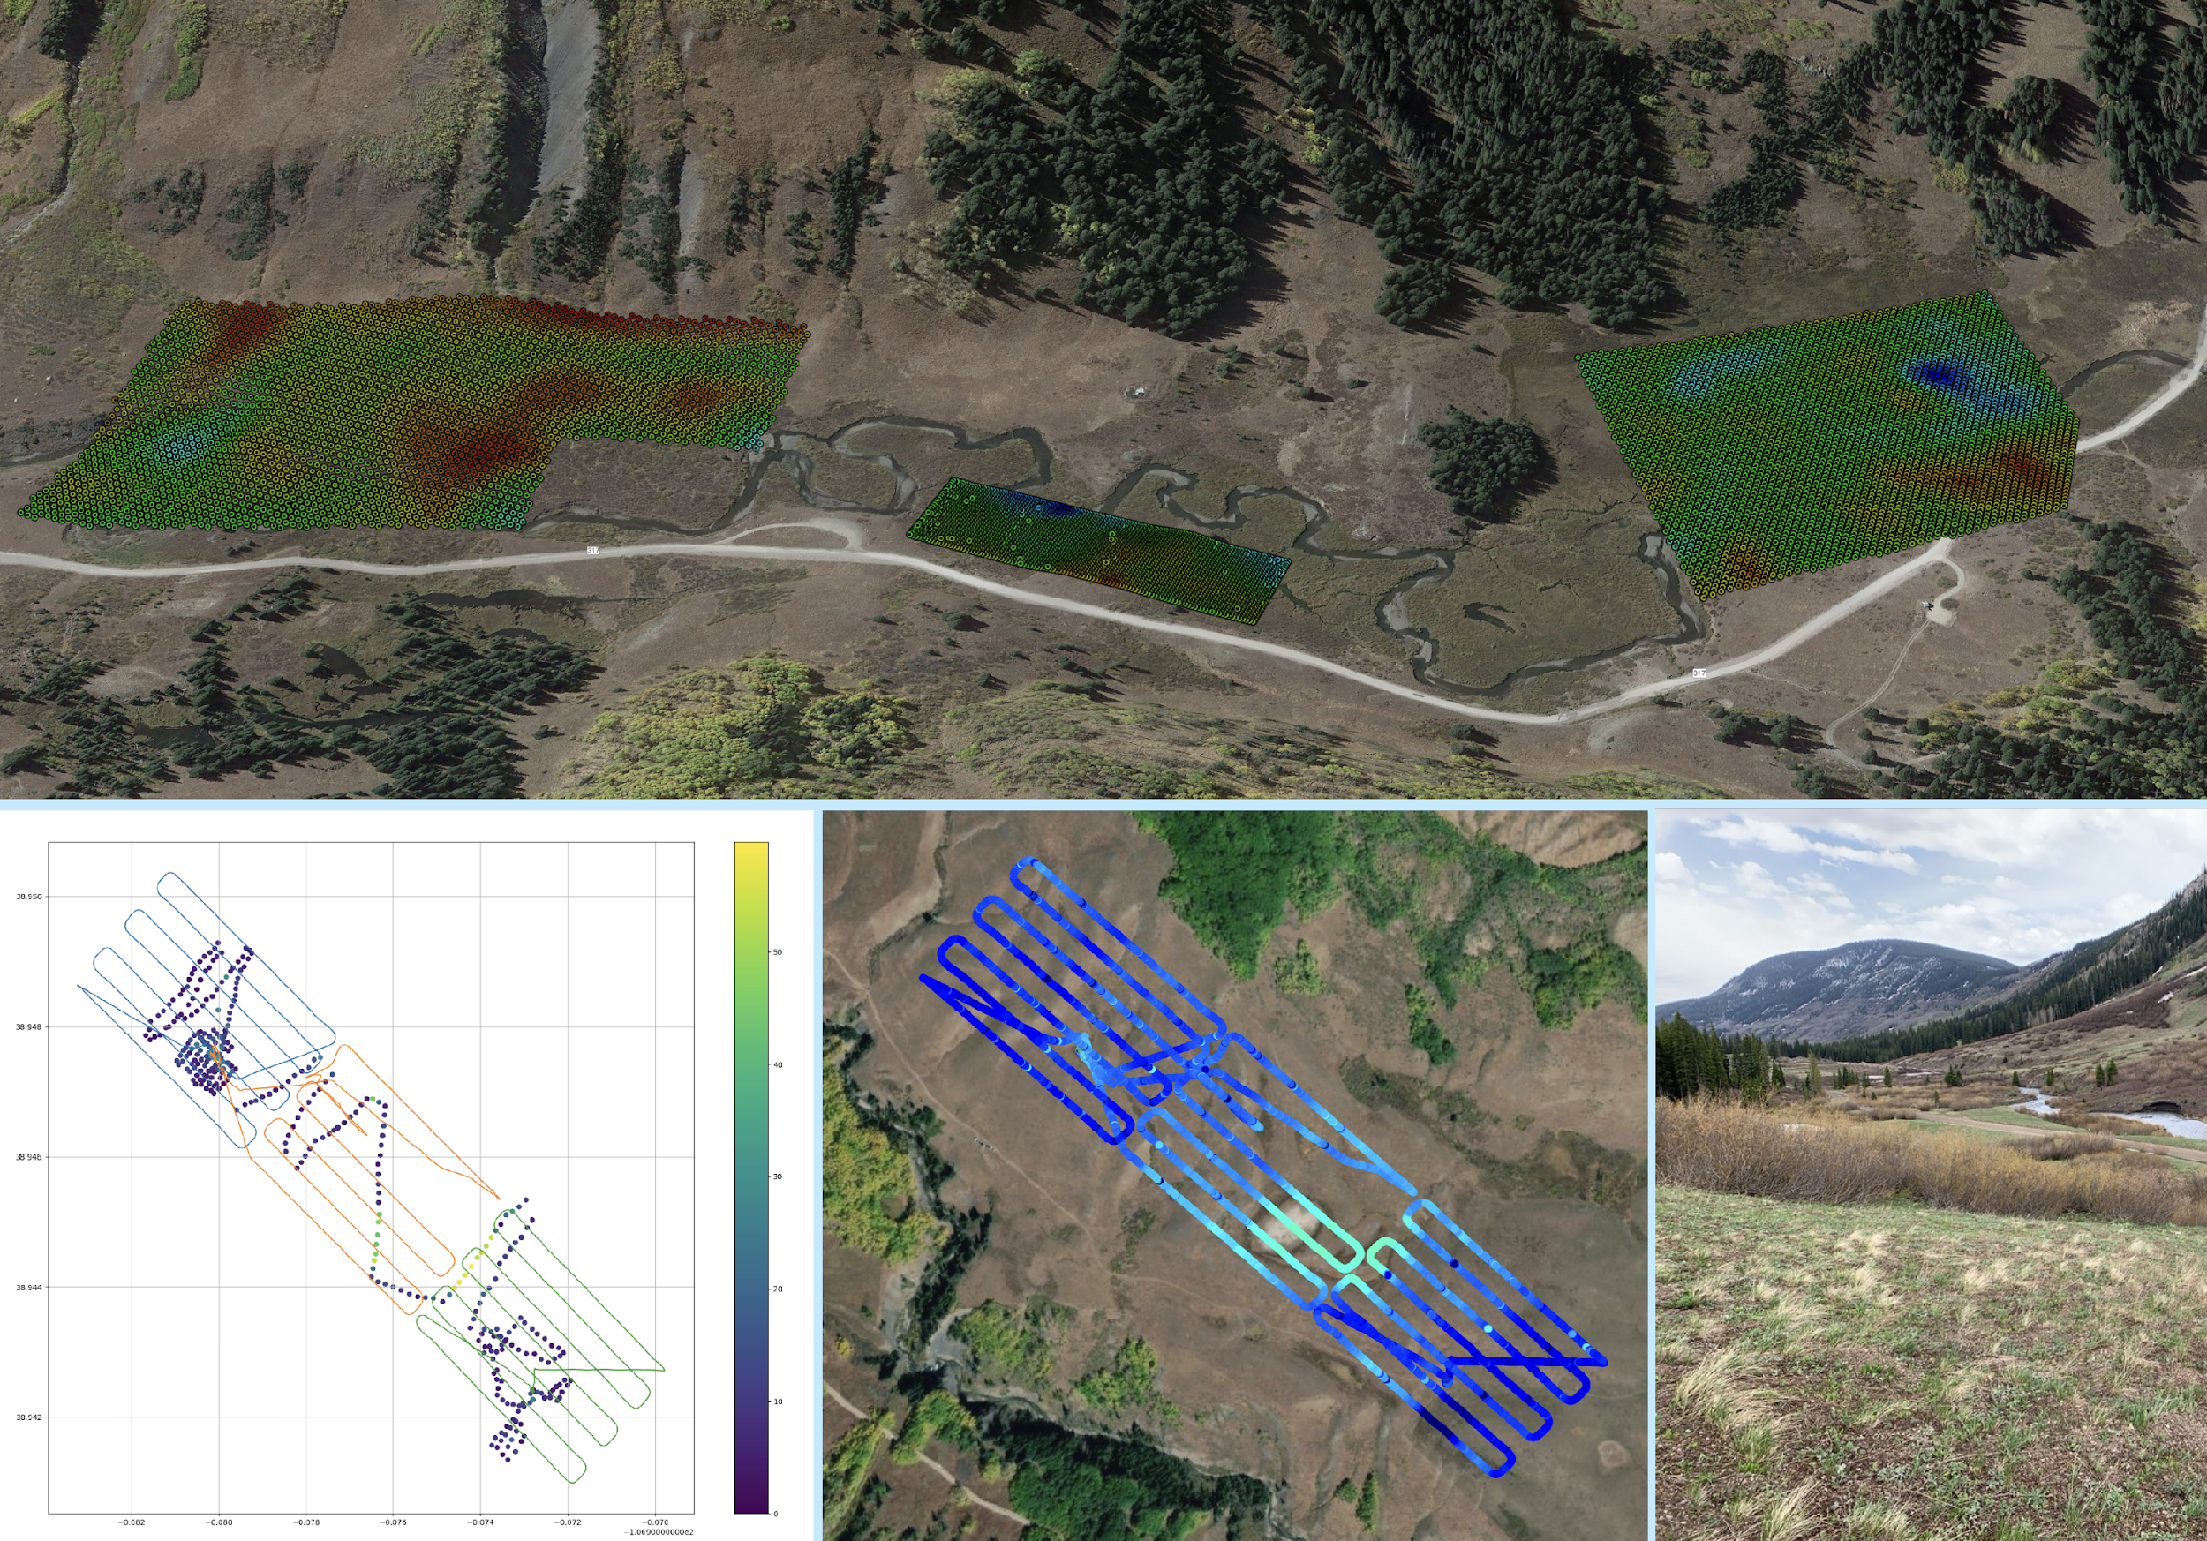
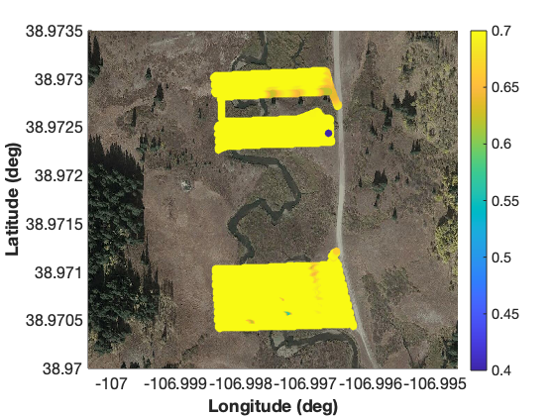
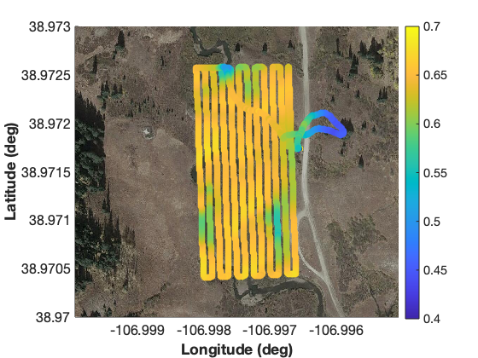
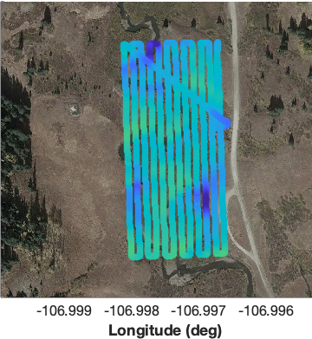
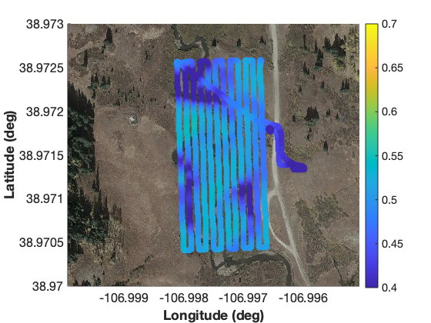
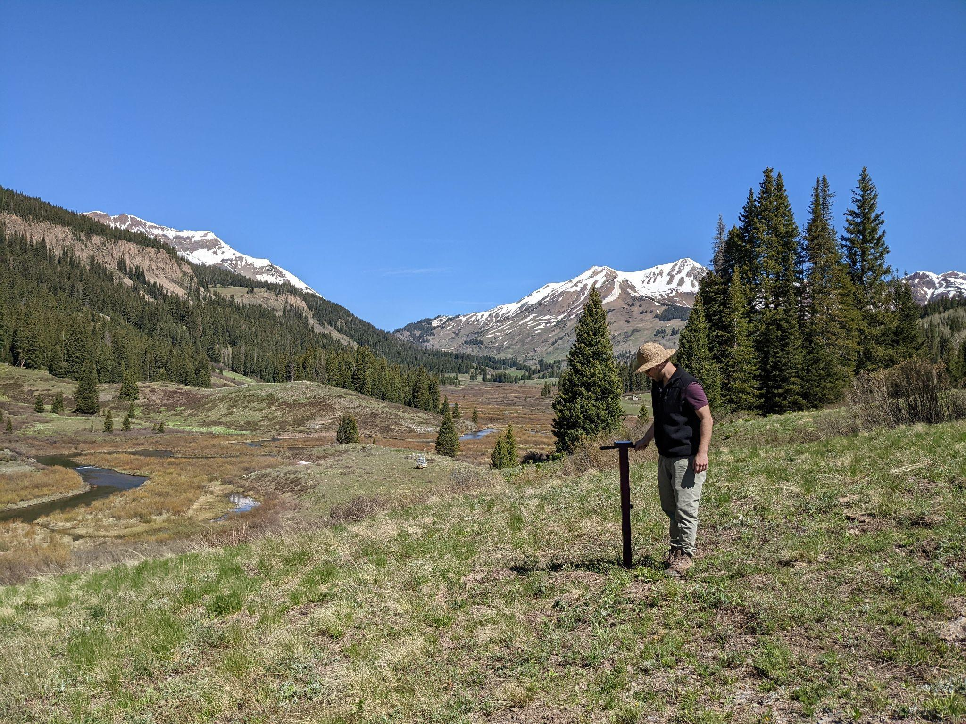
Surface UAS Mapping Obs (AYP, KPA areas)
Avery Picnic Mapping Areas (Upper: S2, E2 / Lower: HELiX)
Kettle Ponds Mapping Area
(Left: In situ probe / Right: S2, E2)
12-16 MAR 22
18 APR 22
19 APR 22
21 APR 22
Significant snow melt was observed during the April deployment. During this time, dust that had previously been deposited in the snowpack emerged at the surface, and the snowpack became significantly wetter. Together, these events resulted in a substantial reduction of the snow surface albedo. March flights showed albedos in this area of around 0.8, while the April albedos decreased from around 0.65 to 0.45 over the course of four days. Additionally, the river began to open up, resulting in even lower albedos values (<0.4).

Slide 13
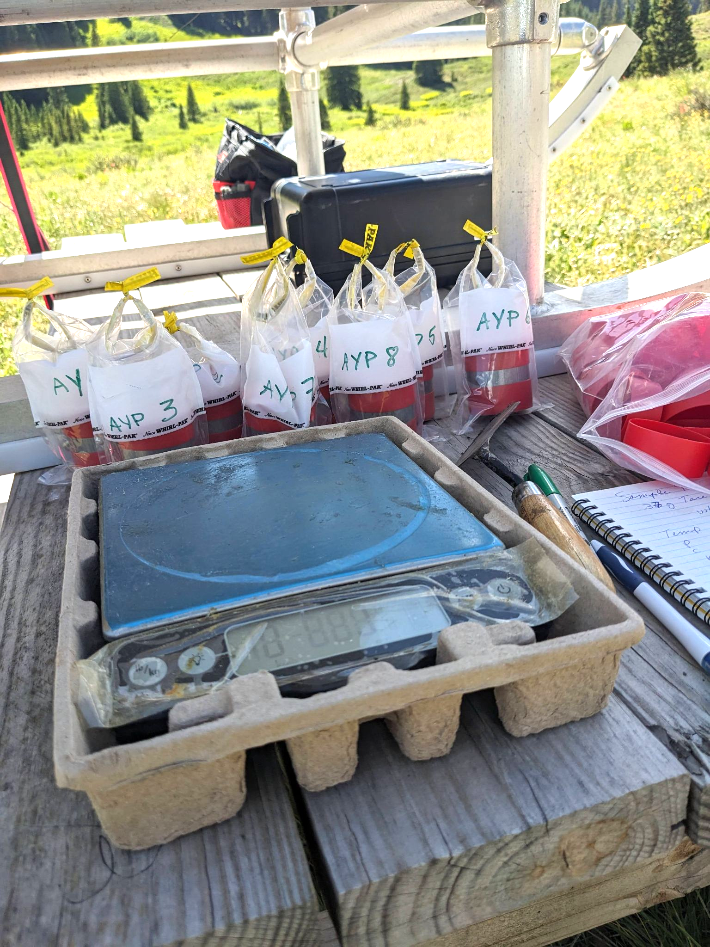
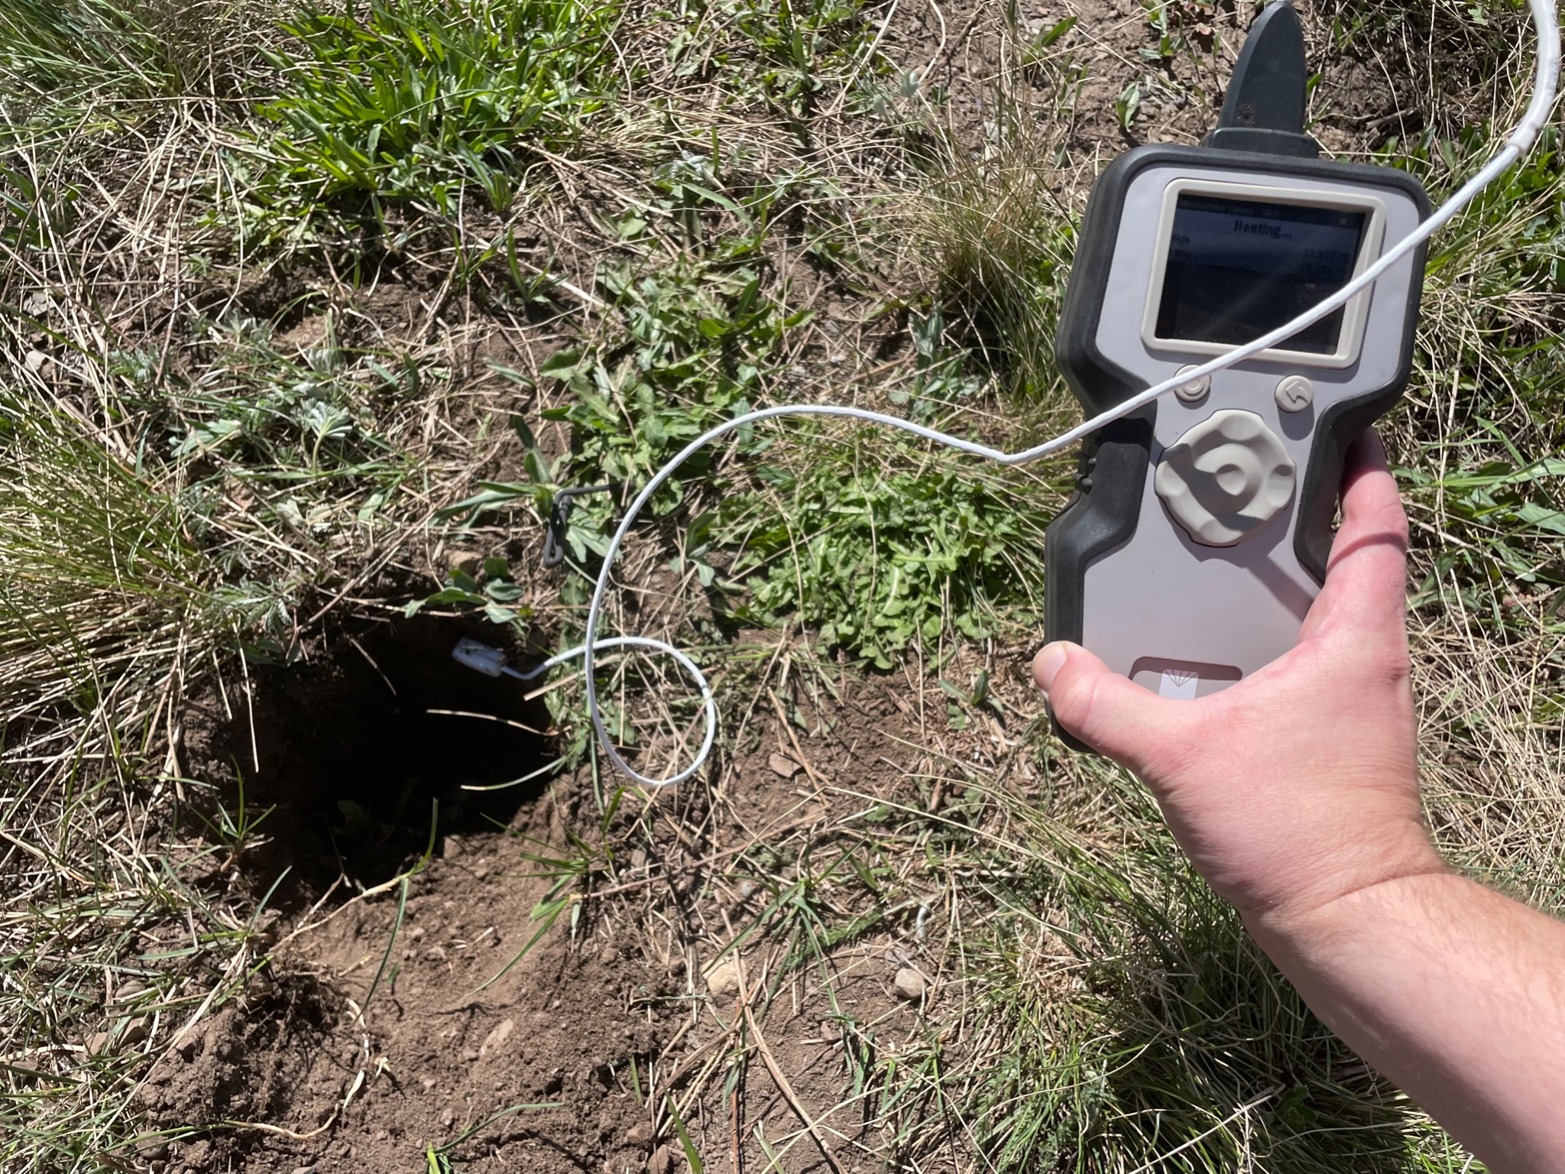
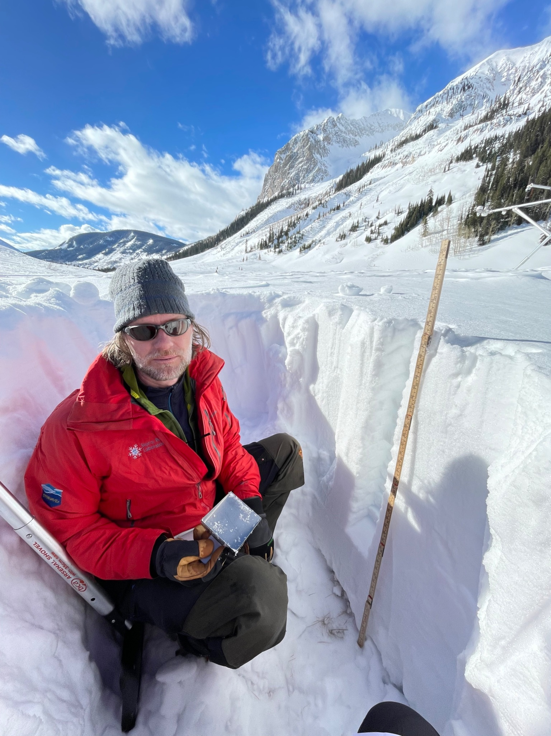
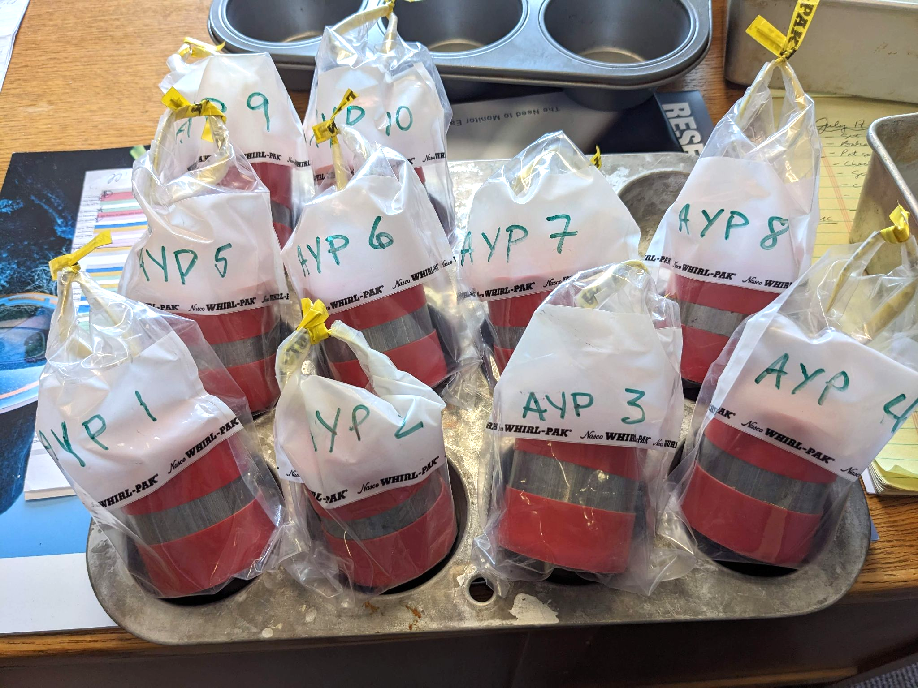
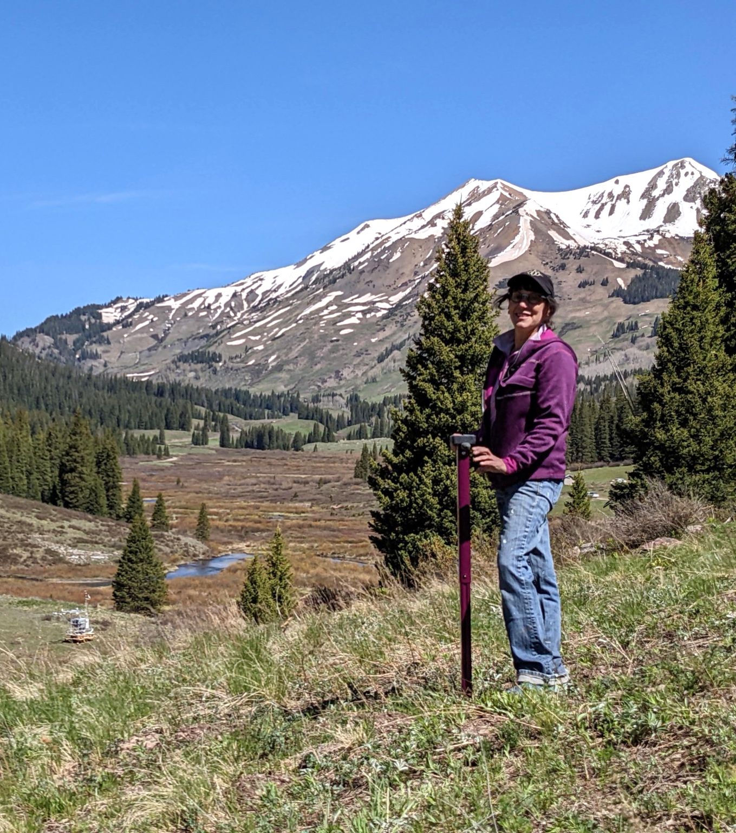
Sfc Observations characterizing soil (KP & AYP areas) & snow (AYP) properties
Soil bulk density
Soil thermal conductivity
Snow density
Near-surface soil moisture
UAS & model validation
Soil texture analysis
Sample ID | Depth | Soil Texture
 |  | Sand | Silt | Clay | Soi Texture
 | in | --------------- % --------------
KEP1 | 2 | 43 | 35 | 22 | Loam
AYP | 2 | 40 | 35 | 25 | Loam
KPA | 2 | 35 | 42 | 22 | Loam
Soil moisture data available through Zenodo
POC’s: Janet.Intrieri@noaa.gov Darren.L.Jackson@noaa.gov

Slide 14
1 November
Session 1: Modeling efforts – Parameterization development, process studies, model evaluation, and more!
- 15:45-15:55: What resolution snow model is needed for accurate streamflow timing and volume simulation? [R. Currier]
- 15:55-16:05: Soil moisture comparison between SPLASH observations and HRRR [D. Jackson]
- 16:05-16:15: Evaluation of Wintertime Precipitation Estimates and Forecasts in the Mountains of Colorado (with a focus on the East River Basin) [K. Mahoney / J. Bytheway]
2 November
Session 3: Precipitation science – radar heads unite!
- 11:00-11:10: Quantitative Precipitation Estimation in SPLASH and SAIL [S. Biswas]
- 11:10-11:20: The role of vertically-pointing Ka-band radar in studies of precipitation processes using SAIL/SPLASH data [S. Matrosov]
Session 5: Lower atmospheric properties and processes – Drainage flows, turbulence, initiation of convection and more!
- 15:15-15:25: Past Observations of Airflow and Precipitation in the Complex Terrain of Western North America: Relevance to SAIL/SPLASH [O. Persson]
- 15:45-15:55: Climatological perspective & multiscale investigation of a major precipitation event in the Upper Colorado River Basin during late December 2021 [B. Moore]
3 November
Session 6: The surface situation – surface properties and energy budget
- 09:10-09:20: UAS-based observations of surface properties during SPLASH [G. de Boer]
- 09:20-09:30: Springtime observations of surface energy & hydrologic variables over ablating snow in CO’s East River Watershed in 2022 & 2023 [C. Cox]
- 09:30-09:40: Characterizing the Annual Surface Energy Balance in Gothic Valley during SPLASH [B. Butterworth]

Slide 15
Chris Cox, Michael Gallagher, Bianca Adler, Gijs de Boer, Jackson Osborn, Benn Schmatz, Dave Costa, Matt Shupe, Jonathan Hamilton, Majiec Stachura, Brian Butterworth, Jake Longenecker, Janet Intrieri, Erik Hulm, Laura Bianco, Jim Wilczak, Ryan Currier, Kelly Mahoney, Mimi Hughes, Darren Jackson, Rob Cifelli, Allen White, Janice Bytheway, Ben Moore, CSU Radar Team, CU UAS Team, Black Swift Technology, ++
Thank you!

